Slide 1
Development Impacts of Digital Enterprises: Some Insights from Indian Start-Ups
M.N. Ravishankar
DIODE workshop, 25th May 2017
Yogyakarta, Indonesia

Slide 2

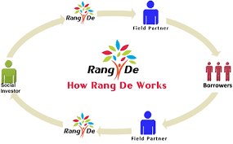
















Three digital start-ups
Social enterprise
Regular enterprise
Jayalaxmi Agrotech
Business model struggles
Rang De
Investor shyness
Blow Horn
Credibility handicap
Development issue
Information asymmetry
Financial exclusion
Unpredictable & unreliable intra-city logistics

Slide 3
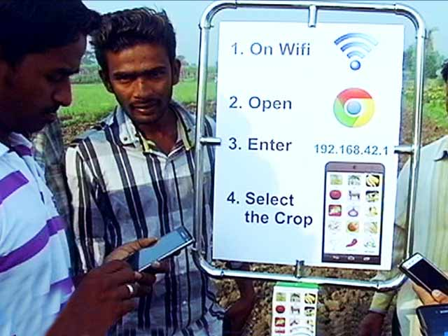









Digital Products: Device, Applications and Platform
Jayalaxmi Agrotech
Agri Apps
Analytics platform
Agri-pole
Crop specific Applications

Slide 4
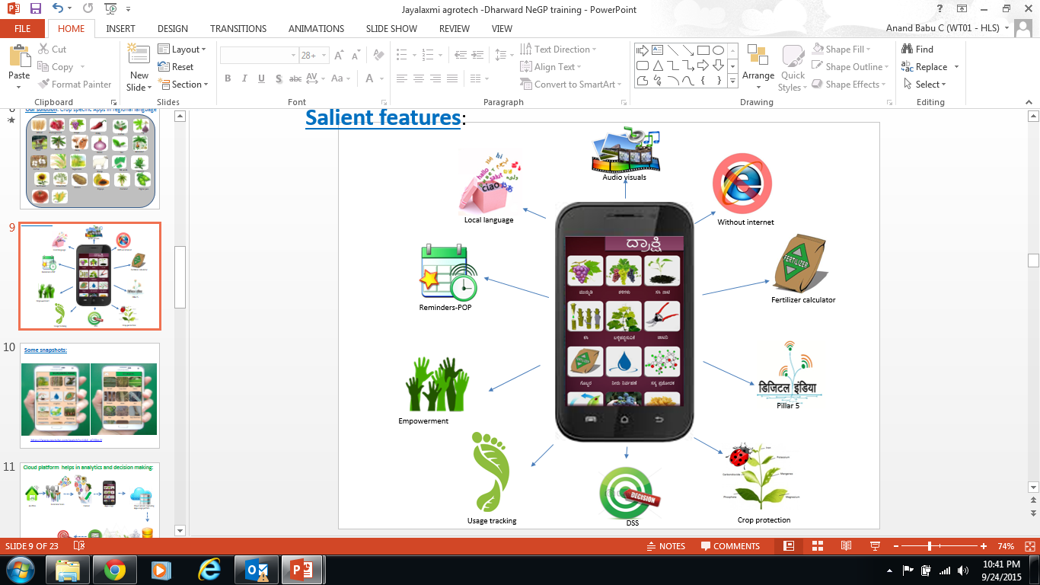
Agri Apps
Light weight apps & works without internet.
Built to “Break the literacy barrier”.
Built with audio visuals support regional language
Provide decision support system for farmers.
Provide pricing analytics & break even analysis
Remind farmer on irrigation, firtigation, spray etc.
Information on verities and their fitment.
End-to-end information on 20 crops.
Guide to use growth hormones, fertilizers and pesticides.
Information on Goat, sheep and diary forming.
Vaccination details for live stock.
Providing details on elements like sunlight, altitude
On demand weather services(Optional).
Crop specific post harvesting technology information.
Farmer-to-Farmer to multiplier effect.

Slide 5

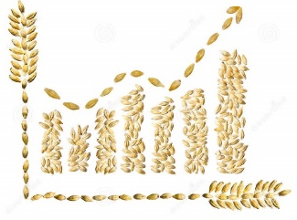


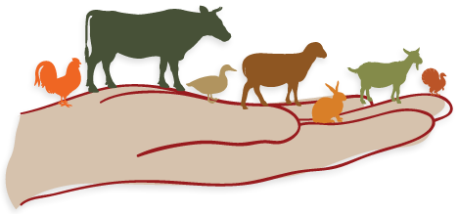

Impact
Reduced input costs by 14% and achieved productivity improvements of 17%
A 46% improvement in farmers’ knowledge and skills
150,000 users
Reduction in overall fertilizer consumption by 50,000 tons
Reduced livestock mortality rates by 6%

Slide 6
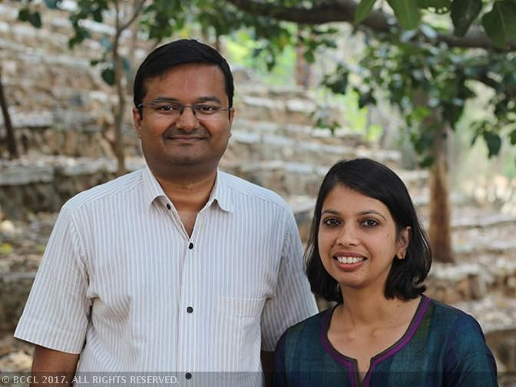
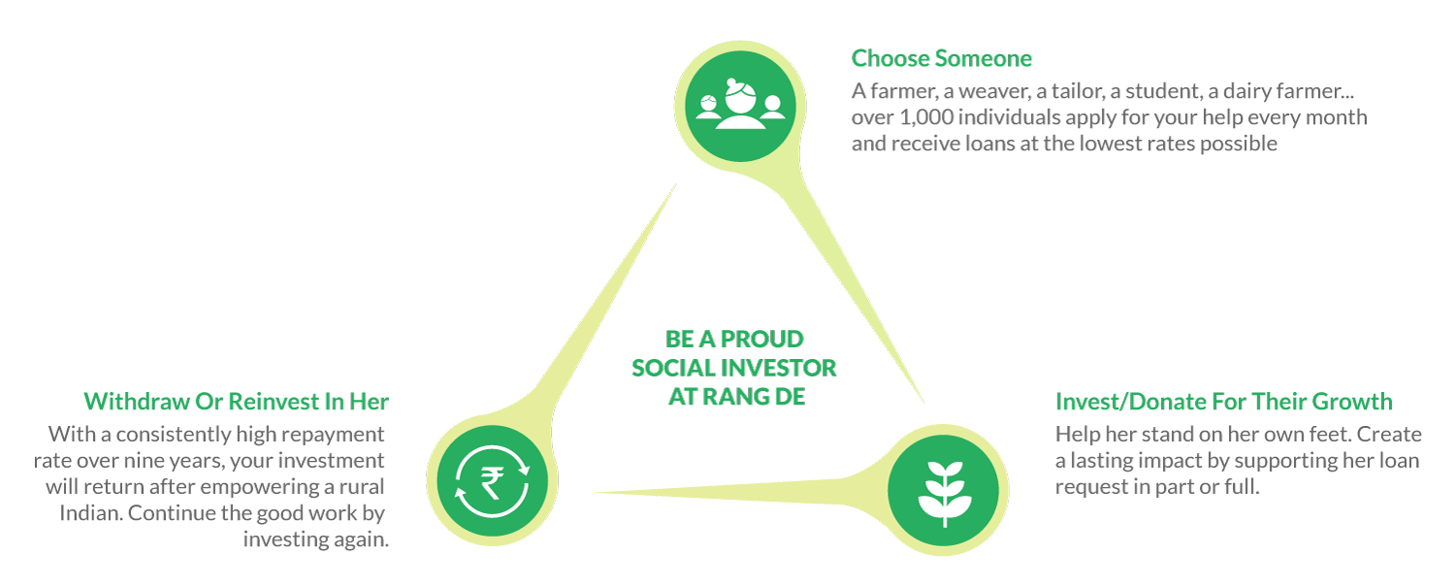
Rang De
Peer-to-peer lending model
Access to low cost microcredit
Individuals lend small sums of money via online portal

Slide 7
Rang De Impact
12508 social investors
57474 loans disbursed
INR 584.4M (£7M): social investments raised
92.96%: repayment rate
18 states
3697 education loans
93.33% women borrowers
9-18%: APR interest rate charged

Slide 8
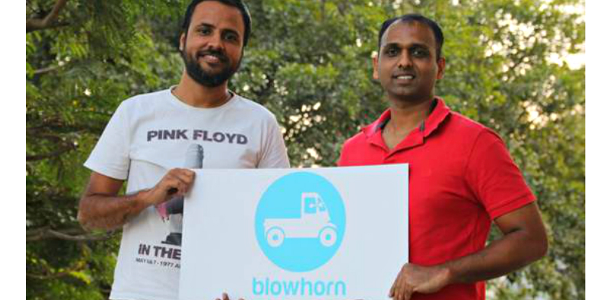
Blowhorn

