Slide 1


Digital Labour in Africa
Jean Paul Van Belle
University of Cape Town

Slide 2

Contents
Digital Labour
Africa
Platforms
Focus on micro-tasking
Proposed research gaps
Relevant references

Slide 3
Initial Problems: What is Digital Labour?
Digital Labour = remunerated Digital Work (valorized)
Crazy wide definition: anything enabled by ICTs (Winn, 2014)
  Includes entire IT & telecoms industry
  But also large proportions of manufacturing & service industry
  Even e.g. rare minerals miners? (what about % of infrastructure building to transport such? Feeder industries? …)
Narrow definition: anything impossible without ICTs
I.e. a continuum / fuzzy boundary concept
Attribute-based definition hides diversity
(“all work that requires electricity”?)
Pragmatic definition for research purposes?
Objective = (economic?) development from the worker perspective?

Slide 4
What is Digital Labour?
Narrow Developmental View DL4D? µ-view?
Tele-work; tele-consulting; callcentres; …
Gig Economy?
Crowdsourcing; (online) outsourcing; impact-sourcing; off-shoring; micro-tasking/work (incl. surveys, labelling, …)
Digital works creation/editing:
  Website | Document (dev / edit / translate / transcribe / capture) | Artwork | film & media …
  Software (design / development / testing)
Other digital services: SEO, marketing,
Wider View
Telecomms / IT / … industries
Everything e-xxx ; m-xxx ; i-xxx
Digital innovation

Slide 5
Digital Labour
To propose a typology (Digital Economy Models?)
Different types based on:
  Nature of the work (see preceding page)
  Channels/mechanism/tech/model used
Different dimensions:
  Degree of valorisation
  % of HH income
  Capabilities or education/expertise level (labelling sheep ⬄ SW dev)
  Granularity (micro-tasks ⬄ single projects)

Slide 6
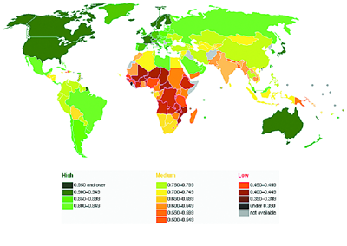
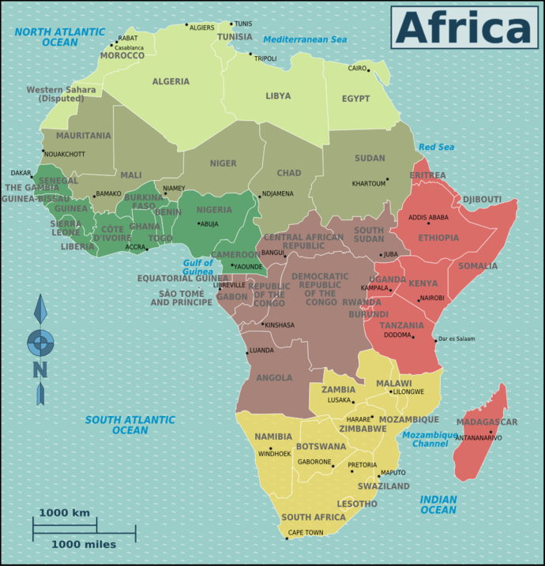
2 Initial Problems: What/Why Africa?
There is more diversity in Africa than in Europe/N-America
54 (49) countries spanning much of the HDI spectrum
Very under-developed statistics capabilities
Possible units of analysis:
  Regional: North | East | West | Central | Southern | Sub-Saharan
  Colonial Language: Francophone | English
  HDI: Middle-income; Lower-Income; Least Developed

Slide 7
Statistics / figures
Highly dependent on ‘definitions’
Available for selected industries
But very unreliable / spotty
Still to be collated (after ‘agreement on definition’)
Likely to be illustrative rather than definitive
Also need examples of typical actors

Slide 8
Generic Barriers/Issues
Awareness
Access:
  Access tools: PC/tablet ⬄ mobile (M=crucial vector)
  Availability, cost, quality, latency of bandwidth
Infrastructure: electricity
Skills/Education issues: shallow IT skills pool
Payment systems
Governance and legal frameworks/constraints

Slide 9
South African platforms
Money4Jam:
  companies have to provide a minimum of 1000 tasks a time.
  “jobbers” are remunerated via M4Jam and MTN Mobile Money. “Jobbers” can earn between R15 and R30 per task + additional R5 for getting more users to sign up.
  All of these jobs can be completed using either a computer or smartphone
  Approximately 87000 users
Refer2Earn:
  users earn money by referring others to insurance-related companies and products.
  for a quote referral, the referrer will get approximately R7.
  If they buy, the referrer can earn anywhere from R16 to R100 (Nkabinde, 2015)

Slide 10
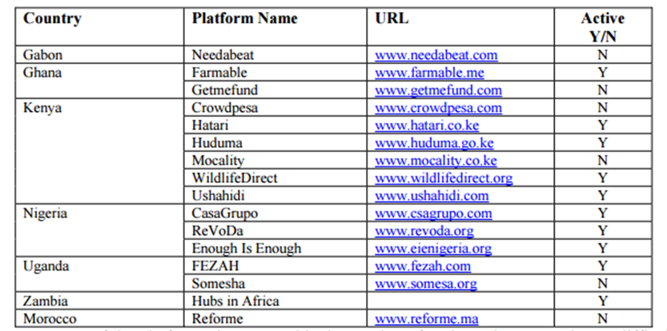
African Crowdsourcing Platforms
(Source: Chuene & Mtsweni, 2015)

Slide 11
Micro-tasking examples
Amazon Mechanical Turk
Samasource does impact sourcing: hire people from the bottom of the work pyramid, provide training and support that helps them to find long-term employment which enables them to earn a decent wage. E.g. $1M in wages to Kenya, South Africa and Uganda
Jana (previously txteagle) pays with airtime when completing tasks via SMS on their mobile devices (Narula & Kulkarni, 2011). Tasks include product promotions, translation, transcription and instant global surveys amongst other tasks.
(Mtsweni & Burge III, 2014).

Slide 12
Micro-Tasking Barriers
Barriers
Access
Bandwidth (quality & cost)
Education levels (⬄ Asia)
Payments
Electricity
Visibility / awareness
(of platforms)
Issues
Demand-supply imbalance
=> lack of bargaining power
=> exploitation (“digital sweatshop”)
Quality Control
Task assignment (& other ‘invisible processes’)
Security (scamming…)
Re-intermediation (front-persons “delegating”
Lack of legislation (enforcement?)

Slide 13
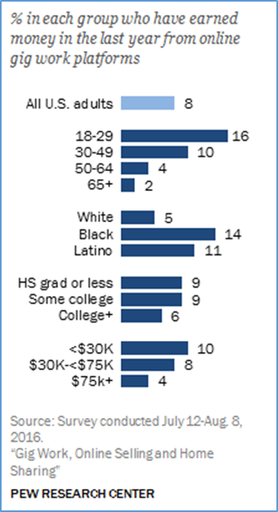
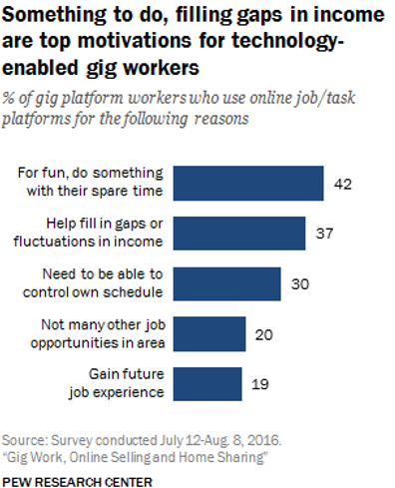
US Research (Pew)

Slide 14
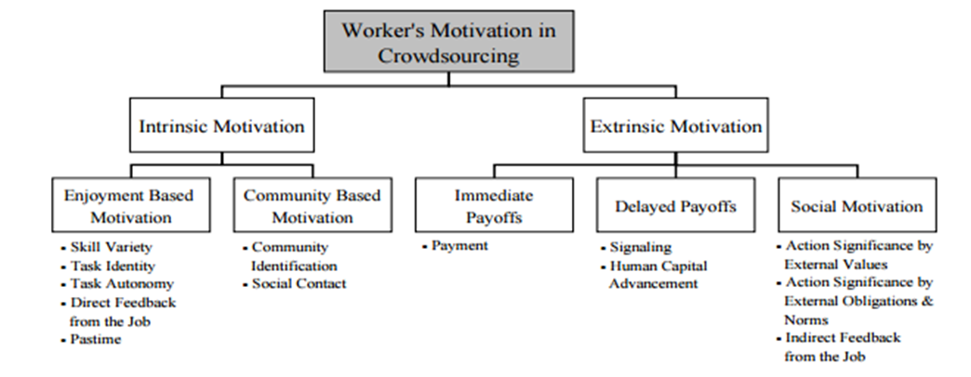
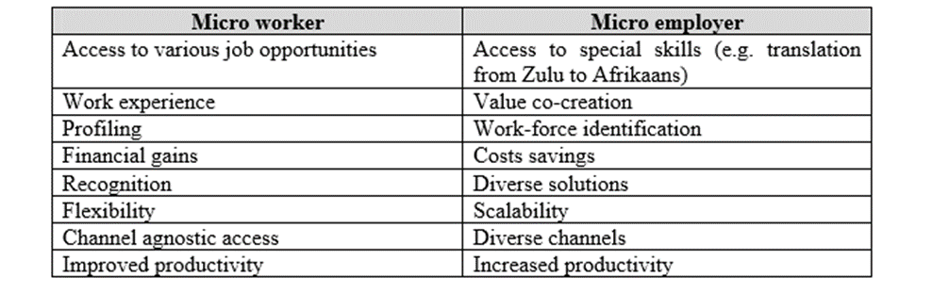
Western Views of Micro-Tasking

Slide 15
Some Research/Knowledge Gaps
Appropriate, operationalizable definitions (conceptual)
  a concept map/taxonomy/network
Reliable data; alternative data sources; proxies; models
(macro – desktop/secondary)
Impact conceptualization & measurement (conceptual)
Attitudes and experiences (micro – field/empirical)
  From digital workers
  From work providers
Generalizations and best practice frameworks (C-inductive)
Theories & models incl. contextualities (C-deductive)
Policy options, impacts, imperatives (macro)
Critical review of literature and platforms (conceptual)
Links with digital innovation (all)

Slide 16

References
Chuene, D., & Mtsweni, J. (2015). The adoption of crowdsourcing platform forms in South Africa. Internation Information Management Corporation (pp. 1-9). Lilongwe.
Graham, M., Hjorth, I., & Lehdonvirta, V. (2017). Digital Labour and Development: Impacts of global digital labour platforms and the gig economy on worker livelihoods. Transfer, 1-28. doi: 10.1177/1024258916687250
Irani, L. (2015). The cultural work of microwork . New media & Society, 17(5), 720-739. doi: 10.1177/1461444813511926
Mtsweni, J., & Burge III, L. (2014). The Potential Benefits of Mobile Microwork Services in Developing nations: Research opportuniteis and challenges. International Information Management Corporation. Le Meridien Ile Maurice.
Narula, P., & Kulkarni, A. (2011). MobileWorks: A Mobile Crowdsourcing Platform for Workers at the Bottom of the Pyramid. Human Computation. San Francisco.
Page, J., & Shimeles, A. (2015). Aid, Employment and Poverty reduction in Africa. African Development Review, 27(S1), 17-30.
Paolacci, G., & Chandler, J. (2014). Inside the Turk: Understanding Mechanical Turk as a Participant Pool. Current Directions in Psychological Science, 23(3), 184-188. doi: 10.1177/0963721414531598
Ramalingam, B. (2016). Can Digital Jobs solve Africa's unemployment crisis. Institute of Developmental Studies.13, 1-4.
Samdaria, N., Mathur, A., & Balakrishnan, R. (2012). Paying in Kind for Crowdsourced Work in Developing Regions. International Conference on Pervasive Computing (pp. 343-360). Berlin, Heidelberg: Springer.

Slide 17
References
Casilli, A. (2016, April). Is there a global digital labor culture? Marginalization of work, global inequalities, and coloniality, communication 2nd symposium of the Project for Advanced Research in Global Communication (PARGC).
Coe, N., & Yeung, H. (2015). Global Production Networks: Theorizing Economic Development in an Interconnected World. Oxford: Oxford University Press.
Deng, X., Joshi, K. D., & Galliers, R. D. (2016). The duality of empowerment and marginalization in microtask crowdsourcing: Giving voice to the less powerful through value sensitive design. Mis Quarterly, 40(2), 279-302.
Fuchs, C. (2013). Theorising and analysing digital labour: From global value chains to modes of production. The Political Economy of Communication, 1(2). 3-27.
Fuchs & Sevignani (2013) What is Digital Labour? What is Digital Work? What’s their Difference? And why do these Questions Matter for Understanding Social Media? tripleC 11(2): 237-293.
Goldman, M., Little, G., & Miller, R. C. (2011, May). Collabode: collaborative coding in the browser. In Proceedings of the 4th international workshop on Cooperative and human aspects of software engineering (pp. 65-68). ACM.
Graham, M., Hjorth, I., & Lehdonvirta, V. (2017). Digital labour and development: impacts of global digital labour platforms and the gig economy on worker livelihoods. Transfer: European Review of Labour and Research , 1-28.

Slide 18
References
Irani, L. (2015). Difference and Dependence among Digital Workers: The Case of Amazon Mechanical Turk. South Atlantic Quarterly, 114(1). 225-234.
Kaplinsky, R. (2000, January 1). Spreading the gains from globalisation: What can be learned from value chain analysis? Institute of Development studies, pp. 1-37.
Kietzmann, J. (2016). Crowdsourcing: A revised definition and introduction to new research. ScienceDirect, 1-3.
Kobayashi, M., Saito, S., Takagi, H., & Watanabe, T. (2014). Skill Development Framework for Micro-Tasking. International Conference on Universal Access in Human-Computer Interaction (pp. 400-409). Springer International Publishing .
Lehdonvirta, V. (2016). Algorithms that Divide and Unite: Delocalisation, Identity and Collective Action in ‘Microwork’. In Villi Lehdonvirta, Space, Place and Global digital work (pp. 53-80). Oxford: Palgrave Macmillan UK.
Nkabinde, S. (2015, September 1). Micro-jobbing: the closest thing to easy money. Retrieved from Money Web: https://www.moneyweb.co.za/mybusiness/micro-jobbing-the-closest-thing-to-easy-money/
Oyedemi, T. (2012). Digital inequalities and implications for social inequalities: A study of Internet penetration amongst university students in South Africa. Telematics and Informatics, 302-313.

Slide 19
References
Saito, S., Watanabe, T., Kobayashe, M., & Tagaki, H. (2014). Skill Development Framework for Micro-Tasking. International Conference on Universal Access in Human-Computer Interaction (pp. 400-409). Cham: Springer.
Scholz, T. (2012). Digital Labour: The internet as a playground and factory. New York: Routledge.
Smith, A. (2016, November 17). Labor platforms: technology-enabled ‘gig work’. Retrieved from www.pewinternet.org: http://www.pewinternet.org/2016/11/17/labor-platforms-technology-enabled-gig-work/
Thies, W., Ratan, A., & Davis, J. (2011, May). Paid crowdsourcing as a vehicle for global development. In CHI Workshop on Crowdsourcing and Human Computation.
Troll, J., & Blohm, I. (2017). How Does the Crowdsourcing Experience Impact. 13th International Conference on Wirtschaftsinformatik (pp. 1036-1050). St Gallen : University of St. Gallen (HSG).
Winn, J. (2014, March 11). Digital labour, academic labour and Karl Marx. Retrieved from josswinn.org: http://josswinn.org/2014/03/11/digital-labour-academic-labour-and-karl-marx/
Zhang, Y. (2017). The Information Economy. In Y. Zhang, Non-Equilibrium Social Science and Policy (pp. 149-158). Fribourg: Springer International Publishing.
To check: Sandeep & Ravishankar 2015 (Impact sourcing?) ; AT Kearney ; …

Slide 20

Questions? Comments?
“He who asks a silly question may be a fool for 5 minutes.
He who does not ask questions will remain a fool for the rest of his life”

Slide 21

Contact Details
Prof Jean-Paul Van Belle
University of Cape Town
Email:
Jean-Paul.VanBelle@uct.ac.za
Thanks to:
Selina Mudavanhu
Zaakirah Roomaney
Brandon Coetzee
Cuthbert Chidoori

Slide 22
Impact Sourcing
AT KEYRNEY: social impact sourcing in BPO industry (growth @ 11% in 2014?)
Sample platforms
  Digital Divide Data
  Samasource
  TechnoBrain
  CloudFactory
  Kudumbashree
  Upwork
  Freelancer
Everest 2016: 6 arguments for business case for impact sourcing
OO development policy interventions:
  NaijaCloud initiative in Nigeria
  (Pakistan: KP Youth Employment Program; Malaysia: eRezeki microwork for B40)

Slide 23
More notes on Impact Sourcing
Preliminary lessons from Pakistan’s PK YEP
Sinking – struggling – surviving – swimming
Free market ⬄ ‘walled gardens’
Mediation effect of institutions
Recommendations
Institutional ecosystem
Policies to protect rights of dig labour
Contextual/marginal groups’ needs analysis

Slide 24
Shirin: Karnataka case
Impact sourcing as inclusion innovation: dev. Impact in rural Karnataka
Rockefeller Foundation claim: “impact sourcing can alleviate poverty & promote inclusive growth”
Uses the 6-level ‘stages’ conceptualization of inclusive innovation (Heeks et al 2014)
NASSSCOM foundation = 35 ISSPs employing ~5000 people
3 centres: RuralShores / Samarthanam Kirana / Simply Grameen
Very little/no evidence of inclusive growth

Slide 25
Kudumbashree Case (Heeks)
Kudumbashree – up to 3000 women (now few hundred)
Digitisation/Data Entry + IT Traiing + PC assembly/maintenance
Used livelihoods framework (using assets pentagon only: 5 ‘capitals’)
Tensions uncovered:
  Incremental but non-transformational impact
  Hybrid operating logic: commercial ⬄ welfare logic (Anne-Claire Pache & Filipe Santos)
    Complete de-coupling: two faces – one to outside, different one for inside
    Selective coupling – logic hybridity of coexistence
    Compromise (here: allowed men e.g. when women had family priorities)
x

