Slide 1


Digitisation, multinational corporations and economic development
Prof Helena Barnard

Slide 2
Outline
What we know about MNCs and economic development
Three development questions raised by digitisation
  The implications of a hierarchy of locations
  The role of clustering
  Firm size in a digital era

Slide 3


MNCs were the result of technological advances

Slide 4

Spillovers as key mechanism for MNC-based upgrading

Slide 5


Intentional spillovers
from MNC to country
Unintentional spillovers from MNC to country

Slide 6

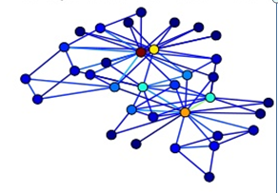

Evolution of MNCs
Miniature replicas
Differentiated network

Slide 7
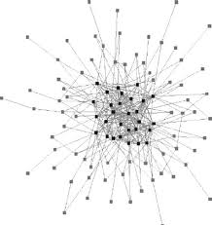
Peripheral countries are most in need of development – and least likely to get an “extended mandate” from the MNC

Slide 8
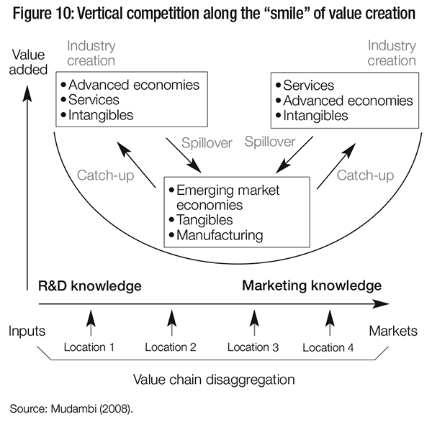
“Smile” of value creation

Slide 9

Locational strength and benefits from MNC entry

Slide 10

Digitisation changes economic activity

Slide 11


Slide 12

Location

Slide 13
How does digitization affect the hierarchy of activities?
High
income
countries
Middle
income
countries
Low
income
countries

Slide 14
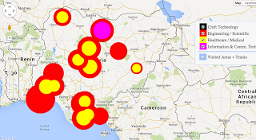
Clusters in a digital age?

Slide 15
Role of producers and users
Producers | High income countries
 | Low income countries
 |  | Low income countries | High income countries
 |  | Users
(Not “winner takes all” type digital enterprises)

Slide 16
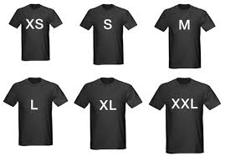
Firm size

Slide 17

How do firms of different sizes engage globally?

