Slide 1

Decent Work and the Digital Gig Economy in Developing Countries
Richard Heeks
Centre for Development Informatics, University of Manchester, UK
DIODE Workshop, Oxford, UK
9-10 October 2017
Centre for Development Informatics

Slide 2
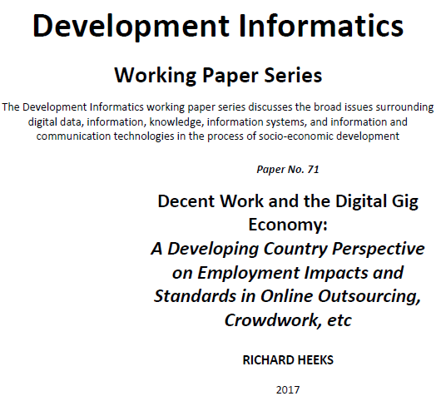
Online Working Paper
Centre for Development Informatics

Slide 3
Scope of the Gig Economy
Gig Economy
Digital Gig Economy
Online Outsourcing -> Online Labour
Physical Gig Economy
Location-Based Service Delivery
Microwork
Online Freelancing
Crowd Work
Contest-Based
Centre for Development Informatics

Slide 4
Justifying Intervention
√
Immanent Development
Global North DGE Workers
?
Global South DGE Workers
Longitudinal Impacts
X
?
Centre for Development Informatics

Slide 5
Immanent Impacts
Drivers
Trends
Patterns
Outcomes
Casualisation
Uncertainty
Marketisation
Volatility
Chronic Precarity
Globalisation
Insecurity
Competitive Logic
Digitisation
Value Asymmetry
Technical Innovation
Virtualisation
Risk Asymmetry
Automation
Resource Asymmetry
Structural Inequality
Standardisation
Information Asymmetry
Fragmentation
Power Asymmetry
Centre for Development Informatics

Slide 6
Inductive: ILO Decent Work
Employment Context
- Work That Should be Abolished
- Social Security
- Social Dialogue, Employers’ and Workers’ Representation
- Economic and Social Context for Decent Work
Employment
- Employment Opportunities
- Combining Work, Family and Personal Life
- Stability and Security of Work
- Equal Opportunity and Treatment in Employment
(- Dignity and Respect at Work)
Work Conditions
- Adequate Earnings and Productive Work
- Decent Working Time
- Safe Work Environment
Centre for Development Informatics

Slide 7
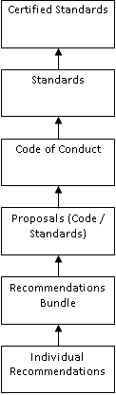
Inductive: Literature and Action
Centre for Development Informatics

Slide 8
Decent Digital Work Standards
 | Code Components / Standards
Employment Context
Social Security | Provision of annual, sick and maternity leave Provision of unemployment, disability and health insurance Provision of liability insurance Provision of pension contributions Portable benefits Shared contributions from workers, platforms and clients including taxation
Social Dialogue, Employers’ and Workers’ Representation | Right to organise and negotiate collective agreements Legal changes where collective negotiation is prevented for independent contractors Enable (collective) communication between workers
Economic and Social Context for Decent Work | Compliance with all relevant national laws in worker jurisdiction Client responsibility for digital supply chain Access for policy-makers to anonymised transactional platform data
Employment
Employment Opportunities | Opportunity to access digital gig economy work Provision of training opportunities Worker-accessible, portable work history and reputation profiles
Stability and Security of Work | Combination of stability and flexibility Clarification / recategorisation / development of new / flexibility to choose employment status
Equal Opportunity and Treatment in Employment | No discrimination Data protection and privacy for both clients and workers
Dignity and Respect at Work | Respectful and prompt communications between clients, platform and workers Clear rules for work rejection and re-work, worker deactivation, worker ratings, and worker ‘levelling-up’ Human review of worker complaints Neutral third-party dispute resolution mechanism
Work Conditions
Adequate Earnings and Productive Work | At least minimum wage paid taking unpaid time and other costs into account Clear information and communication about tasks Clear information about payment including schedule and conditions and non-payment General-terms details about client identity and task purpose Rating system for both clients and workers
Decent Working Time | Compliance with national working time directives and with ILO guidelines
Safe Work Environment | Ensure potentially psychologically unsafe tasks are signalled, and support provided
Centre for Development Informatics

Slide 9



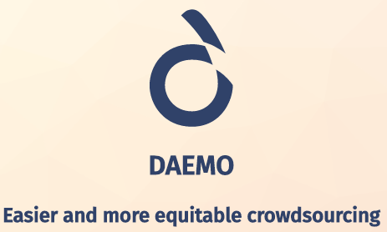
Decent Digital Work Innovations
Centre for Development Informatics
Image sources: http://theconversation.com/explainer-what-is-the-robin-hood-or-tobin-tax-48335; http://photobucket.com/images/donate%20button; https://creativecommons.org/2017/01/24/platform-cooperatives-movement-helps-light-commons/; https://www.daemo.org/home

Slide 10
Using Decent Digital Work Standards
 | Code Components / Standards | Uganda Focus Group Recommendations
Employment Context
Social Security | **Portable benefits
Social Dialogue, Employers’ and Workers’ Representation | **Enable (collective) communication between workers
Economic and Social Context for Decent Work | **Compliance with all relevant national laws in worker jurisdiction **Client responsibility for digital supply chain **Access for policy-makers to anonymised transactional platform data | **Ceiling for platform / intermediation fees
Employment
Employment Opportunities | **Worker-accessible, portable work history and reputation profiles | **Fund power/comms needed for work
Stability and Security of Work |  | **Create low-cost, understandable, locally-appropriate, enforceable contract
Equal Opportunity and Treatment in Employment | **No discrimination **Data protection and privacy for both clients and workers
Work Conditions
Decent Working Time | **Compliance with national working time directives and with ILO guidelines
Safe Work Environment | **Ensure potentially psychologically unsafe tasks are signalled, and support provided
Centre for Development Informatics

Slide 11






Using Existing Standards in the Gig Economy?
Centre for Development Informatics
Image sources: https://www.globalreporting.org/information/about-gri/alliances-and-synergies/Pages/United-Nations-Global-Compact.aspx; https://www.linkedin.com/pulse/moving-forward-iso-26000-benoit-froment; https://www.globalreporting.org/standards/; http://bimpactassessment.net/bcorporation; http://gisc.bsr.org/; http://www.ukaccreditation.co.uk/sa-8000.html

Slide 12

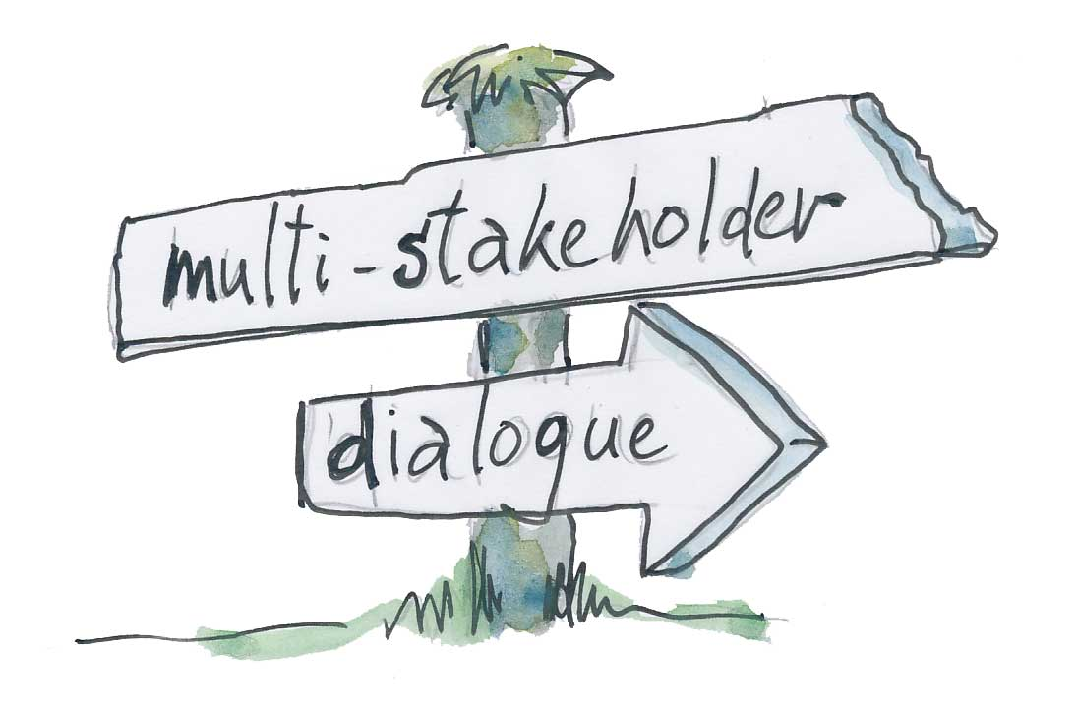


Decent Digital Work: Next Steps
Centre for Development Informatics
Image sources: http://www.differencebetween.info/difference-between-opinion-poll-and-exit-poll; http://www.bumble.dk/multi-stakeholder-dialogue/; http://holyguardianangelsfl.org/outreach/; https://www.auroville.org/categories/24

