Slide 1
Where are online workers located?
The international division of digital gig work
Vili Lehdonvirta & Otto Kässi
Oxford Internet Institute
@ViliLe
vili.lehdonvirta@oii.ox.ac.uk
Notes:
transaction platforms, not media platforms

Slide 2
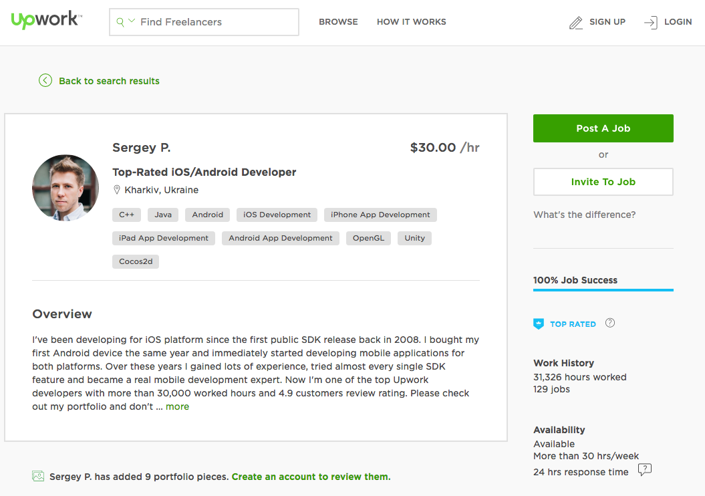
Notes:
3 billion Internet users
Global online outsourcing platforms connect tens of millions clients and workers
World bank estimates: value of projects traded via outsourcing platforms
I 2015 $4.8 billion
I .. by 2020 $15-25 billion
reputation system + online dispute resolution

Slide 3

Notes:
Accounting, financial planning, project management
Customer service, data entry, tech support
Animation, architecture, logo design, voice acting
Data science, game development, website Q&A
Copywriting, translation
new earning opportunities, but also erode labour protections
alleviate local labour shortages, but also generate demand for new skills and training
contribute to the temporal flexibility of work, but also to the unpredictability of working life
further undermine social policies based on binary notions of employment and unemployment, breadwinners and dependant
Yet the real scale and scope of these implications is hard to assess, because conventional labour market statistics and economic indicators are ill-suited
definitional issues: ILO: employment = anyone gainfully employed for at least one hour in a week or a day
measurement issues: tax underreporting
even when reported, not distinguished from contingent income earnt from the conventional labour market

Slide 4
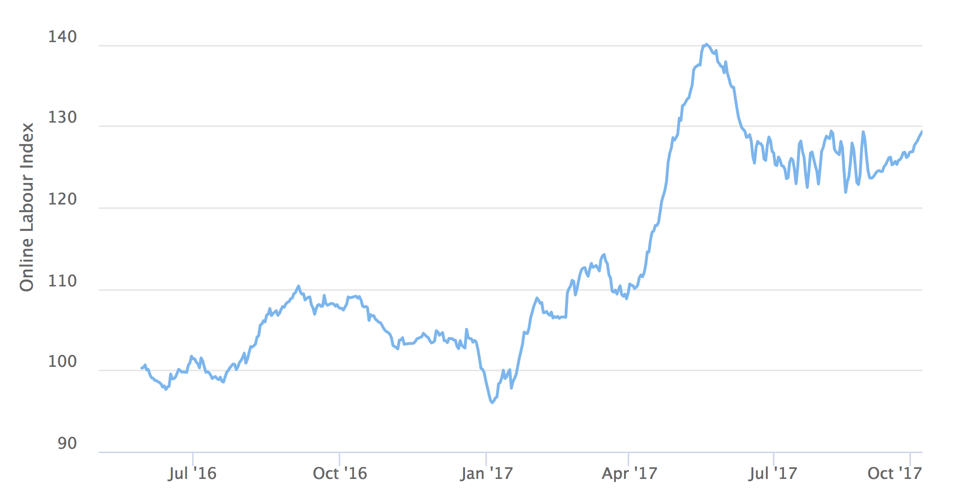
Online gig economy grew 26% over the past 12 months
Notes:
It’s not all hype
Uber is the biggest labour platform by revenue
Ebay and iTunes App Store likewise very significant
large market share

Slide 5
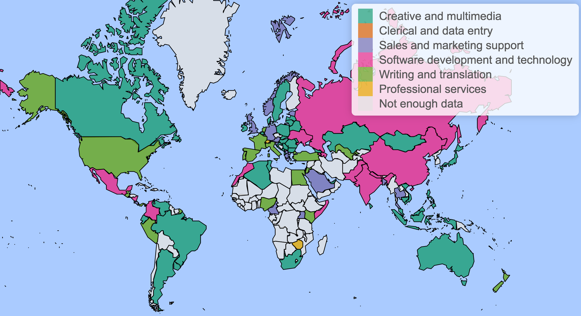

Slide 6
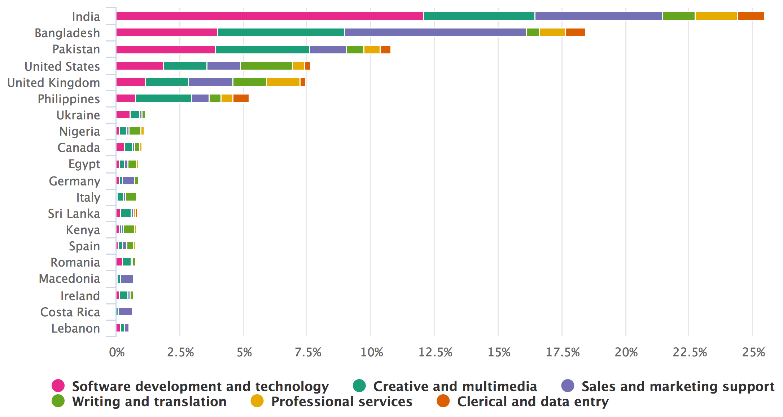
Online worker countries top 20 (OLI Worker Supplement, 2-8 Oct 2017)
Notes:
It’s not all hype
Uber is the biggest labour platform by revenue
Ebay and iTunes App Store likewise very significant
large market share

Slide 7
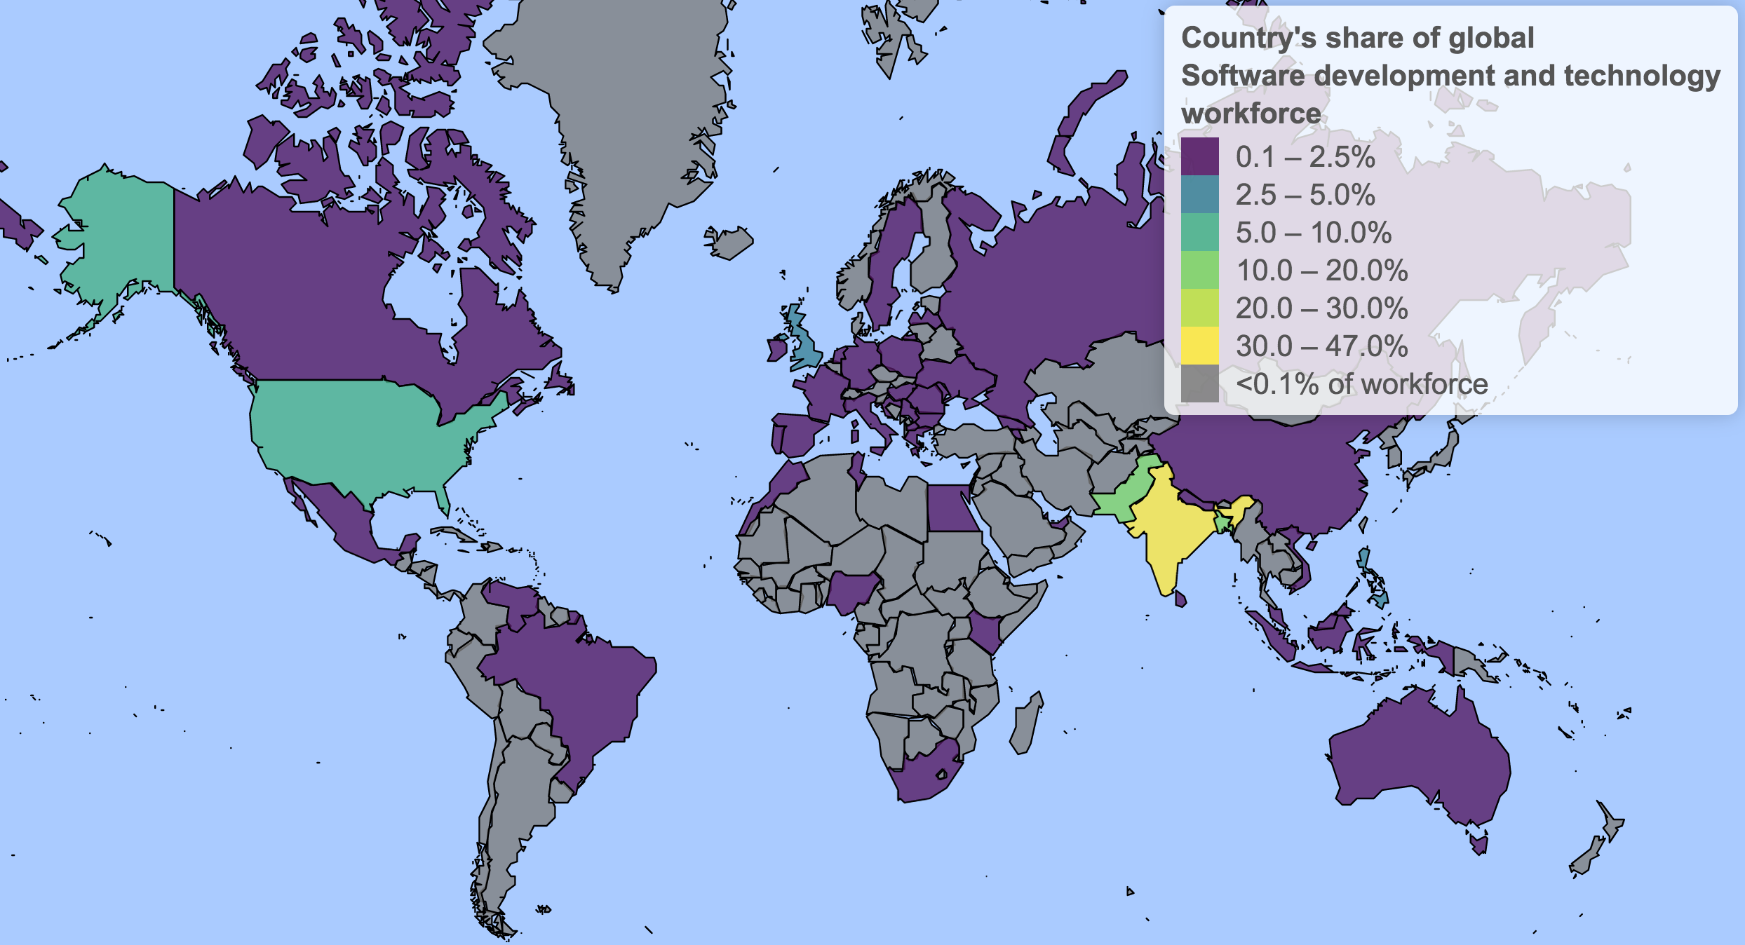

Slide 8
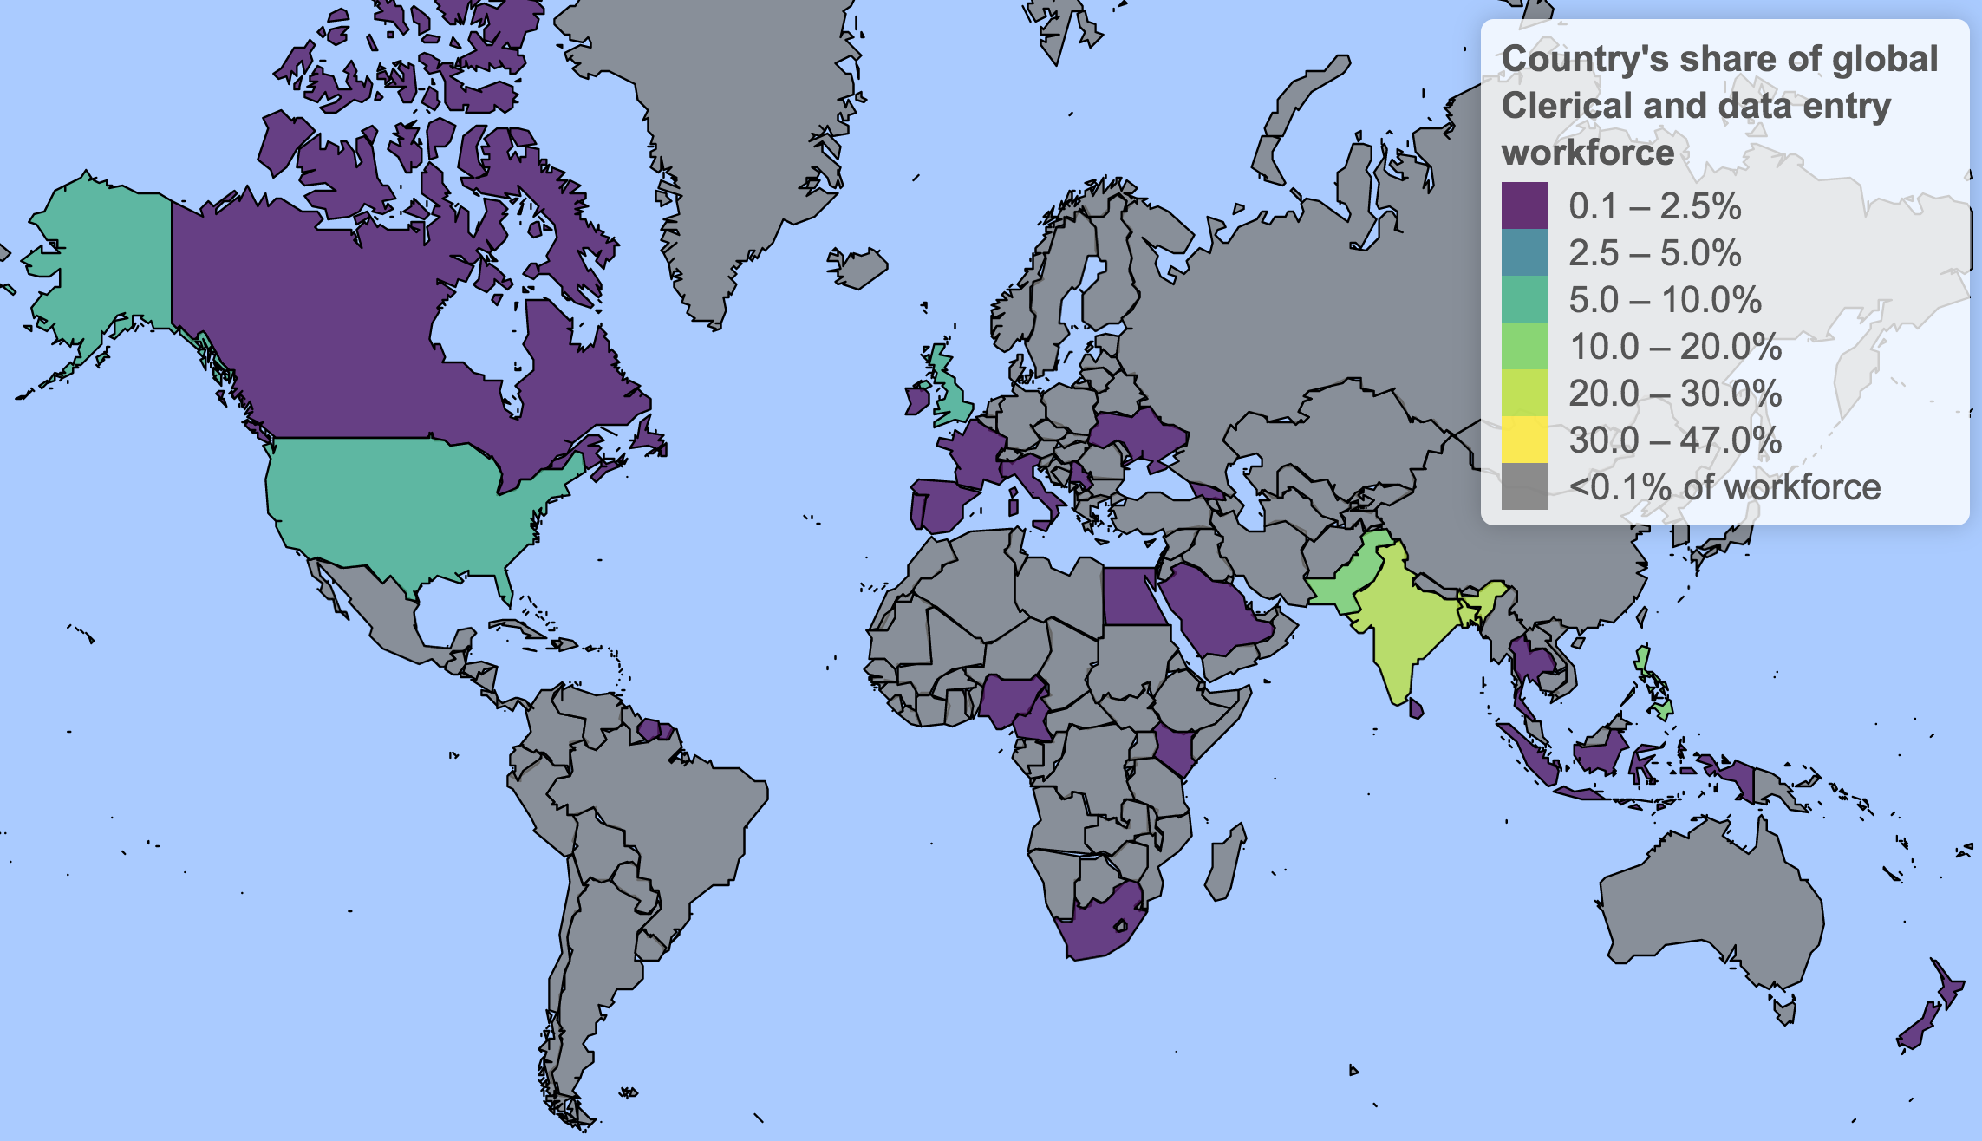

Slide 9
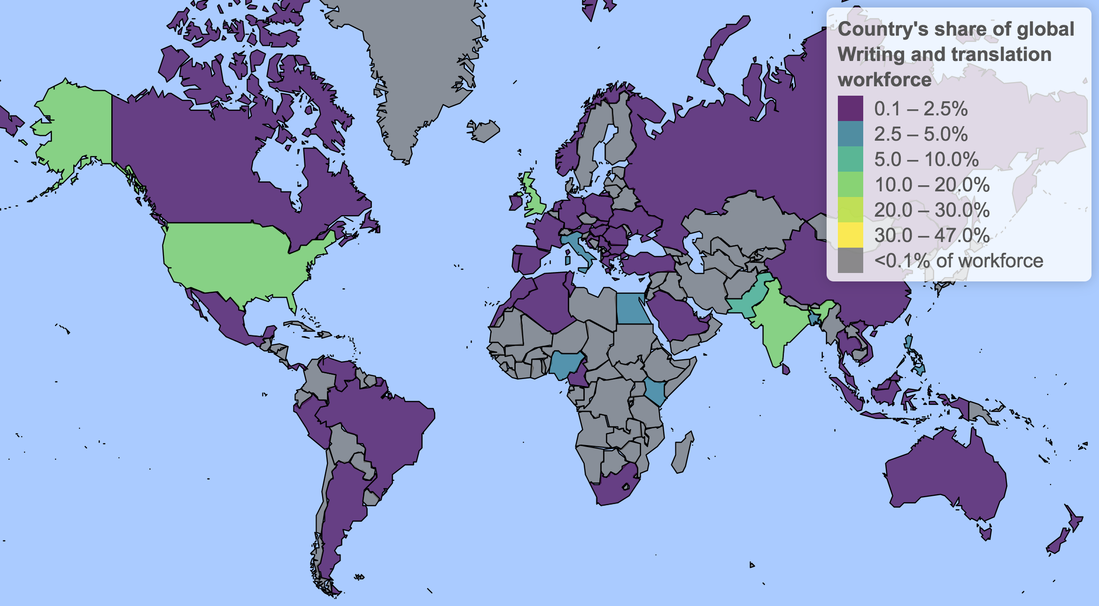

Slide 10
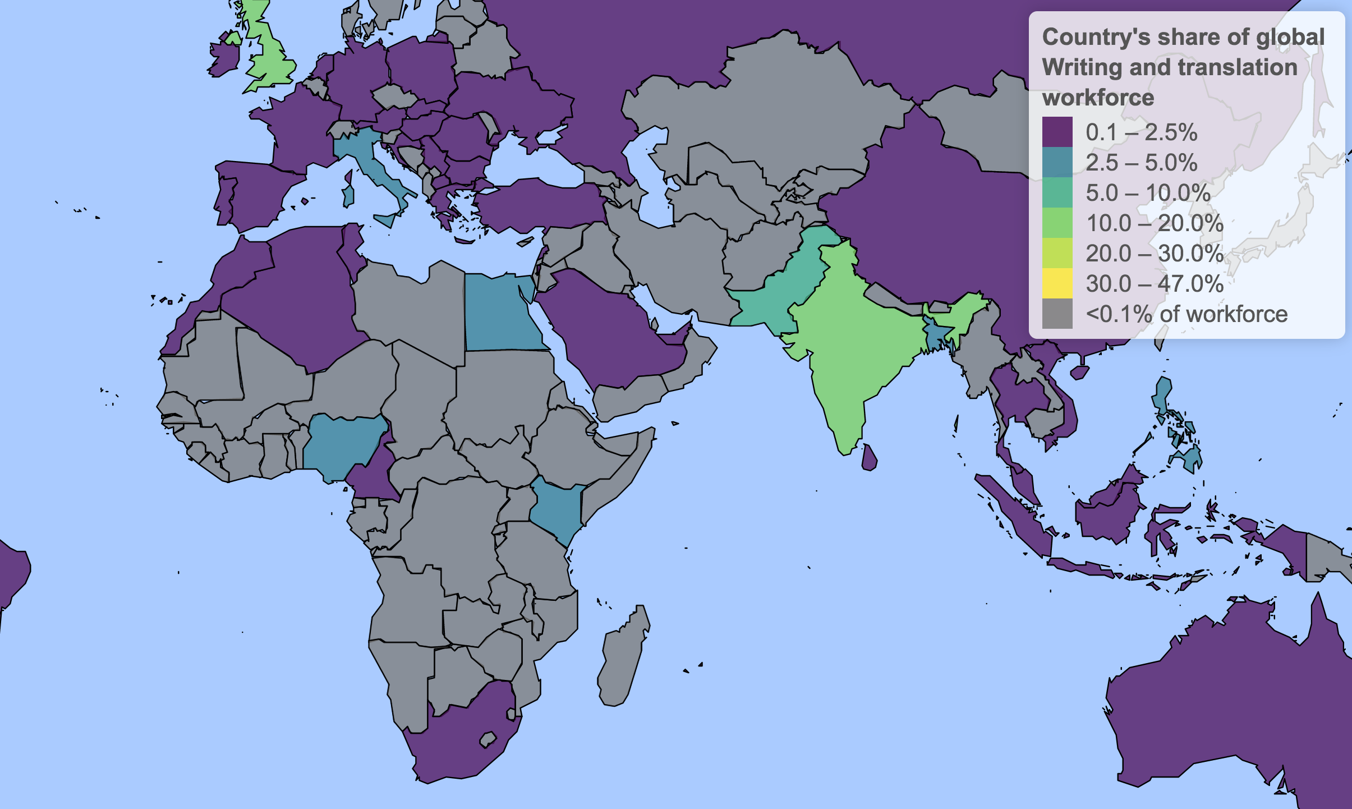

Slide 11
Conclusions
Online gig work still small but growing rapidly
Associated with established IT outsourcing destinations
  Complement rather than substitute to formal IT sector?
But different countries bring different skills to the market
  Writing work (blogging, SEO, ecommerce) in anglophone Africa
ilabour.oii.ox.ac.uk/online-labour-index/

