Slide 1
Can Digital-age work in the Global South move beyond exploitative arrangements?
M.N. Ravishankar & Andrei Gurca
DIODE workshop, 9th October 2017

Slide 2
CloudFactory
uses technology to make it easy for companies to outsource routine, back-office work.
provides a distributed workforce based in Kathmandu and Nairobi who perform micro-tasks on either CloudFactory or client platforms.
a more efficient and conscientious alternative to crowdsourcing? – “talent is equally distributed around the world, but opportunity is not”.
goal to provide “digital-age work” to one million people in developing countries.
a responsible intermediary, guaranteeing quality output for customers and timely payment for workers.

Slide 3
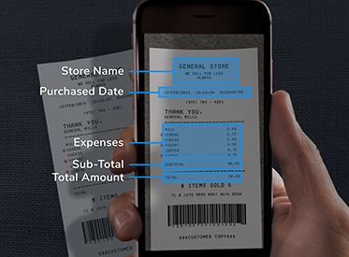

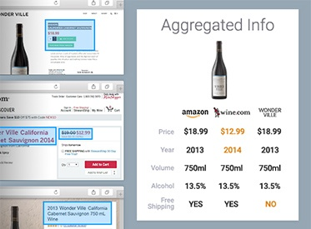
What they do
    Transcriptions and data digitization of documents (e.g., receipts, invoices, medical records and insurance claims)
    Data gathering, cleaning and aggregating

Slide 4
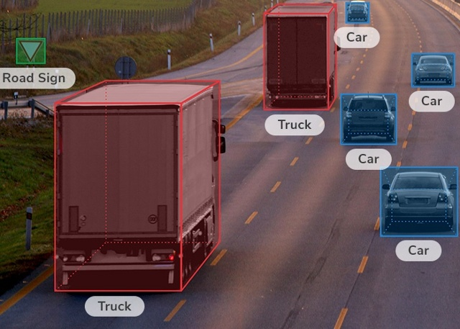

What they do
    Preparing datasets for autonomous driving, computer vision (e.g., face detection, facial recognition and optical character recognition), geospatial mapping, augmented reality, and other AI systems (e.g., ChatBot and virtual assistant training)

Slide 5
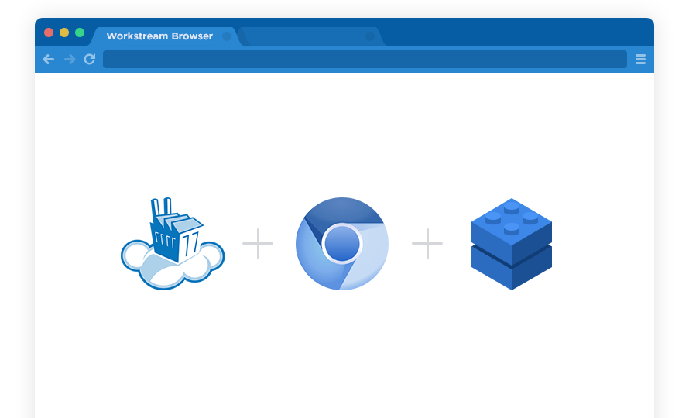
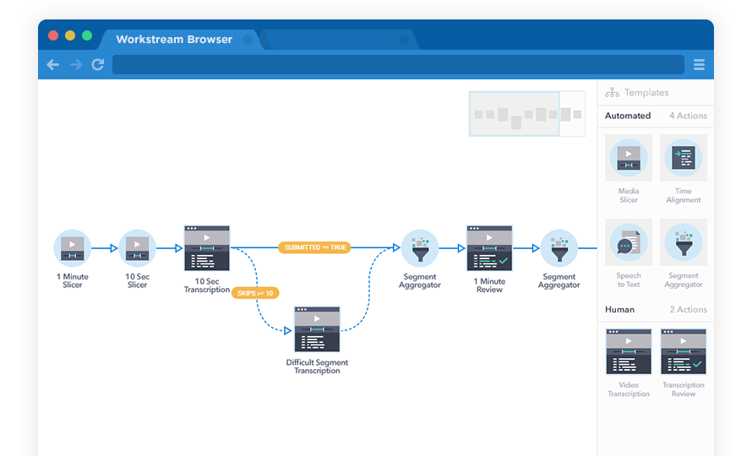
How they do it
WorkStream Browser is a unified workspace for CloudFactory teams
a secured environment to access all work done by CloudFactory teams
Work flows via API to a custom-built production line, then it is broken down for hyper-efficiency and then allocated to CloudFactory teams

Slide 6
How they do it
The vast majority of “cloud workers” are university students looking for part-time work.
Assessments, training and visibility: tests at the recruitment stage; team-based recruitment;
Assignment based on worker availability, skills, prior performance and reputation.
Uses a combination of controls:
      algorithm-based controls
      direct supervision
      peer monitoring

Slide 7
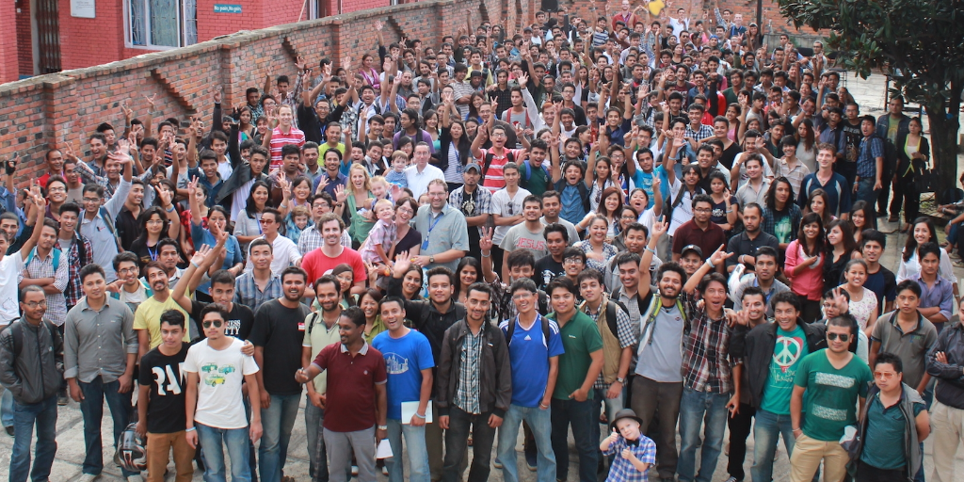
CloudFactory

Slide 8
How they do it
Algorithm-based controls:
Randomly inserts non-paid “gold standard” tasks (i.e., tasks for which the company already knows the answer/solution) into a set of paid tasks.
The reputation score of workers diminishes with every wrong answer for a “gold standard” task. The workers then have to perform several “gold standard” tasks correctly to compensate for a mistake on a “gold standard” task.
A worker with a relatively low reputation score will receive a “gold standard” for every 4 paid tasks, a worker with a good reputation will receive a “gold standard” for every 9 paid tasks, while a worker with an excellent reputation will receive a “gold standard” for every 14 paid tasks.
Notes:
control tasks randomly assigned among paid tasks. [The company randomly assigns non-paid “gold standard” tasks (i.e., tasks for which the company already knows the answer/solution) among the typical, paid tasks. The reputation score of workers diminishes with every wrong answer for a “gold standard” task. The workers then have to perform correctly several “gold standard” tasks to compensate for a single mistake on a “gold standard” task. The reputation score is important when work is assigned and for the frequency with which “gold standard” tasks are assigned. For example, a worker with a relatively low reputation score will receive a “gold standard” for every 4 paid tasks, a worker with a good reputation will receive a “gold standard” for every 9 paid tasks, while a worker with excellent reputation will receive a “gold standard” for every 14 paid tasks. N.B. MTurk uses somewhat similar controls.]
controls based on the average time required to perform a task [Assume the average time required to perform a specific task was 10 secs. If a worker took less than 5 secs to perform the task, then the company would suspect that the worker is trying to cheat the system and would send the task to a full-time reviewer for verification. If a worker would take more than 20 secs to perform a task, then the company would assume the worker was confused/unsure and would send the task to a reviewer.]
controls based on the number of characters required to perform a task correctly [The company took a census-related project which involved extracting names and surnames for hand-written documents. If the workers would input less than 3 and more than 15 characters, then the task would automatically be send for review];

Slide 9
How they do it
Algorithm-based controls:
Assume the average time required to perform a specific task was 10 secs. If a worker takes less than 5 secs to perform the task, suspect cheating, and send the task to a reviewer for verification. If a worker takes more than 20 secs to perform a task, assume confusion, and send the task to a reviewer.
Controls based on the number of characters required to perform a task correctly : a census project - extracting names and surnames from hand-written documents. If the workers input less than 3 and more than 15 characters, send the task to a reviewer.
Notes:
control tasks randomly assigned among paid tasks. [The company randomly assigns non-paid “gold standard” tasks (i.e., tasks for which the company already knows the answer/solution) among the typical, paid tasks. The reputation score of workers diminishes with every wrong answer for a “gold standard” task. The workers then have to perform correctly several “gold standard” tasks to compensate for a single mistake on a “gold standard” task. The reputation score is important when work is assigned and for the frequency with which “gold standard” tasks are assigned. For example, a worker with a relatively low reputation score will receive a “gold standard” for every 4 paid tasks, a worker with a good reputation will receive a “gold standard” for every 9 paid tasks, while a worker with excellent reputation will receive a “gold standard” for every 14 paid tasks. N.B. MTurk uses somewhat similar controls.]
controls based on the average time required to perform a task [Assume the average time required to perform a specific task was 10 secs. If a worker took less than 5 secs to perform the task, then the company would suspect that the worker is trying to cheat the system and would send the task to a full-time reviewer for verification. If a worker would take more than 20 secs to perform a task, then the company would assume the worker was confused/unsure and would send the task to a reviewer.]
controls based on the number of characters required to perform a task correctly [The company took a census-related project which involved extracting names and surnames for hand-written documents. If the workers would input less than 3 and more than 15 characters, then the task would automatically be send for review];

Slide 10
CloudFactory
Clear, explicit contracts
Social mission
Digital Platform
Clients
Workers
Strategies to improve efficiency and quality:
crowd with a face;
micro-tasking;
virtual production lines;
monitoring

Slide 11
Impact
In Nepal, over 2000 cloud workers and 300 full-time staff; 250 in Kenya.
CloudFactory is one of the very few providers of meaningful part-time work in Nepal.
Cloud workers earn, on average, $40 per month. Some earn over $160 per month.
An entry-level position for a graduate in the Kathmandu banking sector earns between $150 and $200 per month.

Slide 12
Impact
Impact | Alternatives
Meaningful, well-paid employment: computer engineering and project management | Insufficient full-time job opportunities in Nepal
 | Low-skill jobs in the Middle East; risk of being exploited is very high
 | Full-time low-skill, low-pay jobs in tourism, agriculture and retailing
Meaningful digital work for students | No job before graduation with high financial pressures on family
 | Giving up studies?
 | Work on other micro-tasking platforms with lower rates and high risk of being denied payment?

Slide 13
Impact
Provides training sessions (e.g., spread sheet processing, public speaking and professional communication).
Encourages workers to leave and pursue other opportunities (e.g., better paid work, entrepreneurship, and further studies) once they graduate and/or acquire new skills.
Average tenure: 2-4 years
Community service projects

Slide 14
Challenges
Reduction in productivity - transitions from team-based recruitment to hiring on an individual basis.
      Recent investments - Dolma Impact Fund; The Social Entrepreneurs Fund.
Risk of mission drift:
      Following a period of fast growth, the frequency of community service projects has reduced.
      With new investors social mission may be compromised in favour of commercial goals.

Slide 15

CloudFactory Impact

Slide 16
Impact
  Field view versus book view
  Distinguish between the heuristic value of an idea and its truth value
  Evidence-based decision making or Decision-based evidence making

Slide 17
CloudFactory – Compassionate solutions (2)
The company organizes worker-lead “community service projects” aiming to provide sustainable solutions for various community problems:
      organising a vegetable market where local farmers could sell their produce;
      helping and training a beggar old lady to manufacture and sell scented candles;
      installing garbage bins in one neighborhood and conducting a door-to-door anti-littering campaign;
      mobilizing community members to regularly clean rain-gutters in the neighborhood

Slide 18
CloudFactory – Implementation (3)
Peer monitoring:
due to the team-based organisation, workers engage in various types of peer-monitoring such as (1) noticing each other’s behavior, (2) praising exceptional performance, (3) discussing issues or challenges in the group, (4) correcting problematic behavior, (5) reporting difficult situations to superiors, (6) gossiping about team members in their absence, and (7) avoiding poor performing team members (see Loughry & Tosi, 2008)
Notes:
control tasks randomly assigned among paid tasks. [The company randomly assigns non-paid “gold standard” tasks (i.e., tasks for which the company already knows the answer/solution) among the typical, paid tasks. The reputation score of workers diminishes with every wrong answer for a “gold standard” task. The workers then have to perform correctly several “gold standard” tasks to compensate for a single mistake on a “gold standard” task. The reputation score is important when work is assigned and for the frequency with which “gold standard” tasks are assigned. For example, a worker with a relatively low reputation score will receive a “gold standard” for every 4 paid tasks, a worker with a good reputation will receive a “gold standard” for every 9 paid tasks, while a worker with excellent reputation will receive a “gold standard” for every 14 paid tasks. N.B. MTurk uses somewhat similar controls.]
controls based on the average time required to perform a task [Assume the average time required to perform a specific task was 10 secs. If a worker took less than 5 secs to perform the task, then the company would suspect that the worker is trying to cheat the system and would send the task to a full-time reviewer for verification. If a worker would take more than 20 secs to perform a task, then the company would assume the worker was confused/unsure and would send the task to a reviewer.]
controls based on the number of characters required to perform a task correctly [The company took a census-related project which involved extracting names and surnames for hand-written documents. If the workers would input less than 3 and more than 15 characters, then the task would automatically be send for review];

Slide 19
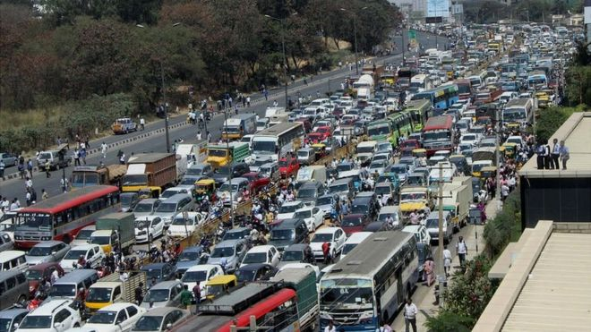

Looking for ‘development’ in digital economies?
  India model of ‘development’ or China model of ‘development’
  Source: www.bbc.co.uk Source: www.fireelf.com

Slide 20
Looking for ‘development’ in digital economies?
  Direct beneficiaries versus trickle-down effects (beneficiaries)
  Source: www.cloudfactory.com

