Slide 1
Framework to analyze prizes
A game changer in financing the digital education economy
Payal Arora
Associatie Professor in Media & Communication, Erasmus University Rotterdam
Founder and Executive Director of Catalyst Lab
@3lmantra

Slide 2


Why prizes?
Obsession with innovation
Natural choice- market-oriented, competitive & result driven
Historical legacy of prizes - renewal
@3lmantra
Notes:
The Renaissance of Prizes: There is a need to talk about a renewed rather than new interest in prizes because their use dates back hundreds of years. Successful and frequently cited case studies of historical prizebased innovations include the Longitude Prize (1714), Napoleon Bonaparte’s (1800) food preservation prize, and the Orteig Prize

Slide 3
Doblin Framework
Resources Sponsorships Partnerships
2. Structure Types of Prizes Eligibility Criteria Scope Types of ICT Projects Phases Intellectual Property Rights
3. Motivators Monetary Incentives Non-monetary Incentives
4. Communications Marketing
5. Evaluation Measuring Impact Long-term Sustainability
@3lmantra

Slide 4

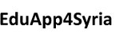
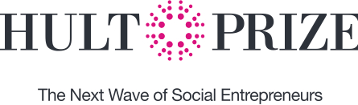





@3lmantra
Notes:
21 prizes in total analysed and 15 interviews of leaders in the field

Slide 5
1. Resources
Sponsorship
Corporate philanthropist funding –commercial agenda (CSR -core business, long term issue)
Private sector not as closely scrutinized
Partnerships
Non funder corporate partnerships for knowledge, expertise & networks
EduApp4Syria director: “The commercial companies are more used to thinking about demand so their expertise is totally needed to see what the end user gets out of these ICT education products”
InnoCentive crowdsourcing platform – digital labor exploitation
Dearth of partnerships with beneficiary countries governments –sustainability issue
@3lmantra

Slide 6
2. Structure
Type of prizes
Incentive and recognition prizes-(97% recognition prizes to now 78% incentive prizes in a decade)
All Children Reading Project Director at World Vision ,“By doing an incentive prize, you get the product upfront, you can evaluate the product and also it’s a good model to attract new problem solvers and a good way to get the message out to the public”
Eligibility Criteria
current bias in funding entrepreneurs over experienced practitioners
Too narrow or too broad criteria impacting the diversity of applicants
Founder of Makeosity “I didn’t have enough money, a strong team. Anyone competing for the XPRIZE should see this as a major commitment, a full time job”
@3lmantra
Notes:
little (if any) seed money, requiring the innovators to either be independently wealthy, or come with existing funding (sponsors/grants) or be established entities that are merely tweaking their products to fit the prize and gain the much needed media attention through their participation.
If the technical requirements are too rudimentary and push innovators to design products based on existing technology and narrowly structured field-testing (more on that in the next section), we will get a basic and possibly unimaginative and redundant product by the time it reaches the market. Several prizes produce device specifications for the innovations, already narrowing the scope of the innovation for this sector

Slide 7
2. Structure (cont.)
Eligibility Criteria
Technical criteria – existing vs future technology and cost effectiveness
Ed McNierney, Director of Technical Operations of XPRIZE
“We are working with Google to procure tablets for this competition and part of this reason we have not released what model we will be deploying the product on is because it has not been built yet…We are aiming for a relatively expensive device. The device we will be using for the field test will be expensive now but by 2019, it should be much cheaper. We don’t want to limit you with the technology today as we recognize that it needs to be effective for the technology for tomorrow”
Political dimension on device usage –XPRIZE and Google
Scope
Self-Autonomous solutions
Basic literacy, numeracy and early education
M-learning and teacher training (informal vs formal)
Localization of content- local engagement vs. commercialization and scalability
Notes:
Other features such as sunlight readability of tablets, GPS and private mesh networking is deemed as unfeasible. Interestingly, while Google is a key partner here, Google media services are proprietary and thereby, not an option for innovators as this would in itself increase the cost of the tablet and make it a non-sustainable product and project.

Slide 8
2. Structure (cont.)
Phases
Incorporating R&D in the Prize Process (e.g. Global Learning XPRIZE 18 months; upfront costs of participating)
Incorporating Field-Testing into the Prize Process
innovators and evaluators co-design the field testing measures
NORAD director “if we don’t do that [field-testing] then we are not in sync with how the technology world actually works. This is usually rather alien to the development agency world. We have to be sensitive to how the typical launching of a digital game entails certain stages that need to be assessed at certain periods.”
Intellectual Property Rights
Open innovation vs design ownership incentives
winning solutions should be released under royalty-free copyright licenses
Patents deter innovation

Slide 9
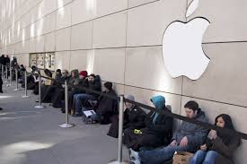
3. Motivation
Monetary Incentives
Size of the prize
Assumptions on user-pay & commercial viability in the ICTs for education sector (bop)
Non-monetary Incentives
travelling, capacity building, networking opportunities, and commercial benefits through investment and advance market commitments
Notes:
XPRIZE foundation has shown that the participants’ collective expenditure often exceeds 10-16 times the cash value of the prize itself
For instance, 95% of the estimated industry value is being captured by just 10 countries. In the emerging digital economies of South Asia and Sub-Saharan Africa, “the app model will be the default, rather than the open publishing model of the Web”

Slide 10
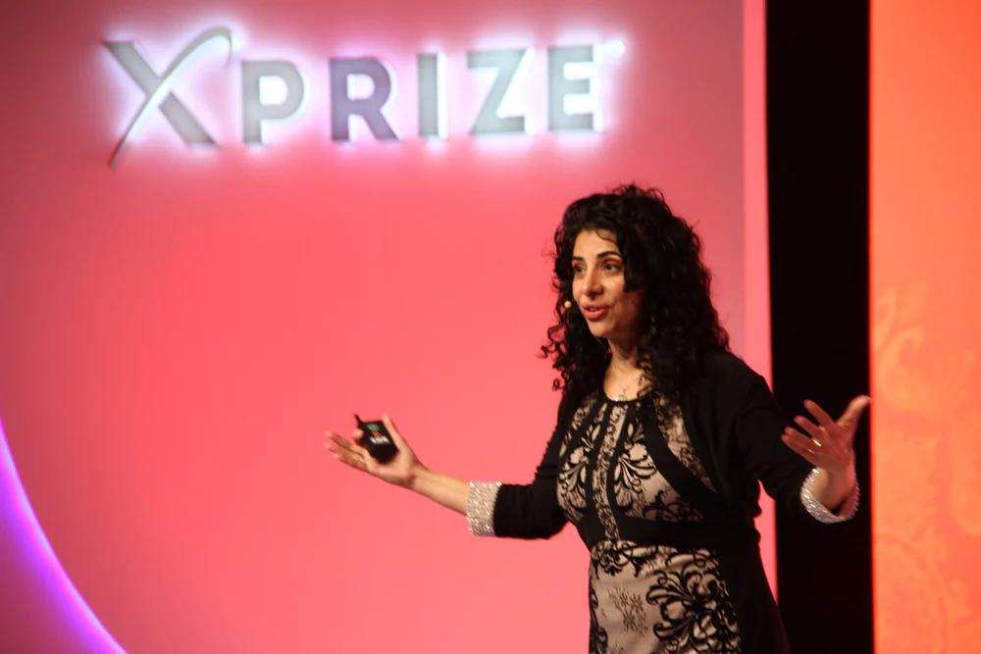
4. Communications
Marketing and new media- building reputation
Notes:
XPRIZE foundation has shown that the participants’ collective expenditure often exceeds 10-16 times the cash value of the prize itself
For instance, 95% of the estimated industry value is being captured by just 10 countries. In the emerging digital economies of South Asia and Sub-Saharan Africa, “the app model will be the default, rather than the open publishing model of the Web”

Slide 11
5. Evaluations
Post evaluation impact
post-award monitoring & evaluation (M&E) of prizes absent
Long-term Sustainability
Juan-Pablo Giraldo from UNICEF
“I am skeptical about incentive prizes because they are not a bottom-up process”
Michael Hollaender from GIZ
“innovation and long-term sustainability is contradictory in its pure essence. If you look at Silicon Valley, 17% of their innovations will become successful –so when they talk about innovation, they have already calculated that most of them will fail. If we offer prizes and also claim sustainability, then we are offering the impossible”
Notes:
XPRIZE foundation has shown that the participants’ collective expenditure often exceeds 10-16 times the cash value of the prize itself
For instance, 95% of the estimated industry value is being captured by just 10 countries. In the emerging digital economies of South Asia and Sub-Saharan Africa, “the app model will be the default, rather than the open publishing model of the Web”

Slide 12
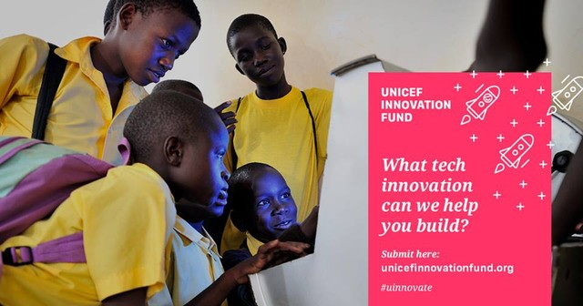
Thank you
Q. Do prizes stimulate innovation?
Q: Is technology innovation central to educational reform?
Q. Are prizes the most efficient funding mechanism?
Q. Is scalability a proxy for sustainability?
Institutions –corporate funders
Digital start ups –maturing companies
Digital reputation – designing campaigns
Social entrepreneurship – short term
Co-design – evaluation stage

