Slide 1
Digital Social Entrepreneurship and Hybrid Organizing
M.N. Ravishankar
DIODE workshop, 22nd January 2018
Cape Town, South Africa

Slide 2



Digital Social Entrepreneurship (DSE)
DSE: entrepreneurial work of social ventures whose business models rely primarily on digital technologies

Slide 3
Hybrid Organizing
Hybrid Organizing: activities by which organizations combine multiple organizational forms (Battilana and Lee, 2014)
Integrated activities: advancement of commercial and social goals through a common set of activities
Less integration implies difficult trade-offs

Slide 4
Question
How does DSE incorporate and develop ‘activity integration’?
Process-level insights missing
Successful combination of charity and commercial logics
Rang De – an instantiation of DSE

Slide 5
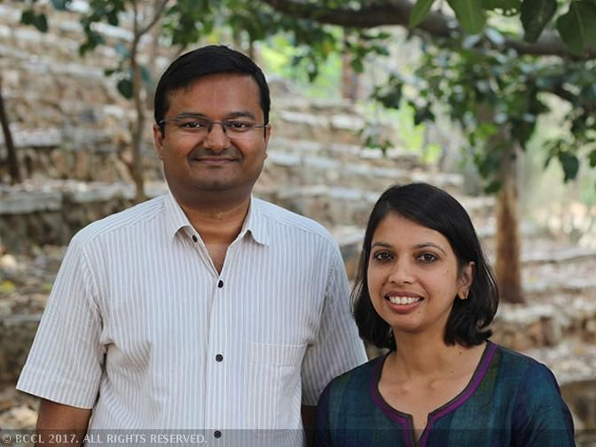
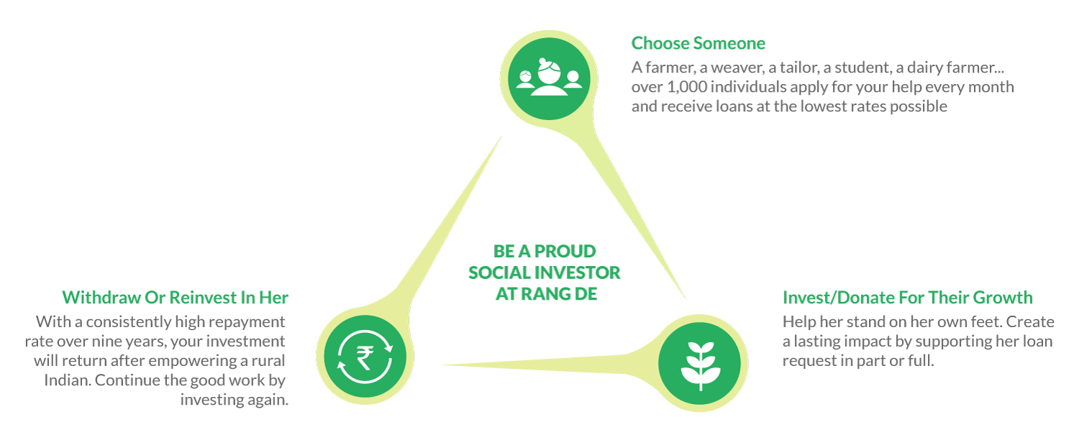
Rang De
Peer-to-peer lending model
Access to low cost microcredit
Individuals lend small sums of money via online portal

Slide 6
Rang De Impact
12508 social investors
57474 loans disbursed
INR 584.4M (£7M): social investments raised
92.96%: repayment rate
18 states
3697 education loans
93.33% women borrowers
9-18%: APR interest rate charged

Slide 7
How does it work?
Interest rate breakup for borrower repayments for each loan type
Loan Product | Impact Partner | Rang De | Social Investor | Contingency | Total (Flat) | Total (APR)*
Business | 5.50% | 2.00% | 2.00% | 0.50% | 10.00% | 17.97%
Higher Education | 2.00% | 2.00% | - | 0.50% | 4.50% | 8.41%
Primary Education | 4.00% | 2.00% | - | 0.50% | 6.50% | 11.79%
Microventure | 2.00% | 2.00% | 2.00% | 1.00% | 7.00% | 12.60%
Working Capital for Artisans | - | 2.00% | 2.00% | 1.00% | 5.00% | 8.98%
Special Loans | 5.00% | 2.00% | 2.00% | 1.00% | 10.00% | 17.97%
*APR interest rates are calculated on a monthly repayment schedule.

Slide 8
Entrepreneurial actions
- Creative visuals
- Social media to reach
wide audiences
Digital attention-building
- Transparency in
detailing impact and
operations on website
- Statements like: “every
time someone’s life is
impacted, we
blog/tweet about it”
Digital credibility-building
Digital capabilities
Digital empathy-building
- Faithful and moving
digital representation of
borrowers’ struggles

Slide 9
Entrepreneurial actions
- Field visits to build strong and durable face-to-face relations with impact partners
Intermediary relationship-building
Field immersion capabilities
- Surveys/interviews
with borrowers during
field visits
- Engagement with
borrowers
- ‘Swabhimaan’ kiosks to
enable direct
applications for loans
Direct relationship-building

Slide 10
Some reflections
DSE: the extent to which digital capabilities influence integration of social and commercial activities
Digital capabilities and social imprinting
The cost of acquiring and developing field immersion capabilities
Digital capabilities and mission drift?

Slide 11
Questions? Comments?

Slide 12
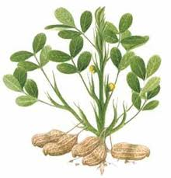
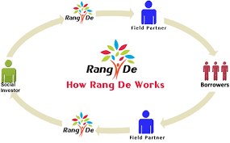
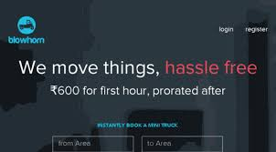















Three digital start-ups
Social enterprise
Regular enterprise
Jayalaxmi Agrotech
Business model struggles
Rang De
Investor shyness
Blow Horn
Credibility handicap
Development issue
Information asymmetry
Financial exclusion
Unpredictable & unreliable intra-city logistics

Slide 13
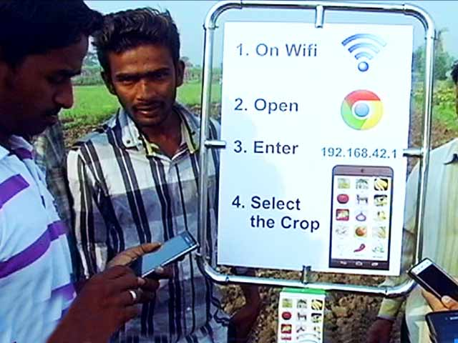









Digital Products: Device, Applications and Platform
Jayalaxmi Agrotech
Agri Apps
Agri-pole
Crop specific Applications
Analytics platform

Slide 14
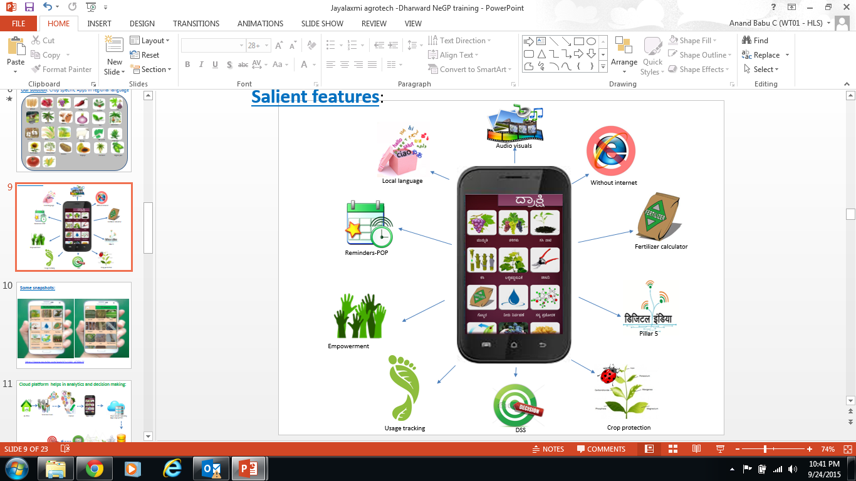
Agri Apps
Light weight apps & works without internet
Built with audio visual support for multiple Indian languages
pricing analytics & break even analysis
End-to-end information for 20 crops.
How to use growth hormones, fertilizers and pesticides.
Vaccination details for livestock.
Crop specific post-harvesting
information.
Multiplier effect.

Slide 15
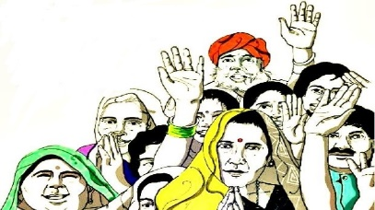
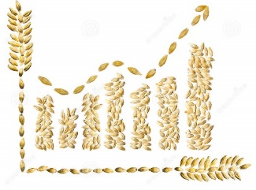


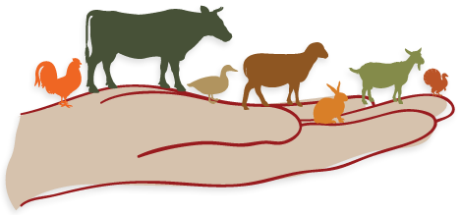
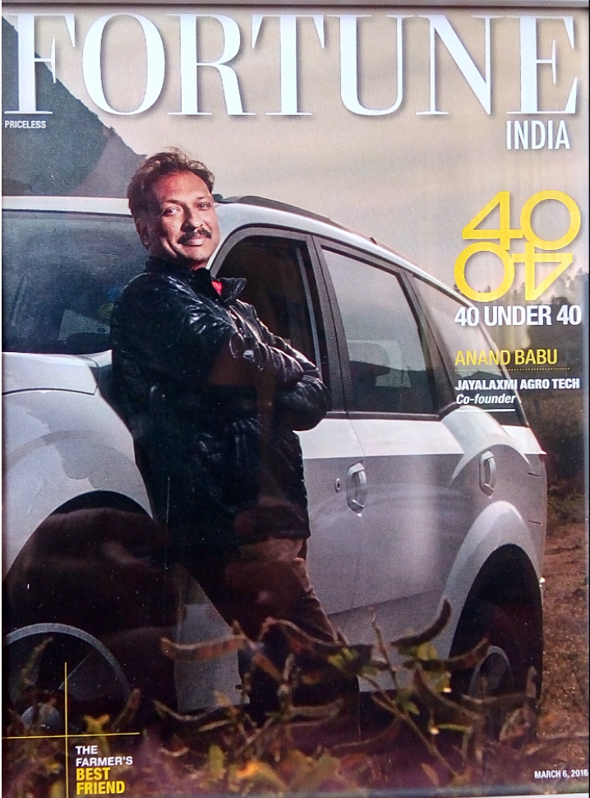
Impact
Reduced input costs by 14% and achieved productivity improvements of 17%
A 46% improvement in farmers’ knowledge and skills
150,000 users
50,000 tons - reduction in overall fertilizer consumption
Reduced livestock mortality rates by 6%
Sustaining the business???

Slide 16
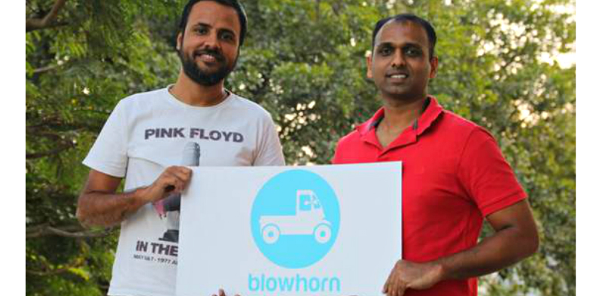
Blowhorn
offers mini-trucks for rent in multiple cities - Bengaluru, Chennai, Hyderabad and Mumbai - in India.
intra-city logistics - Uber for trucks in India!
£2.9M funding – IDG Ventures, Michael & Susan Dell Foundation
connecting mini truck drivers to the demand for deliveries via an app.

Slide 17
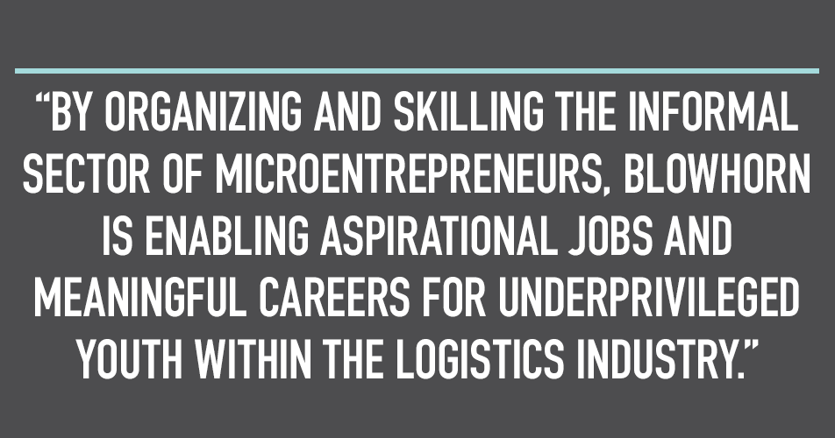
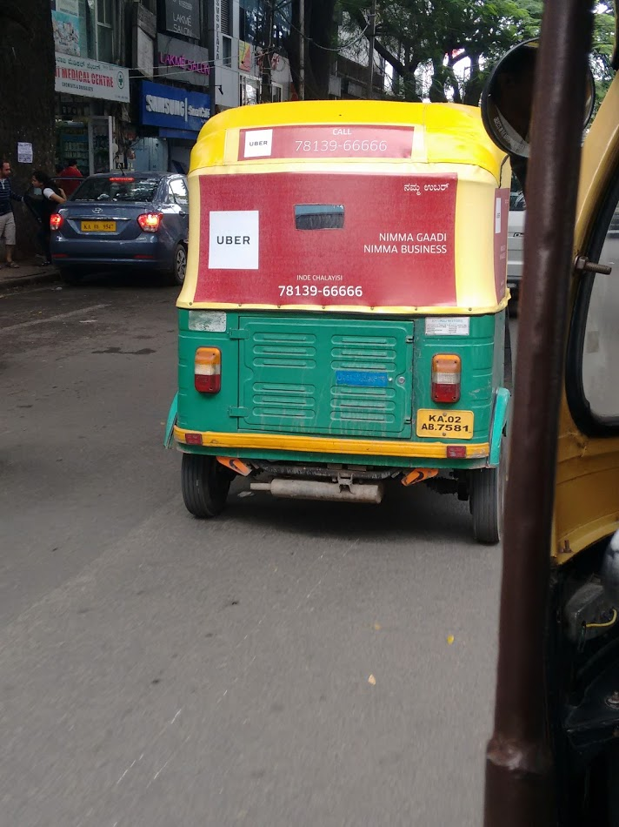
Impact
  number of registered drivers, percentage of active drivers, average income of drivers, income increase for drivers, and percentage of drivers who have bought an additional vehicle after using the platform.
  Impacting over 10000 drivers (and families)
  104%: net monthly increase in earnings
Credibility handicap

Slide 18
Three digital start-ups
Social enterprise
Regular enterprise
Jayalaxmi Agrotech
Business model struggles
Rang De
Investor shyness
Blow Horn
Credibility handicap
Development issue
Information asymmetry
Financial exclusion
Unpredictable & unreliable intra-city logistics

