Slide 1

Academic Institutions
Corporate Institutions
NGOs
Entrepreneurs
Foundations
Governments & Government Agencies
Start-Ups

Slide 2

iHub Research sits at the intersection of unearthing evidence based research relating to the thematic areas of technology, innovation, entrepreneurship to enable institutions and individuals to make decisions & influencing policy by equipping policy makers and influencers with the resources to formulate sustainable policy

Slide 3
Digital Government’s Responsiveness to Citizens Needs
A study of Kenya’s Government Responsiveness in the Age of ICTs

Slide 4
Project Phases
ICTs & Governance in EA
Government Responsiveness
User Centric e-Governance

Slide 5


Slide 6


Slide 7
ICTs are being used to enhance governance and development in Kenya (and the EA region). However, what is the state of the feedback loop between the government and its citizens? What is the current impact of the feedback loop as it exists?

Slide 8
Methodology
Focus group discussions and Interviews with 80 ICT professionals, citizens & government representatives across 4 counties in Kenya

Slide 9
Findings
Enthusiasm by citizens to access government services conveniently
Technical manpower gaps needed to meet citizen needs in handling ICT tools
Lack of educational programs targeting citizens to uptake ICTs
ICT platforms have not been localised – language, citizen needs
Infrastructure gaps in certain counties in Kenya
Cost of access (devices & internet packages) locking out majority of Kenyans
Cyber café culture a win in accessing e-government services

Slide 10
Impact of the rush to digitalisation of Governments
Huge investments in technology – one child per laptop initiative
IT is sexy and influence in IT related education fields
Talent capacity; Local Vs Import of talent
Internet Adoption
Open Data
Transparency…

Slide 11
“e-government is a powerful tool in reducing corruption—via telecommunication infrastructure and the scope and quality of online services—which is strengthened by greater internet adoption. The interaction effects between e-government and internet adoption suggest both as complements in anti-corruption programs.” Nasr G.Elbahnasawy 2013

Slide 12


Slide 13


Slide 14
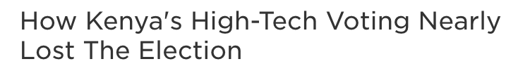
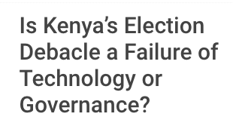


Slide 15
“There is no app to solve for the lack of political will. In other words, there is no technological intervention that fixes intrinsic human motivations.” Sambuli 2016

Slide 16
Project Phases
ICTs & Governance in EA
Government Responsiveness
User Centric e-Governance

Slide 17
Digital Government Journey
Infrastructure (push online)
Single Platform Service Delivery
User Centric Design

Slide 18
Developing a Smart Society and Public Services
“…it offers greatest reward when citizens are placed at the centre of the digital government agenda and their views are creatively embedded within the core of the system. Today’s governments have a number of lessons, practices and technologies which can be leveraged to leapfrog their digital agenda, ensuring citizens and communities are truly smart in design and results.” Hajhamad (2017)
Notes:
Developing a Smart Society and Public Services
Bassam Hajhamad (2017)
This is a journey which is not immune to significant challenges. However, it offers greatest reward when citizens are placed at the centre of the digital government agenda and their views are creatively embedded within the core
of the system.

Slide 19
Findings
Enthusiasm by citizens to access government services conveniently
Technical manpower gaps needed to meet citizen needs in handling ICT tools
Lack of educational programs targeting citizens to uptake ICTs
ICT platforms have not been localised – language, citizen needs
Infrastructure gaps in certain counties in Kenya
Cost of access (devices & internet packages) locking out majority of Kenyans
Cyber café culture a win in accessing e-government services

Slide 20

Next Phase?

Slide 21
Questions and Comments welcome!

