Slide 1

Institutional Theory and Platform Labour in Developing Countries
Richard Heeks
Centre for Development Informatics, University of Manchester, UK
DIODE Workshop, Cape Town, South Africa
22-23 Jan 2018
Centre for Development Informatics

Slide 2


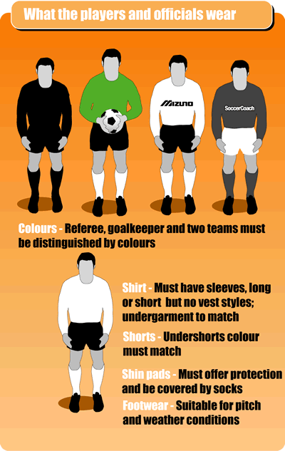
Institutions
"Institutions are the rules of the game in a society or, more formally, are the humanly devised constraints that shape human interaction." (North 1990:3)
Centre for Development Informatics
North, D. (1990) Institutions, Institutional Change and Economic Performance, Cambridge University Press, Cambridge

Slide 3
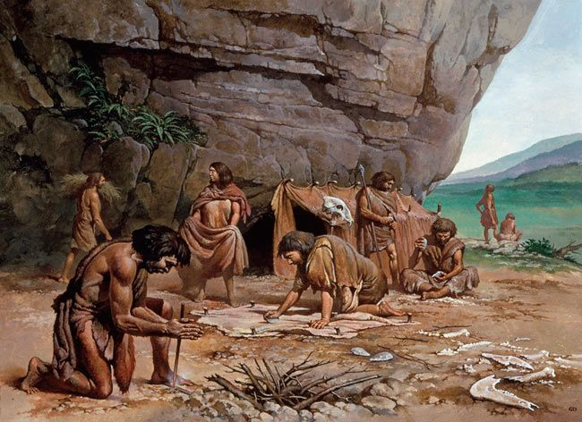

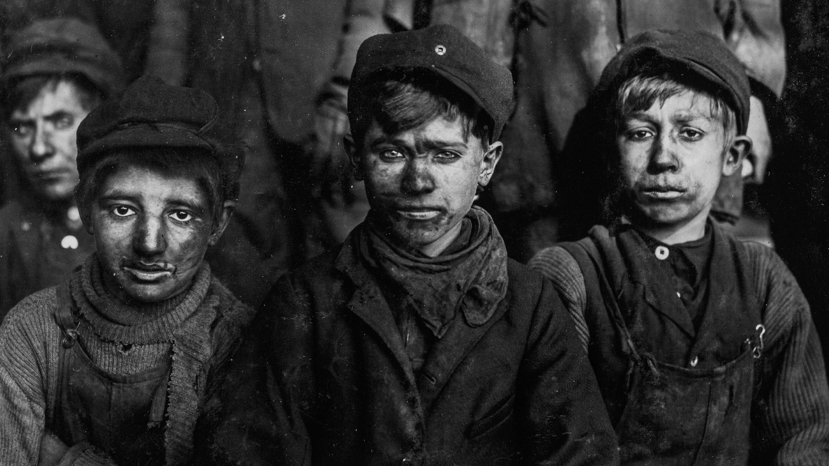
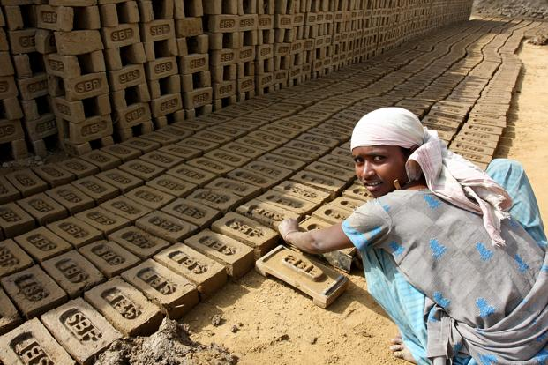
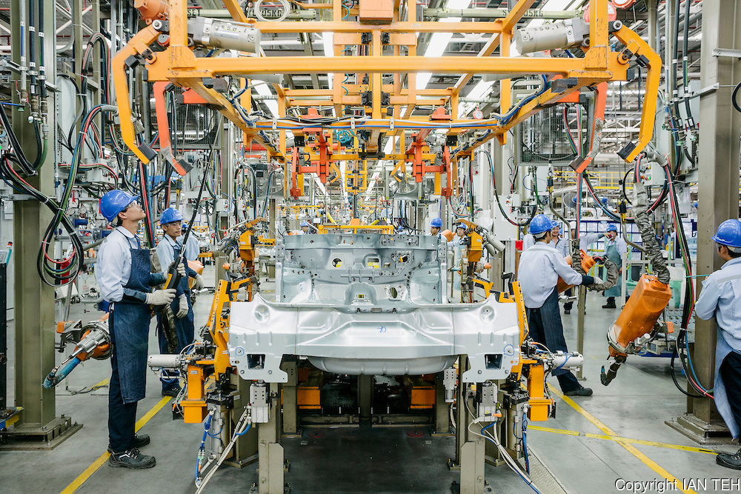
Institutions and Work Over Time
Centre for Development Informatics

Slide 4

Labour Institutions
International Agencies
Government Ministries
ILO / International Standards
National Laws & Policies
Political
Demographic
Labour Institutions:
- Contracts & Contract Law
- Social Security Systems
- Collective Bargaining
- Job Search Procedures
- Wage Determination & Payment Methods
- Management of Work
- Ownership and Control of Production
Economic
Technological
Social Norms
Production System
Trade Unions
Employers & Associations
Consumers & Civil Society
Centre for Development Informatics

Slide 5




Narrative 1: De-Institutionalisation
International Agencies
Government Ministries
ILO / International Standards
National Laws & Policies
Labour Institutions:
- Contracts & Contract Law
- Social Security Systems
- Collective Bargaining
- Job Search Procedures
- Wage Determination & Payment Methods
- Management of Work
- Ownership and Control of Production
Social Norms
Production System
Trade Unions
Employers & Associations
Consumers & Civil Society
Centre for Development Informatics

Slide 6
Narrative 2: Re-Institutionalisation
International Agencies
Government Ministries
ILO / International Standards
National Laws & Policies
Platforms
Client-Side
Labour Institutions:
- Contracts & Contract Law
- Social Security Systems
- Collective Bargaining
- Job Search Procedures
- Wage Determination & Payment Methods
- Management of Work
- Ownership and Control of Production
Worker-Side
Government
Social Norms
Production System
Trade Unions
Employers & Associations
Consumers & Civil Society
Centre for Development Informatics

Slide 7
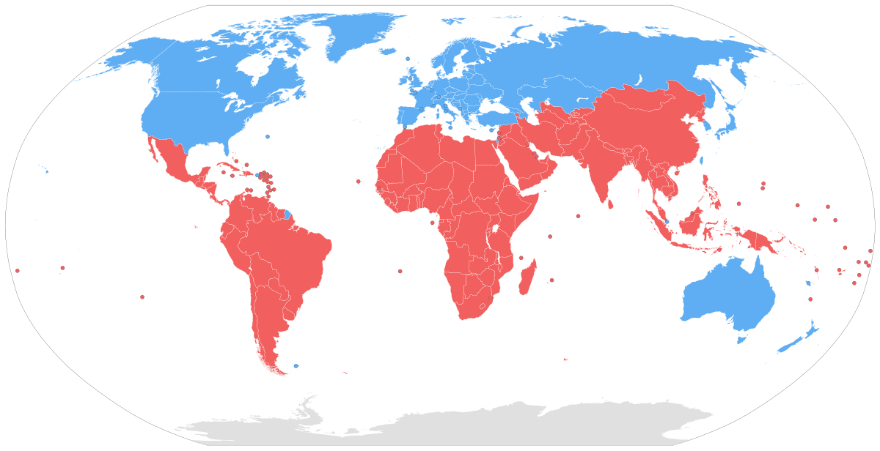
Narrative 3: Global Differentiation
International Agencies
Government Ministries
ILO / International Standards
National Laws & Policies
Labour Institutions:
- Contracts & Contract Law
- Social Security Systems
- Collective Bargaining
- Job Search Procedures
- Wage Determination & Payment Methods
- Management of Work
- Ownership and Control of Production
Social Norms
Production System
Trade Unions
Employers & Associations
Consumers & Civil Society
Centre for Development Informatics

Slide 8
Narrative 4: Institutional Dynamics
International Agencies
Government Ministries
ILO / International Standards
National Laws & Policies
Labour Institutions:
- Contracts & Contract Law
- Social Security Systems
- Collective Bargaining
- Job Search Procedures
- Wage Determination & Payment Methods
- Management of Work
- Ownership and Control of Production
Social Norms
Production System
Trade Unions
Employers & Associations
Consumers & Civil Society
Centre for Development Informatics

Slide 9
Platform Labour Institutions: Agenda
International Agencies
Government Ministries
ILO / International Standards
National Laws & Policies
Labour Institutions:
- Contracts & Contract Law
- Social Security Systems
- Collective Bargaining
- Job Search Procedures
- Wage Determination & Payment Methods
- Management of Work
- Ownership and Control of Production
Social Norms
Production System
Trade Unions
Employers & Associations
Consumers & Civil Society
Centre for Development Informatics

Slide 10
Decent Digital Work Standards
 | Code Components / Standards
Employment Context
Social Security | Provision of annual, sick and maternity leave Provision of unemployment, disability and health insurance Provision of liability insurance Provision of pension contributions Portable benefits Shared contributions from workers, platforms and clients including taxation
Social Dialogue, Employers’ and Workers’ Representation | Right to organise and negotiate collective agreements Legal changes where collective negotiation is prevented for independent contractors Enable (collective) communication between workers
Economic and Social Context for Decent Work | Compliance with all relevant national laws in worker jurisdiction Client responsibility for digital supply chain Access for policy-makers to anonymised transactional platform data
Employment
Employment Opportunities | Opportunity to access digital gig economy work Provision of training opportunities Worker-accessible, portable work history and reputation profiles
Stability and Security of Work | Combination of stability and flexibility Clarification / recategorisation / development of new / flexibility to choose employment status
Equal Opportunity and Treatment in Employment | No discrimination Data protection and privacy for both clients and workers
Dignity and Respect at Work | Respectful and prompt communications between clients, platform and workers Clear rules for work rejection and re-work, worker deactivation, worker ratings, and worker ‘levelling-up’ Human review of worker complaints Neutral third-party dispute resolution mechanism
Work Conditions
Adequate Earnings and Productive Work | At least minimum wage paid taking unpaid time and other costs into account Clear information and communication about tasks Clear information about payment including schedule and conditions and non-payment General-terms details about client identity and task purpose Rating system for both clients and workers
Decent Working Time | Compliance with national working time directives and with ILO guidelines
Safe Work Environment | Ensure potentially psychologically unsafe tasks are signalled, and support provided
Centre for Development Informatics

