Slide 1
Digital Economy and Inclusive Development:
Insights from Indonesia
Wirawan Agahari
DIODE Network Workshop, The University of Manchester, 11-12 April 2018

Slide 2
Three digital economy initiatives
The problem | Financially excluded population in rural areas | Inefficient and high cost of fish feeding | SMEs products are not market ready
How it works | P2P Lending for female micro-entrepreneurs | IoT solution for fish and shrimp farming | Capacity building and mentoring for SMEs
Challenges | Technological knowledge Financial literacy & sustainability Digital mindset & visionary thinking

Slide 3



Analytical Lens: Inclusive Development
Economic
Increasing household income
Access to finance
Social
Enhancing access to education
Ensuring equity principles for participation
Opening up opportunities for employment
Equitably sharing rights, responsibilities, and risks
Ecological
Environmentally concern
References: Farhan & Sudrajat (2017), compiled from various sources
Notes:
Consult FF
Kayaknya mirip antara “Ensuring equity principles for participation” dengan “Equitably sharing rights, responsibilities, and risks”

Slide 4


The Problem
Lack of access to financial capital in rural areas
insufficient collateral
fluctuating income
the absence of credit history
How it works
Peer-to-Peer lending platform, connecting investors with female micro-entrepreneurs in rural areas in Indonesia
Lending groups of 15-20 people, loan from US$ 225 to US$ 750
Commission from both lenders and borrowers as a revenue source
Advanced Credit Score Technology with machine learning approach
Notes:
Amarta is a group lending institution, similar to Bangladesh’s Grameen Bank. Its concept was to work together with big banks to disburse loans to members of lending groups in rural areas.
Advanced Credit Score Technology with machine learning approach to assess the feasibility of each borrower
30 percent commission from investors?

Slide 5

Inclusiveness
Increase in net income from 5.92 – 14.81 US Dollar (>100%)
Better access to education for their kids due to increased income
Self-employed as an entrepreneur
Everyone can become investor and create social impact
Empowering women to improve quality of life
Group lending system
“ I am happy to be able to renovate the house. I can save some of the profits from selling ‘gorengan’ for renovating my house. Now, my house already has a bathroom and a kitchenette. From now on, I want to try to live healthy to avoid disease.”
- Peni,39 years old

Slide 6
Impact
Challenges
Total loan disbursed
Empowered micro-entrepreneurs
16.6
million USD
70,977
Women
On time repayment
532
Villages
99.7
Percent
Technological skill and knowledge
Financial literacy
Increase in average income
Micro-entrepreneurs above the poverty line
27
Percent
94
Percent
Notes:
Future vision: empowering women in rural area to become independent in accessing financial resource. Collaborate with bank. Performance monitoring with credit scoring, create lots of data.
Bias algorithm: those with credit score of E won’t have a chance to receive loan

Slide 7
The Problem
inefficiency of feeding in the fish farming business
50-80% of cost for fish feeding
Unmeasured and inexact fish feeding method
How it works
automatic smart feeder with sensors, measure appetite and dispense food appropriately
real-­time reports of consumption straight to the farmer’s smartphone
Revenue from hardware and software
One-time purchase (578 USD) or monthly rental (22 USD/month)
monthly fee for dashboard and feeding reports
Notes:
Fish feeding is done inefficiently by laborers, and farmers don’t have any technology to control the feeding yet
Overfeeding negatively impacts the environment in many ways, as a great deal of fish food ultimately goes to waste. It also harms the health of a farmer’s stock.
Underfeeding, on the other hand, means fish may not survive.
Data untuk transparansi dan traceability kualitas ikan

Slide 8
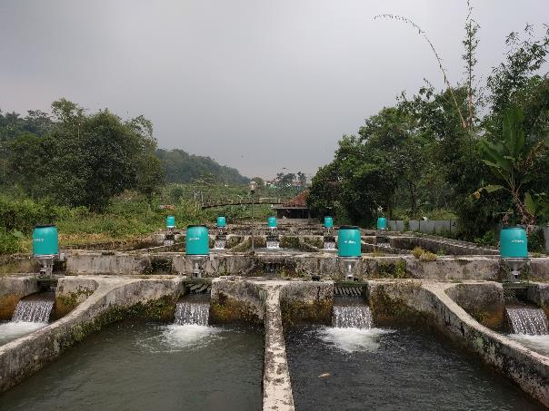



Inclusiveness
Increase in gross margin from US$ 0.15 to US$ 0.34 (92%)
Fish farmer become more tech-savvy
Reducing water pollution due to fish food
No water exchange for the whole cycle (3 months)
“eFishery helps me to reduce the feeding cost that is currently really high. My 50-something year old employee is also helped by this as the machine makes his job is easier”
– Kang Hernan, petani nila (Subang, Jawa Barat)

Slide 9
Impact
Challenges
Units sold / rented
Increase in feeding efficiency
>1,500
21
Percent
Fish farmers
Profit increase
>300
92
Percent
Business model struggle
Technology push into traditional market
Small-medium scale
Total cost reduction
88
Percent
12
Percent
Notes:
Expansion to Bangladesh and Thailand
Future vision: platform, connect fish farmer with potential buyer. Data as a leverage for fish farmer (e.g. access to financing, improve quality of fish)
Koperasi petani ikan
Too expensive for fish farmers to buy the product
53% rent, but cannot cover production cost
Replacing traditional labor

Slide 10
(in English: creative home of SOEs)
The Problem
Lack of capacity and capability of local SMEs in commercializing their products to realize digital economy vision of Indonesia
How it works
Top-down approach, pioneered by 7 State-owned Enterprises in Indonesia
Establishing digital economy ecosystem through capacity building, access to market, access to finance
Three stages: Go-Modern, Go-Digital, Go-Online
Notes:
Amarta is a group lending institution, similar to Bangladesh’s Grameen Bank. Its concept was to work together with big banks to disburse loans to members of lending groups in rural areas.
Advanced Credit Score Technology with machine learning approach to assess the feasibility of each borrower
30 percent commission from investors?

Slide 11
Inclusiveness
(Potential) income improvement of SMEs, increase in market reach due to digitalization
Providing access to financial resource as part of the program
Empowering SMEs with digital knowledge
Opportunities for SMEs to participate and compete in the digital era
Create responsibilities for SMEs to be profitable and market ready

Slide 12
Impact
Challenges
SMEs participation
475,429
SMEs registered
22,547
Products listed
Digital mind-set
Visionary thinking
9,113
SMEs go digital
9,171
Transaction
Capacity building conducted
3,181
Training
514
District
Competitiveness of blanja.com

Slide 13
Linking Digital Economy with Inclusive Development
Development Dimension | Sub-Dimension
Economic | Increasing household income | v | v | v
 | Access to finance | v | v | v
Social | Enhancing access to education | v | v | v
 | Ensuring equity principles for participation | v |  | v
 | Opening up opportunities for employment | v |  | v
 | Equitably sharing rights, responsibilities, and risks | v |  | v
Ecological | Environmentally concern |  | v

Slide 14
Concluding remarks
Digital divide (access, skills, knowledge) as crucial barriers
Two sides of digital economy in Indonesia: Inclusiveness and inequalities
infrastructure is still lacking, but emerging technologies are on its way

