Slide 1
DIODE - strategic research network
Factors underpinning failure of digital start-ups in developing countries
Rauf Jabarov
Director,
Electron Government Education and Training Center,
under the Ministry of Transport, Communication and High Technologies of Azerbaijan Republic
Manchester, 12 Aprel 2017

Slide 2
Content
1.
2.
3.
4.
Start-ups’ failure
Researches about Start-up ecosystem
Factors underpinning failure
What might be perspective research topics
DIODE - strategic research network

Slide 3

Research topics
The role of multi-stakeholders’ intervention in the sustainability of digital start-ups
Factors underpinning failure of digital start-ups in developing countries
DIODE - strategic research network
Notes:
The researches were initiated to understand Why successful disruptive startups did not emerge in Azerbaijan.
What is the problem? Where is the problem? What cause the problem?
Even small number of startups (les than 500) cannot represent success stories

Slide 4
Motivation
To understand digital entrepreneurship in developing countries and how to develop an economic growth of digital entrepreneurship?
To determine why digital entrepreneurship in Global South does not associate the same process and practice like in Global North?
DIODE - strategic research network
Notes:
The motivation is to understand what is difference between Global North and global South in terms of startups’ process and practice

Slide 5

Why startups fail so often
DIODE - strategic research network
Notes:
What is startup failure?
Startup ecosystem is like marathon in terms of the number of participants who just participate without any chance to win. And the strange part is all startups know that they likely will not win but they participate in any way.
Though many losers is not good in sport, in startup ecosystem big number helps to build a healthy environment which can create many number of success stories.
Not all participants can finish and sometimes the number of finishers is pretty low. From that perspective good startup ecosystem should generate more and more participants which can ensure relatively more success stories.

Slide 6
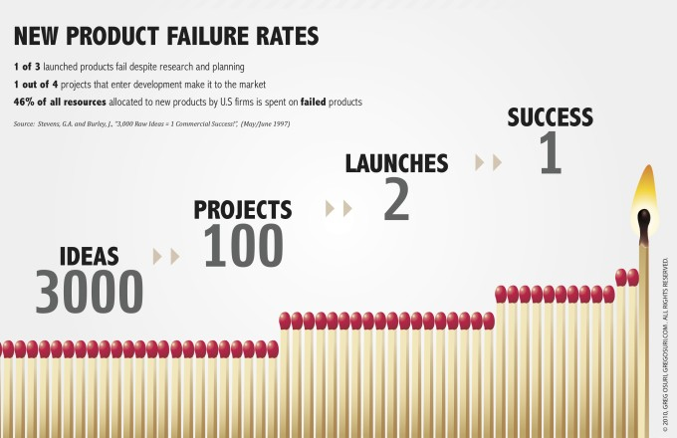
Why they fail so often
DIODE - strategic research network
Notes:
In global south the number of initial startups is low which determines insufficient success stories.
The main problem is the number of startup projects. First of there is need to increase the number of startups to get successful one in the end.
Generally IT should be vice versa because of huge opportunities in global south…there are still a lot of market segments which are open for new market players; there is low level of competitiveness in digital sector;

Slide 7

Azerbaijan startup ecosystem
500
startups
5
success
$400k
raised
95%
in Baku
90%
web
Notes:
The numbers surprise because it is very small scope.
Also, the problem is with sectorial definition of startups. There are few number which goals to establish disruptive projects with new trends of ICT (e.g., cloud tech, blockchain tech, big data etc.)

Slide 8
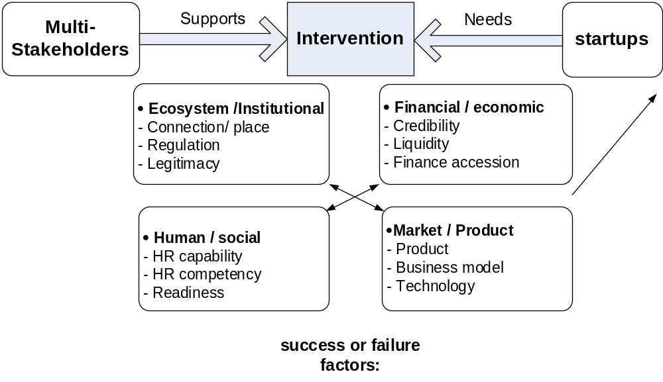
Analytical framework
Success or failure factors
external factors vs internal factors
Notes:
In my original research I tried to understand multi-stakeholders’ relation with startups in terms of their support. This research enables to understand to what extend startups’ sustainability depends on stakeholders from startup ecosystem.
Factors:
ecosystem/institutional – place, connection and legitimacy
Market/product – product, business model, technology
financial/economic – liquidity, credibility, access to funds
Human/social – HR capability, competency, readiness

Slide 9


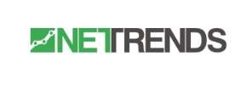


Researched cases – startup stories
GoldenPay – e-payment platform
Manads – mobile ads platform
NetTrends – social network data tracker
WeTravel – US based traveling platform
Keepface – influencer marketing platforms
Notes:
What is the importance of specific place?

Slide 10

Factor 1 – Ecosystem / institutional
Startups in other places are just doing what startups naturally do: fail.
The real question is, what's saving startups in places like Silicon Valley?
BAD LOCATION
POOR CONNECTION
Place means much more
Connection is the half of success
Legal problems hamper the success
Do we need policy?
ʽʽ
Notes:
What is the importance of specific place?
Place brings opportunities of connection and network
Legal difficulties may hamper the success through breaking team
So do we need policy for startups. Do we need to regulate this activity?
If not how special legal issues may be addressed?

Slide 11

Factor 2 – Market, product, technology
Many startup products do not fit market or NO MARKET NEED.
They do not disrupt or their product is a poor copy of foreign products.
New tech trends like big data, clouds, mobile should be considered.
Wrong business models to achieve a market scale
Whatever you sell, you have to sell it smartly
ʽʽ
Notes:
Market is main source of failure. Mostly startups cannot enter to the market and dyeing before reaching market.
Startups do not enhance disruptive ideas based on innovation technologies.
Trends driving the change, customers have to buy new things. Unfortunately, the most of startups looking for web base projects.
No disruptive idea to achieve market scale. Startup needs to follow business model which can ensure market scale
Platforms also have impact on success…success depends on where startups intend to sell products.

Slide 12

Factor 3 – financial / economic
Startups cannot use small investments to survive
Startups have no a correct strategy to attract attention of limited number venture companies
Struggling with an access to overseas funding
RUN OUT OF CASH
The small “feeding” grant money does not lead to success but helps to solve some “fixed time problems”
ʽʽ
Notes:
Startups often fails because of run out of cash. Otherwise many of the prefer to carry on the project. This contradictory approach in terms of Global North by which startups should to understand their lifecycle and if they likely tends to fail then they have to stop project instead of waiting when the money ends.
The key challenges are related to financial issues, particularly less of funding institutions and lack of venture investments.
The main financial problem is in the market size which disables startups. the scope of the Azerbaijan market is extremely limited, which disables attempts to achieve the scope effect
The worst case happens when startup created to find investments or grants just for personal earnings

Slide 13
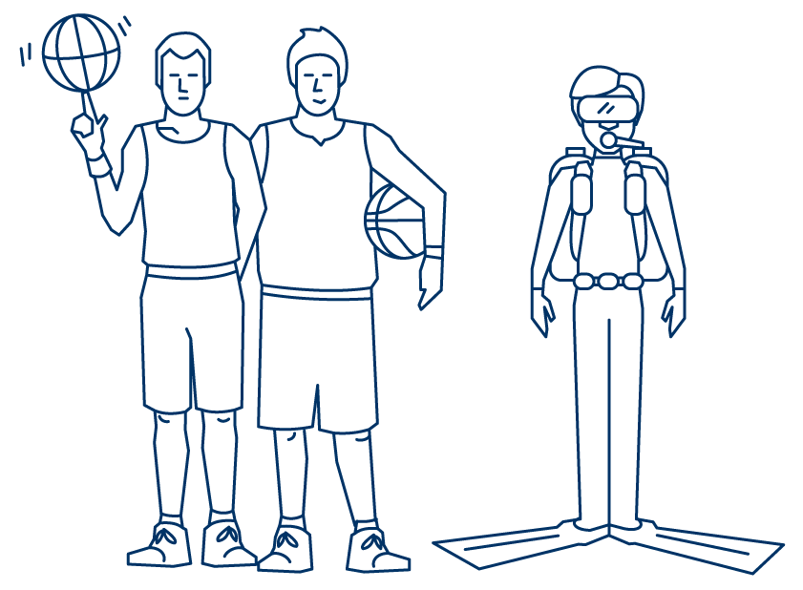
Factor 4 – human and social
No proper experience of founders and developers to succeed
HR capability in IT sector extremely needs to increase the number of developers
Poor self-confidence, lack of startup mind to work extremely hard to get reward.
Fear to take risk
NOT THE RIGHT TEAM
No one can help you, if you simply get it wrong with your team building
ʽʽ
Notes:
Lack of IT skills
Lack of qualified engineers
No sufficient support by Competitions
Incompetency start-up teams
Lack of entrepreneurship mind
Lack mentoring and coaching

Slide 14
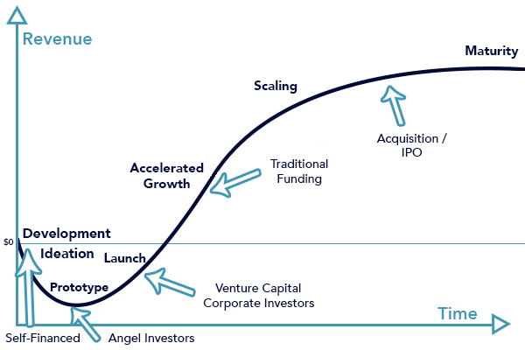
Startup trajectories matter more
Notes:
Some failure or success factors are covered. Though these factors does not give clear picture how startups actually survive and succeed.
We have to look at different stories to deeply understand each case separately. It is like football game…all games looks like the same, but there is no any similar game.
Trajectories matter in terms of understanding startup success and failure.
It is impossible to look at startup failure only through some common factors because these factors plays different role in different trajectories.
Most importantly, There is no only growth trajectories which shows startup lifecycle. Startups move between some spheres throughout the entrepreneurial process. This movement is trajectory for startup. These trajectories might be geography (clusters/ global or local) related or it might be platform related or it might be infrastructure related.
It is like a football game…some team win or lost in games but the reason of lost is always different.

Slide 15
Startup trajectory and research perspective
Digital and analog
Local and Global
business model and sector variables
Trajectory role on success or failure:
  how enterprises are able to pursue certain trajectories
Research perspective:
  Identify, conceptualize, theorize different kinds of trajectories
  Understand reasons for variation of trajectories

Slide 16
Future research direction thoughts
While all stakeholders are keen to understand how to achieve ‘an healthy startup environment’, why startups fail, what are the problems to apply the practice of Global North to the Global South…
Why is it not interesting to research this process?
Maybe I am wrong?!
Notes:
-

Slide 17
DIODE - strategic research network
Thanks for attention
r.cabarov@mincom.gov.az
www.linkedin.com/in/rauf-jabarov/

