Slide 1


Tech Hubs and Development
Andrea Jimenez University of Sheffield
Yingqin Zheng
Royal Holloway University of London
A Spatial Perspective

Slide 2
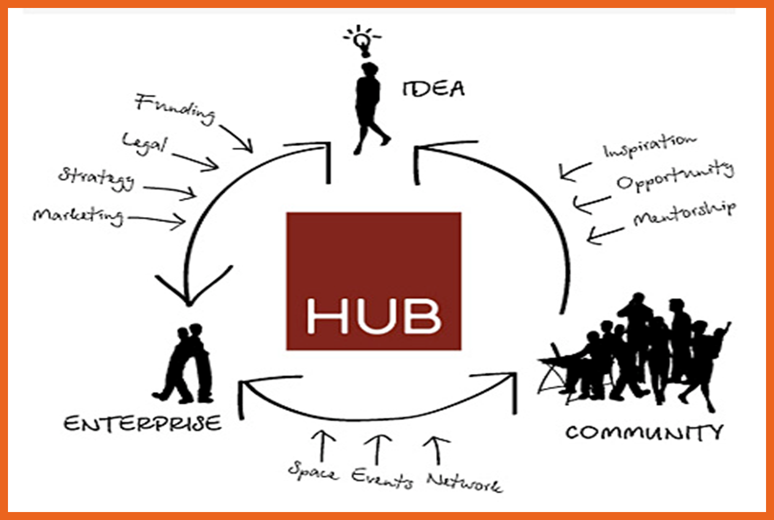
What is an tech hub?
“physical spaces designed to foster and support tech start-ups” - GSMA
These include incubators, accelerators, co-working spaces, fab labs, makerspaces, hackerspaces, and other innovation centres.
Key words: community, collaboration, innovation, entrepreneurship

Slide 3
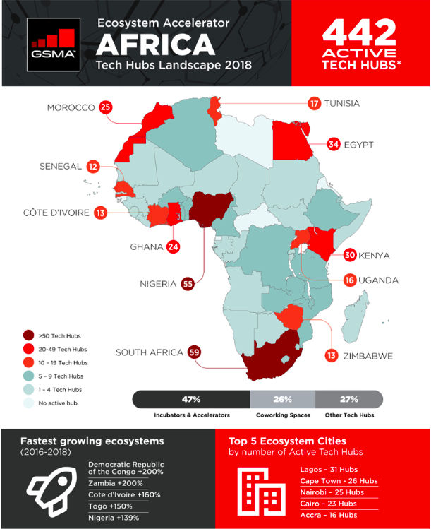
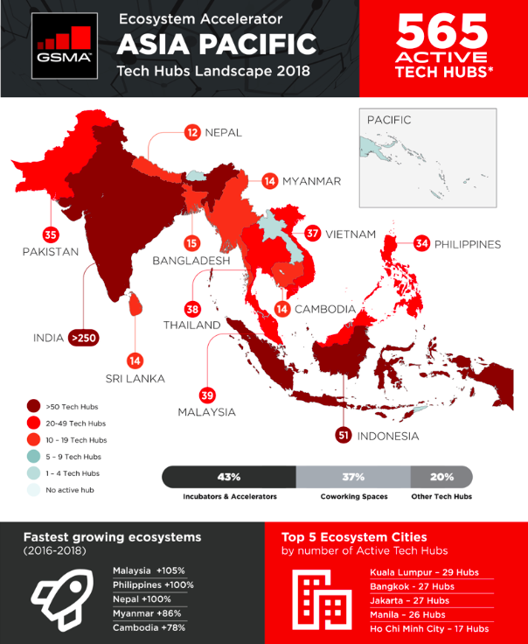
In September 2015 the World Bank listed less than 120 tech hubs in Africa.
Notes:
Moreover, innovation hubs are seen as spaces that will help create innovations and therefore contribute towards development. Friederici (2017) explains how one of the oldest and most famous innovation hubs in the African continent initially positioned itself as a catalyser for development in Kenya, by filling a gap in the market between the need for technology and the lack of local content available. Such discourse proved appealing for many other African countries, which consequently followed suit. Hubs were established in various African cities, following the same criteria.
This was reinforced by the discourse stemming from international organisations. A GIZ report published in 2013 describes African hubs as grassroots organisations embracing the ‘digital and mobile boom the continent is currently undergoing’ (p.4) By writing ‘From Silicon Valley to Silicon Savannah’, the report explains that the idea of an innovation hub was created in the West and then copied into the African continent, establishing a connection from Western hubs to African hubs.

Slide 4
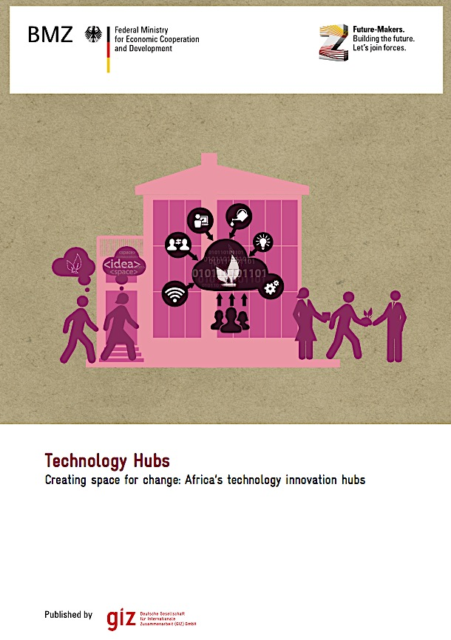
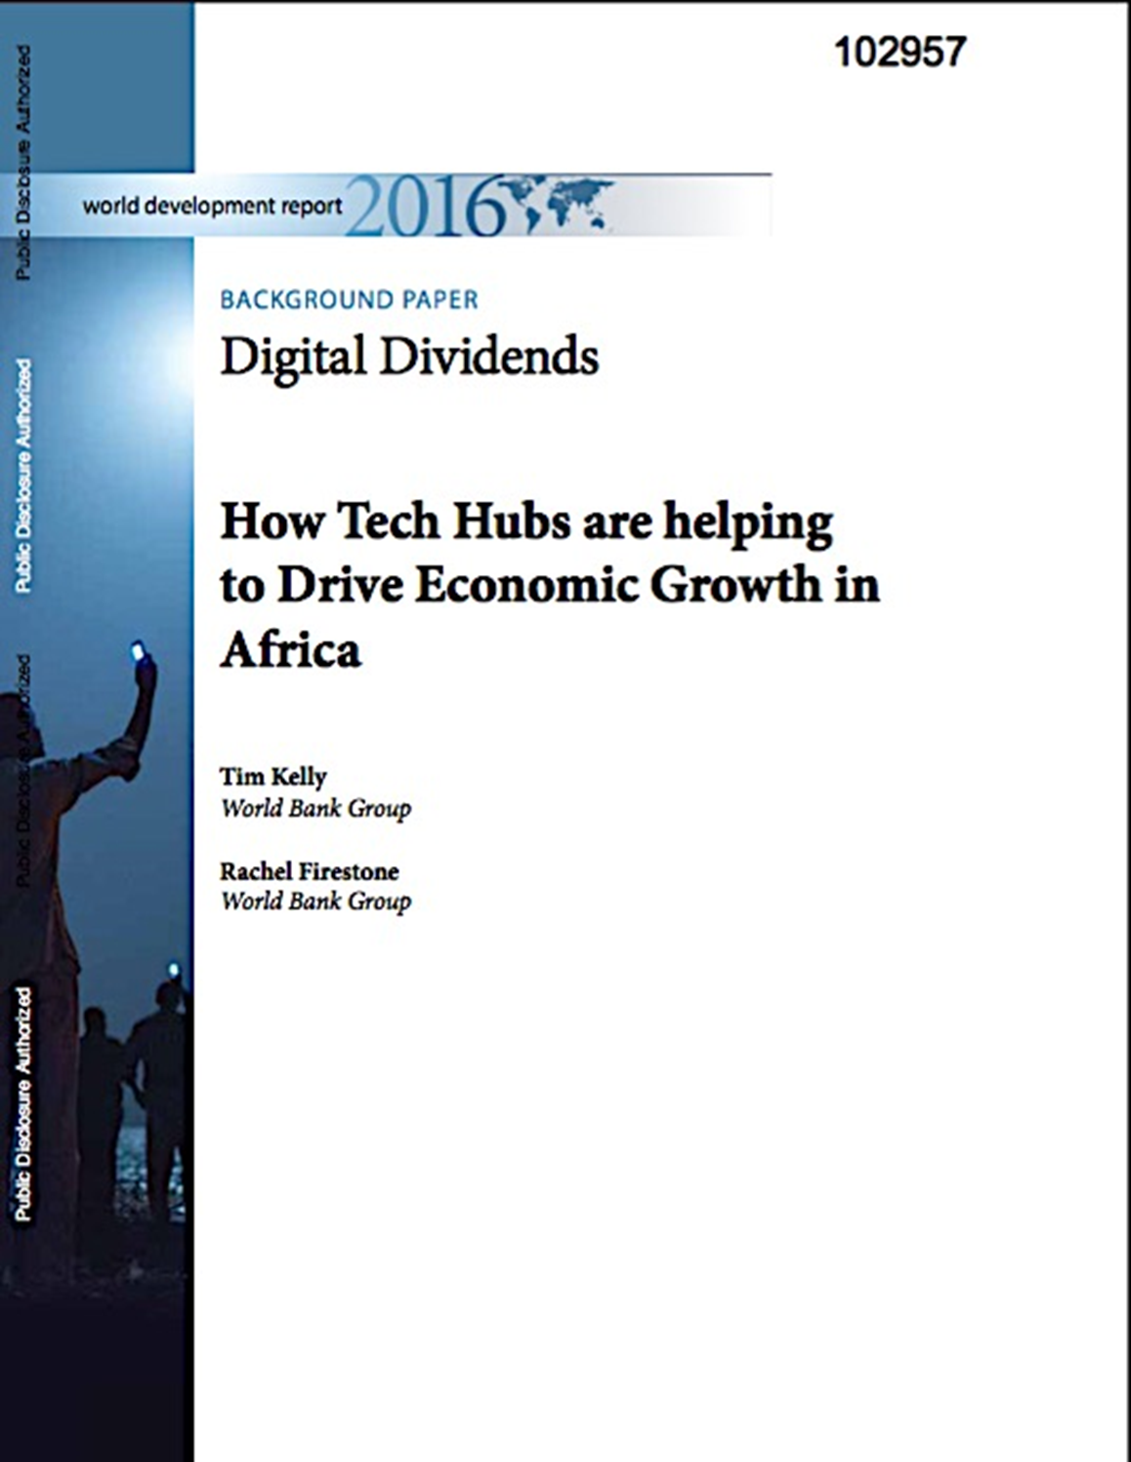
The aspiration of tech hubs
embracing the ‘digital and mobile boom the continent is currently undergoing’
“Filling a gap in the community of academic and private sector players that technology innovation needs to spur economic growth”
‘From Silicon Valley to Silicon Savannah’
Creating Space for Change
GIZ 2015
Notes:
But in the South they present interesting aspects: they are mainly funded and promoted by international organisations. These really like promoting hubs because they see them as the spaces that will help create jobs for young people in contexts with unemployment rates. They are also envisioned as spaces that will help create successful business for the local markets and ultimately inject money into the economy.
Without knowing whether this impact is actually true, there is great expectation for hubs to represent a mechanism of innovation for development. As such, given that they started in the North, the majority of the hubs in the south are following the silicon valley model.
“Tech hub clusters, such as in Cape Town, Lagos, and Nairobi, show that once a certain threshold is passed,
new hubs and ongoing entrepreneurial activity can be
stimulated through enhanced access to finance, services to entrepreneurs, and the demonstration effects of successful
“first mover” startups. ”
“As with the creative destruction of the original dot-com
bubble, many new startups, including some of the hubs
themselves, have overestimated market demand for their
products and services and ended up with short lifespans.
Thus the turnover of hubs and incubators in Africa has been
relatively rapid over the last fi ve years, but the growth
path is still upward, with a net increase of around 15 percent
since the start of 2014. Tech hub performance also depends
on context-specifi c dynamics, and the situation of the local
business community. However, the comparative success of
certain clusters, while others remain stagnant, suggests
that organic, multistakeholder ecosystems work better
than initiatives led by government, the private sector, or
academia alone.”

Slide 5

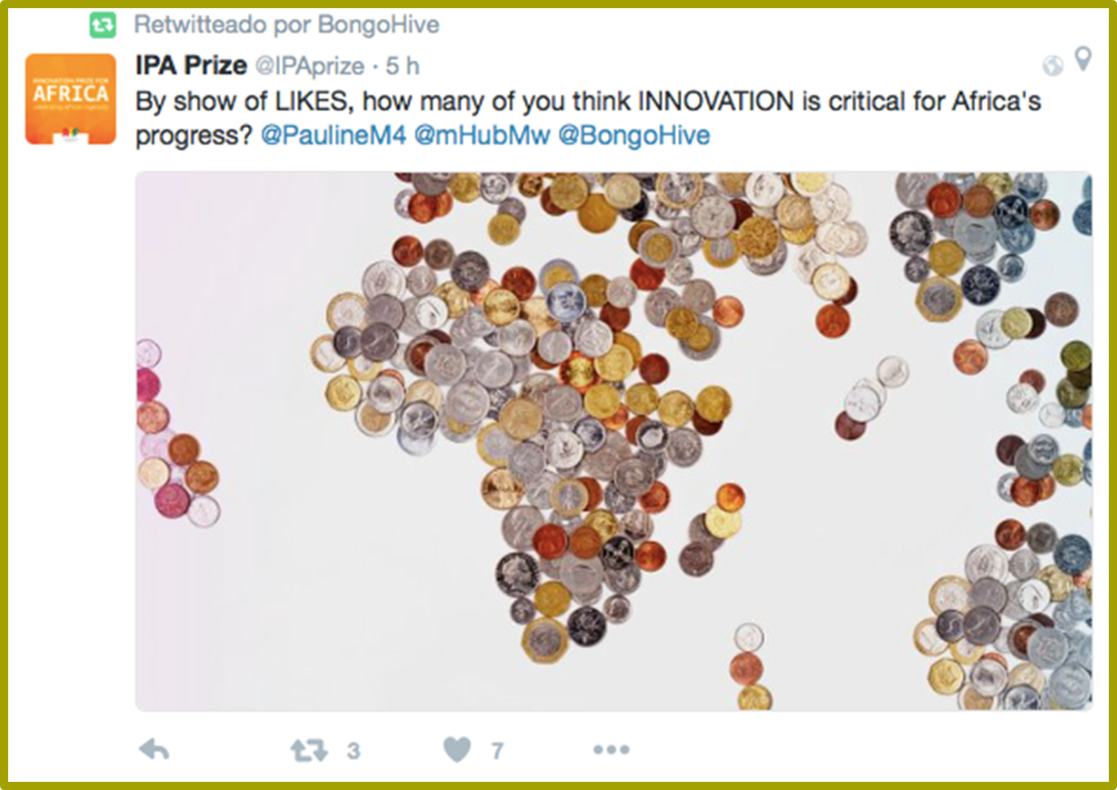
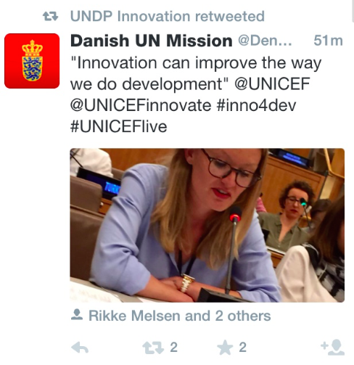


Notes:
But what is happening in the context of innovation hubs is part of a wider phenomena that has been labelled as the cross-fertilisation of business and management into the development discourse. This, more colloquially known as the innovation turn or fever in development, where innovation has become sort of a buzzword, with the introduction of a range of institutions, funding and resource flows, speeches, new job titles and government efforts to think of innovation as a solution to many of the worlds problems.
To give you more specific examples, In November 2011, Bill Gates addressed the G20 country leaders to describe the ‘paramount importance of innovation’ for development
: “I believe innovation is the most powerful force for change in the world. People who are pessimistic about the future tend to extrapolate from the present in a straight line. But innovation fundamentally shifts the trajectory of development.”
the reassurance that we all want innovation, that innovation is always a good thing and therefore speeding up the innovation process can only make things better.
This reflects the dominant discourse and pressure for global south countries to increase their innova- tion capacity, to the point of replicating organisational structures from developed countries and adopt- ing standard international levels of innovation and technology (Kara & Pamukçu, 2011). The chal- lenge of this is that imitating a model of innovation from one region to another may fail to grasp the locally-owned talents and conditions for innovation. Therefore the existing inequalities between the North and the South may be enhanced rather than reduced (George et al, 2012).
To resolve this, we need to look for an alternative approach to the relationship between innovation and development, one that goes beyond competitive advantage and economic growth. To do this, it is nec- essary to problematize the existing linear linkage that equates innovation to economic growth and con- sequently development. This approach follows Srinivas & Sutz (2008)’s argument in relation to tech- nological accumulation in developing countries. The authors argue that innovation, as a term, should be unpacked further, because satisfying to model in economic terms does little to capture the varied types of actual innovation processes.

Slide 6
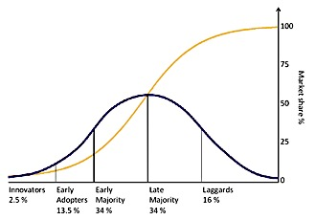
Diffusion of Innovation
Innovation = Progress
Agnostic apolitical
Fails to explain why a certain phenomena move in time and space, and to account for "the social structures producing the space, thereby their existence (Harvey 1990)."
Diffusion of Innovation (Rogers 1995)
Notes:
The stages by which a person adopts an innovation, and whereby diffusion is accomplished, include awareness of the need for an innovation, decision to adopt (or reject) the innovation, initial use of the innovation to test it, and continued use of the innovation. There are five main factors that influence adoption of an innovation, and each of these factors is at play to a different extent in the five adopter categories.
Relative Advantage - The degree to which an innovation is seen as better than the idea, program, or product it replaces.
Compatibility - How consistent the innovation is with the values, experiences, and needs of the potential adopters.
Complexity - How difficult the innovation is to understand and/or use.
Triability - The extent to which the innovation can be tested or experimented with before a commitment to adopt is made.
Observability - The extent to which the innovation provides tangible results.
I want to go back and show you some theories and concepts that have been used to understand and explore innovation as a mechanism for development. Without going too much into detail, we can separate these as concepts looking at the technological innovation transfer, followed by the systems approach, and a more recently body of work that proposes more inclusive ways to frame innovation.
Furthermore, both the Diffusion of Innovation (Rogers 1995) and the Technology Acceptance model (Davis 1989) have been widely used in information systems research and consequently constitute the
dominant theories in studies looking at the role of ICTs for development (ICT4D) in the last two dec- ades (Annika & Hatakka, 2013; Zheng, 2015). This body of literature is mainly concerned with the adoption and diffusion of innovations, rather than the emergence of innovations, and has been previ- ously criticised for taking for granted all the different aspects of context and structure that shape the innovation, sometimes considering people as passive social groups that exist independent of the object (Akrich et al., 2002; Rye, 2009). Zheng (2015) observes that this genre of research does not pay ade- quate attention to issues of power, politics and culture, which affect users’ interaction with innovation, or the embedded values in the design of innovations. Behind the simplistic and fixed view of these theories is an underlying assumption that innovation automatically represents progress, without con- sidering who is innovating, for whom and what, and under what circumstances. Information systems research generally shares the view that ICT innovation should be pursued mainly to foster economic growth and to enhance productivity, with very little discussion on what kind of growth is more inclu- sive and holistic (Xiao et al., 2013).
Those concepts suggest that technological progress is far to be an agnostic apolitical process but it is rather embedded in specific, often contested and hybrid, normative frameworks.

Slide 7
Unpacking the Spaces of Tech Hubs
Research Questions
“How are innovation hubs constructed by spatial relations and practices?”
“How does understanding Tech Hubs as multiple spaces shed light on development discourses, policy and practice?”
Notes:
So in this respect, what we wanted was to look at both hubs that I mentioned earlier, that in London and that in Zambia, and recognise them as part of a multiple constellation of various innovation hubs that are coexisting. Trying to step away from the imitation and adaptation paradigm that is framing hubs, we thought we would evaluate hubs in their own terms, as spaces for community and collaboration, and see how these values take shape in their contexts.
We argue that hubs have the potential to be mechanisms for development, but that there are multiple perspectives of development that are framing the way hubs work. Instead of considering that all hubs collaborate and host communities the same way, we perceive that these are shaped by local aspects and contexts. We propose a way in which this can be theorised, by applying a spatial perspective to see how a hub is embedded in its social economic context, and furthermore, is performed through various temporal-spatial configurations. The aim of this paper is employ a spatial perspective to explore how innovation hubs have a multiplicity of forms and interactions.

Slide 8
Space
From a notion of bounded territories, a container for human activities,
  “empirical, objective and mappable”
To being situated, produced and reproduced through social relations and everyday practices (de Certeau, 1984; Lefebvre, 1991 ).
All spaces are porous, contingent and contested.
Recursive - both a medium and outcome of social practices, relations and power structures .

Slide 9

Doreen Massey
Space is the product of interrelations
  The intersection of multiple trajectories and geometries of power across many spatial scales (Massey, 2005)
  Place is a configuration of temporal-spatiality, an “event”, a “throw-togetherness” of the “here and now” (Massey, 2005, p. 139).
Space is the sphere of the possibility of the existence of multiplicity
  Recognises a simultaneous multiplicity of spaces that are cross-cutting, interconnecting, aligned or contesting with others
  Where alternative narratives and discourses are recognised and where heterogeneity coexists (Massey 2005).
Space is always in process and always under construction
  Open, uncertain, indeterminant
  Always becoming
Notes:
Subsequently, I propose that Massey’s proposition will help us:
Understand innovation for development from a multiplicity of narratives, that are situated in different socio-historical dimensions;
Highlight alternative narratives that are not championed as part of hegemonic discourses that emanate from a Western-centric view of innovation and development.

Slide 10
Space and Development
“Different places are interpreted as occupying different stages in a single temporal sequence in the various stories of unilinear progress that define the West against the rest (such as modernization or development). Talk of the ‘inevitability’ of neoliberal ‘globalization’, to give another example, assumes both a free unbounded space and that globalization takes only one form.” (Anderson 2008 p. 229)
“For this understanding of regional inequality to be challenged it needs to be contested by another geography. Such geography would bring those ‘other regions’ back into view by recognising them in their own rights as locations of their own trajectories [...]” (Massey, 2007 p. 116 –117).

Slide 11
Case Studies: London and Lusaka Hubs
Place is a configuration of temporal-spatiality, an “event”, a “throw-togetherness” of the “here and now” (Massey, 2005).
Across multiple spatial scales

Slide 12
Positionality in the global economic system
LONDON
OECD, financial centre
One of the oldest industrialised economy
16th in World Bank’s Doing Business Report 2017
3rd out of 137 countries in the Global Entrepreneurship Index (GEI)
3rd out of 128 countries in the Global Innovation Index
ZAMBIA (Former British colony)
Economy is mostly reliant on agriculture and copper mining
139 out of 187 countries in HDI
105th in World Bank’s Doing Business Report 2017
96rd out of 137 countries in the Global Entrepreneurship Index (GEI)
125rd out of 128 countries in the Global Innovation Index
Notes:
Overall, the UK shows very high ranks for innovation and entrepreneurship. The World Bank’s Doing Business Report 2017 is an annual report on the state of health of various economies, based on detailed diagnostics of their underlying and embedded characteristics, such as regulatory systems and business governance. In 2017, the UK ranked 16th. The Global Entrepreneurship Index (GEI) looks at the entrepreneurial ecosystem of a country. It combines individual data —attitudes, abilities and aspirations — with institutional components — social and economic infrastructure (Drouillard 2017). In 2017, The UK ranked 3rd out of 137 countries, showing high levels of entrepreneurship. Furthermore, the Global Innovation Index aims to capture a country’s innovation capacity by looking at two main sub-indices — the Innovation Input Sub-Index and the Innovation Output Sub-Index — each built around key pillars. In 2016, the UK ranked 3rd out of 128 countries.

Slide 13
London

Slide 14
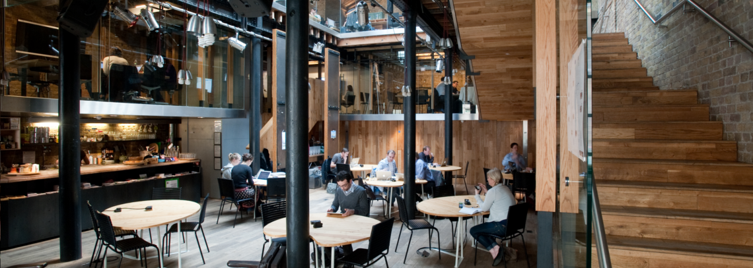
The Hub as an organisational space
The London Hub was founded in 2005, a franchise with over 80 hubs with over 13,000 members worldwide, with headquarters in Vienna – a node in a global network.
The main objective of the hub is to create collaborative communities that are bringing about social change. It sought to gather Londoners with a desire to “[…] work to tackle pressing world problems”.
Co-working space: hot desks, meeting rooms, Internet, kitchen
Community: To connect with a network of entrepreneurs.
  Weekly social events, organised by the Hub or external speakers.
Notes:
This innovation hub was founded in 2005. As of today, it has transformed into a franchise, with over 80 hubs with over 13,000 members worldwide, with headquarters in Vienna. The idea of this hub emerged in the wake of the anti-globalisation movement that arose at the turn of the millennium (Bachmann 2014). It sought to gather Londoners with a desire to “[…] work to tackle pressing world problems”. As such, people looking to find alternative career paths did not have a place to fulfil their ideas. In this respect, the co-founders were looking for a space where people with different backgrounds and skills could work. In a profile written about one of the co-founders:
“Those who had decided to dedicate their lives to new ways of confronting the world’s issues were having to do so from their bedrooms; there was no space for them to find the resources they needed for their project, nor to meet and share with other like-minded people in the same situation” (internal document)

Slide 15
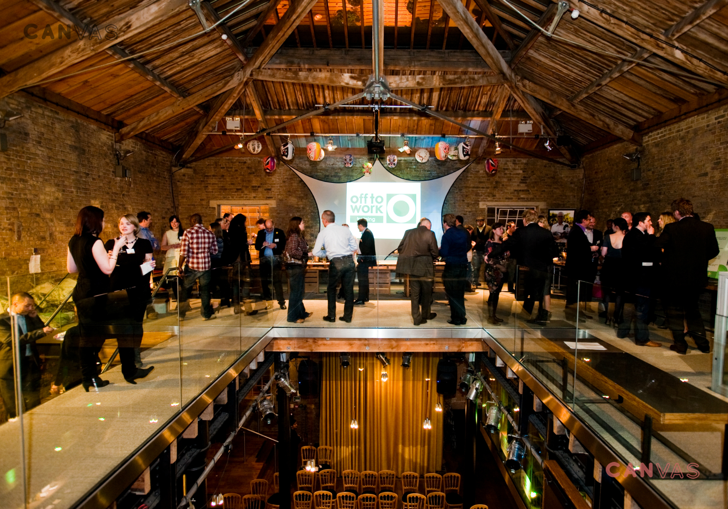
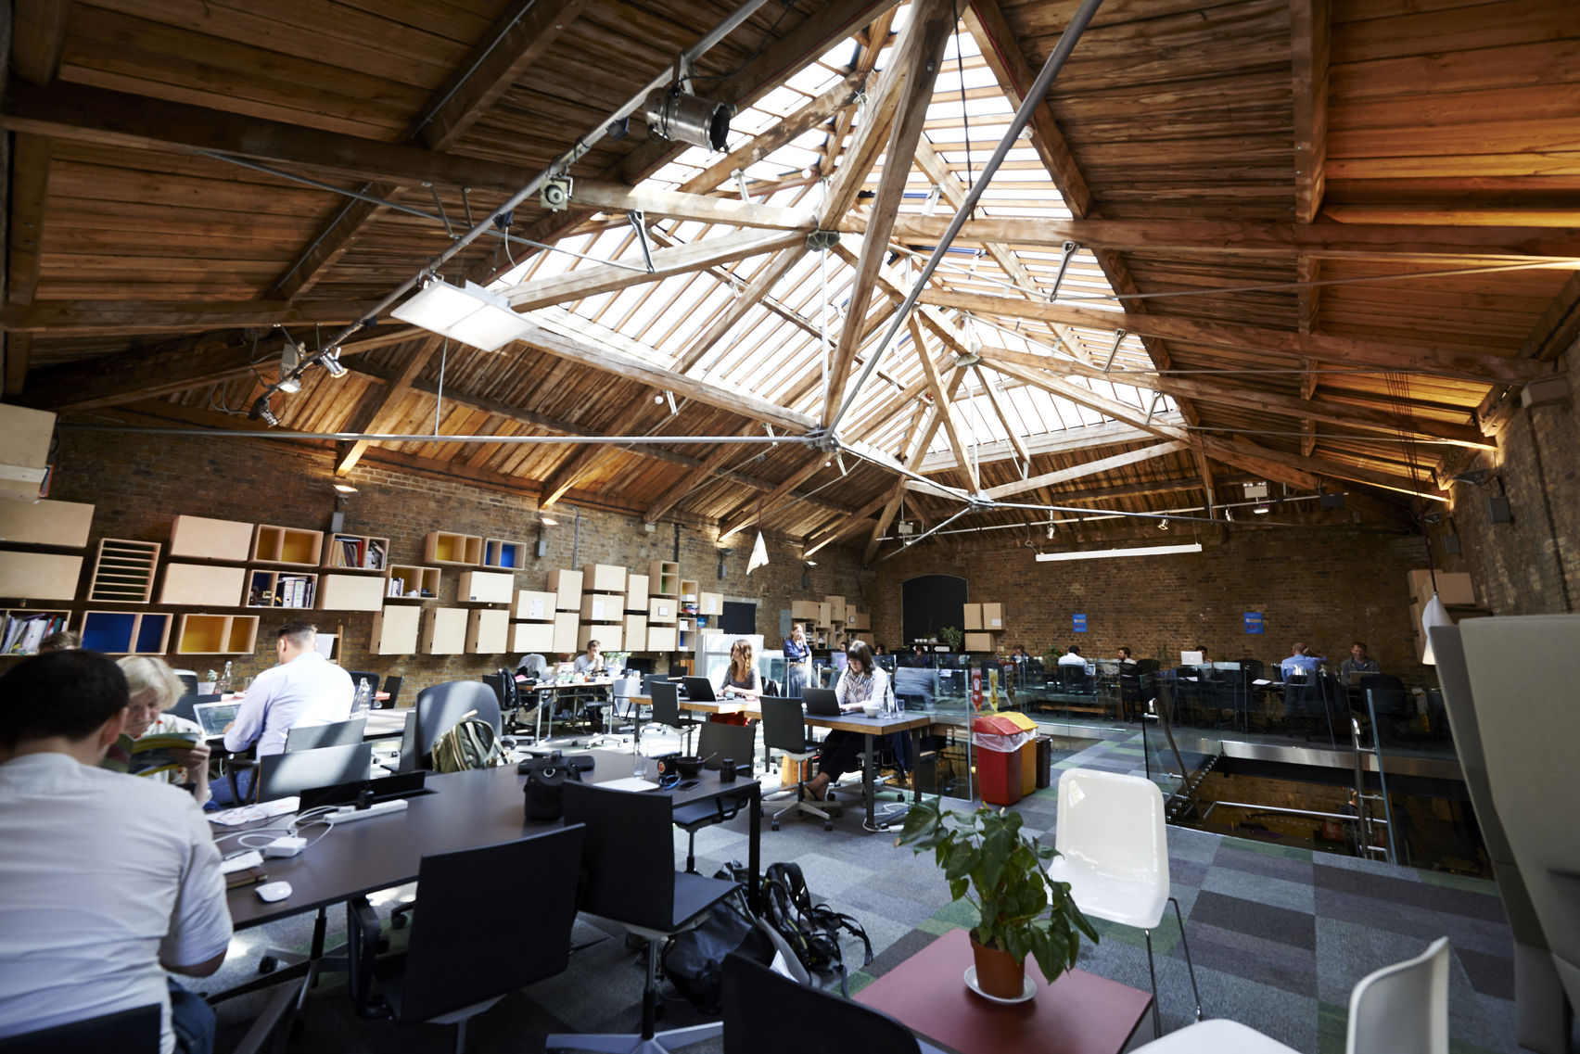
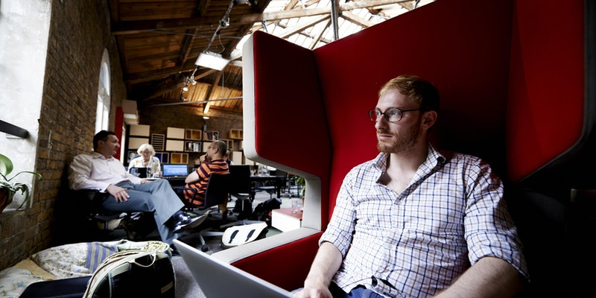
The Hubs as a Physical/ Material Space (London)
“where unlikely allies would meet by serendipity”

Slide 16
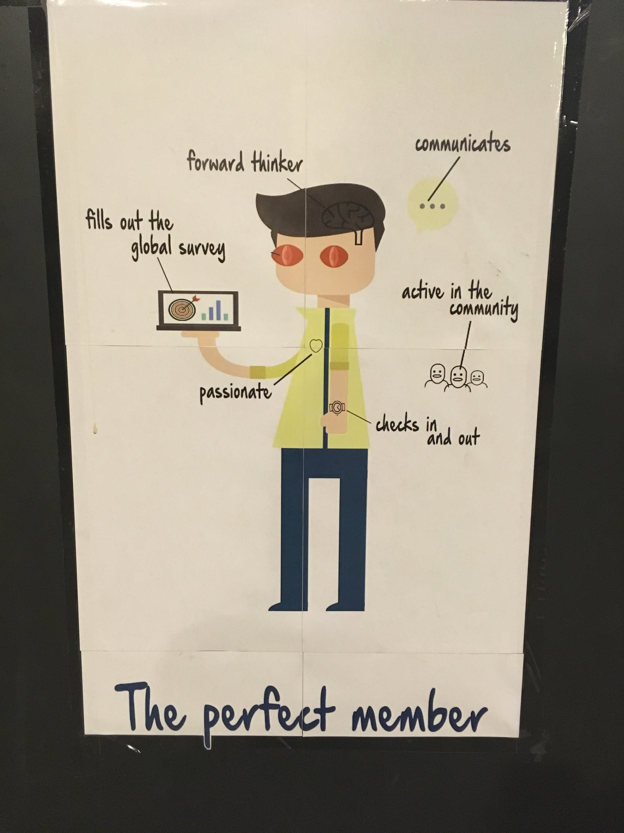
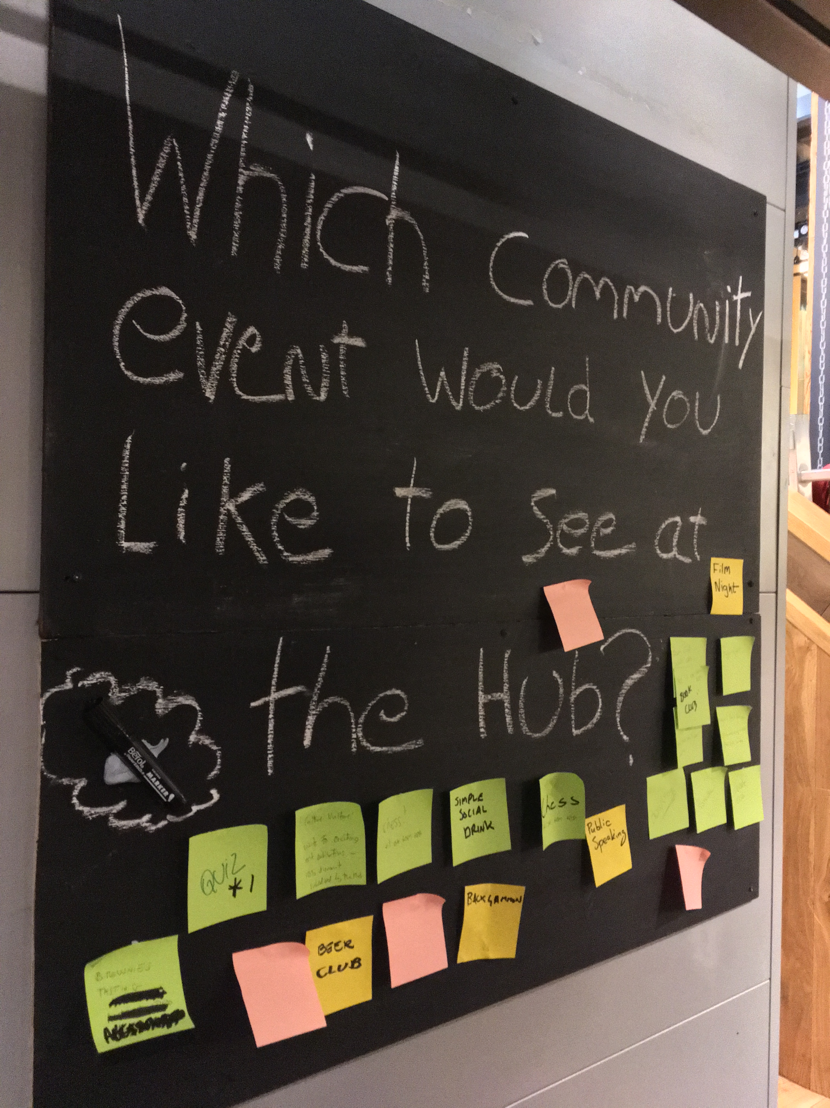
The Hub as Lived Experience
“For shared workspace I think it’s a great place, apart from the intention of trying to get people to collaborate which I don’t think it happens that much (Henry, 32)”
“So I think of the main problems is there’s no private space, no room where people can just go into and have private chats. If you want to chat with a bunch of people, you have to do it out in the open. (Pat, 28) ”
“For us it was more practical, it was more about us being a small business and not wanting to hire a full office. It provides a solution in a really convenient part of London. …. As well as being a great space to bring people to meet and that sort of stuff, is really convenient. But we haven’t really become part of the network.” (Adam)
Notes:
Interestingly, both our interviews and participant observation revealed mixed findings to aspects of community and collaboration. Where you had a lot of effort from the management team to enable community and collaboration, as you can see in the pictures here. This is a board that management team leaves there to try and find better ways to engage with members. This is a picture of the perfect member, the ideal attitutes a member should have.
But the majority of the respondents did not consider themselves part of a community or said they had not collaborated with anyone from the hub.
It’s a gender neutral place. Most women entreprenures commented that they don’t’ feel the gender int eh hbu. Ompared to some discriminatory eperiene in their previous jobs, they commented that in the Hub not only are the balance between gender more balanced, but also the atmosphere, interms of conversations among people, and the respect they receive from other members of the hub,. They feel that there is more in common among the cmembers of the community in terms of common interest in a social cause, than the difference among htem.

Slide 17
Lusaka Hub

Slide 18
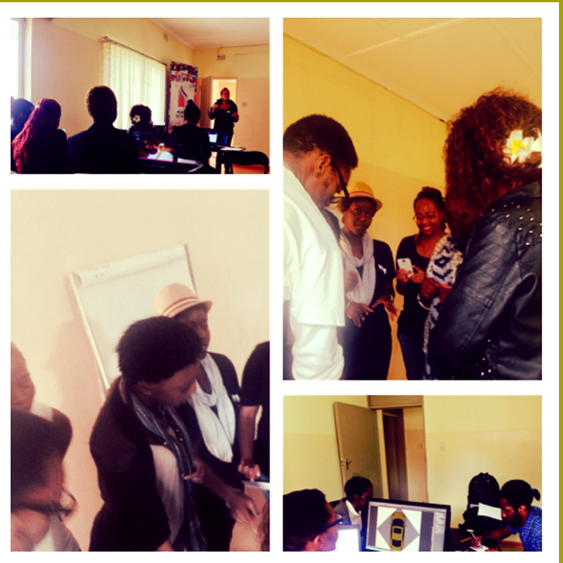
The Hub as an organisational space
Founded in 2011 and is the only hub of its nature in the country
Started as a community of software developers and student interns.
‘To foster a vibrant entrepreneurship community in Zambia’(Website).
Holds values of ‘collaboration’ and ‘sustainability’
  ‘a social enterprise that contributes to local social and economic development.’
Was applying to be a franchise of a London Hub during 2015 but couldn’t afford the membership.
“These guys started it because they wanted a community. They didn't start it because they thought it was a good sell model that would make lots of money. They never thought about money. They just thought about supporting the community, that was it (Vincent, 32).”

Slide 19
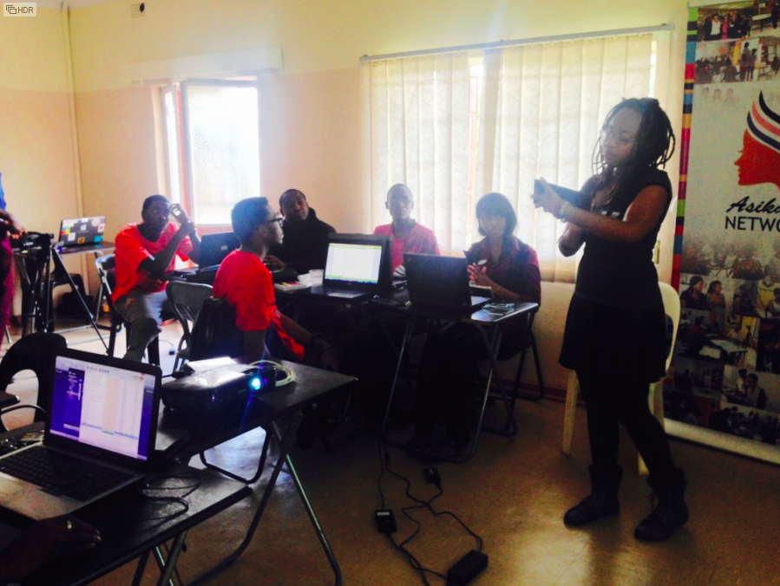
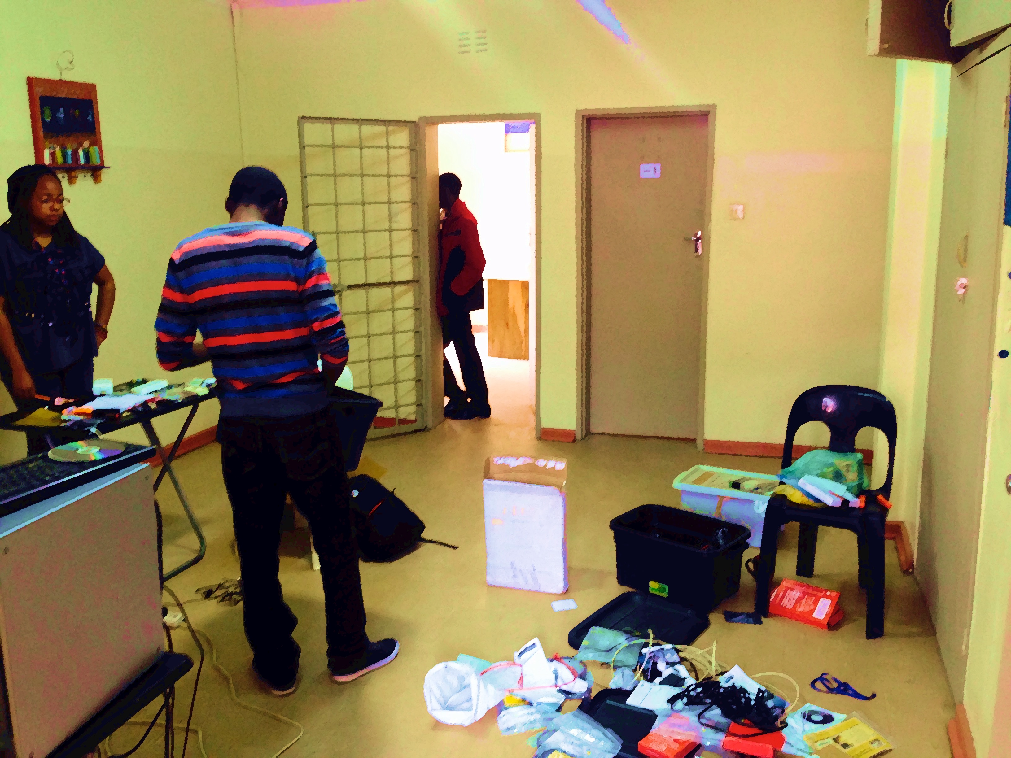
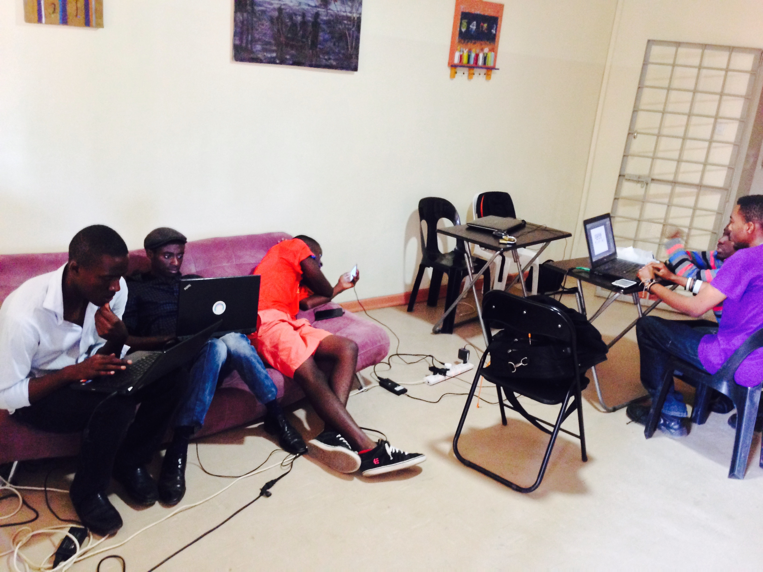
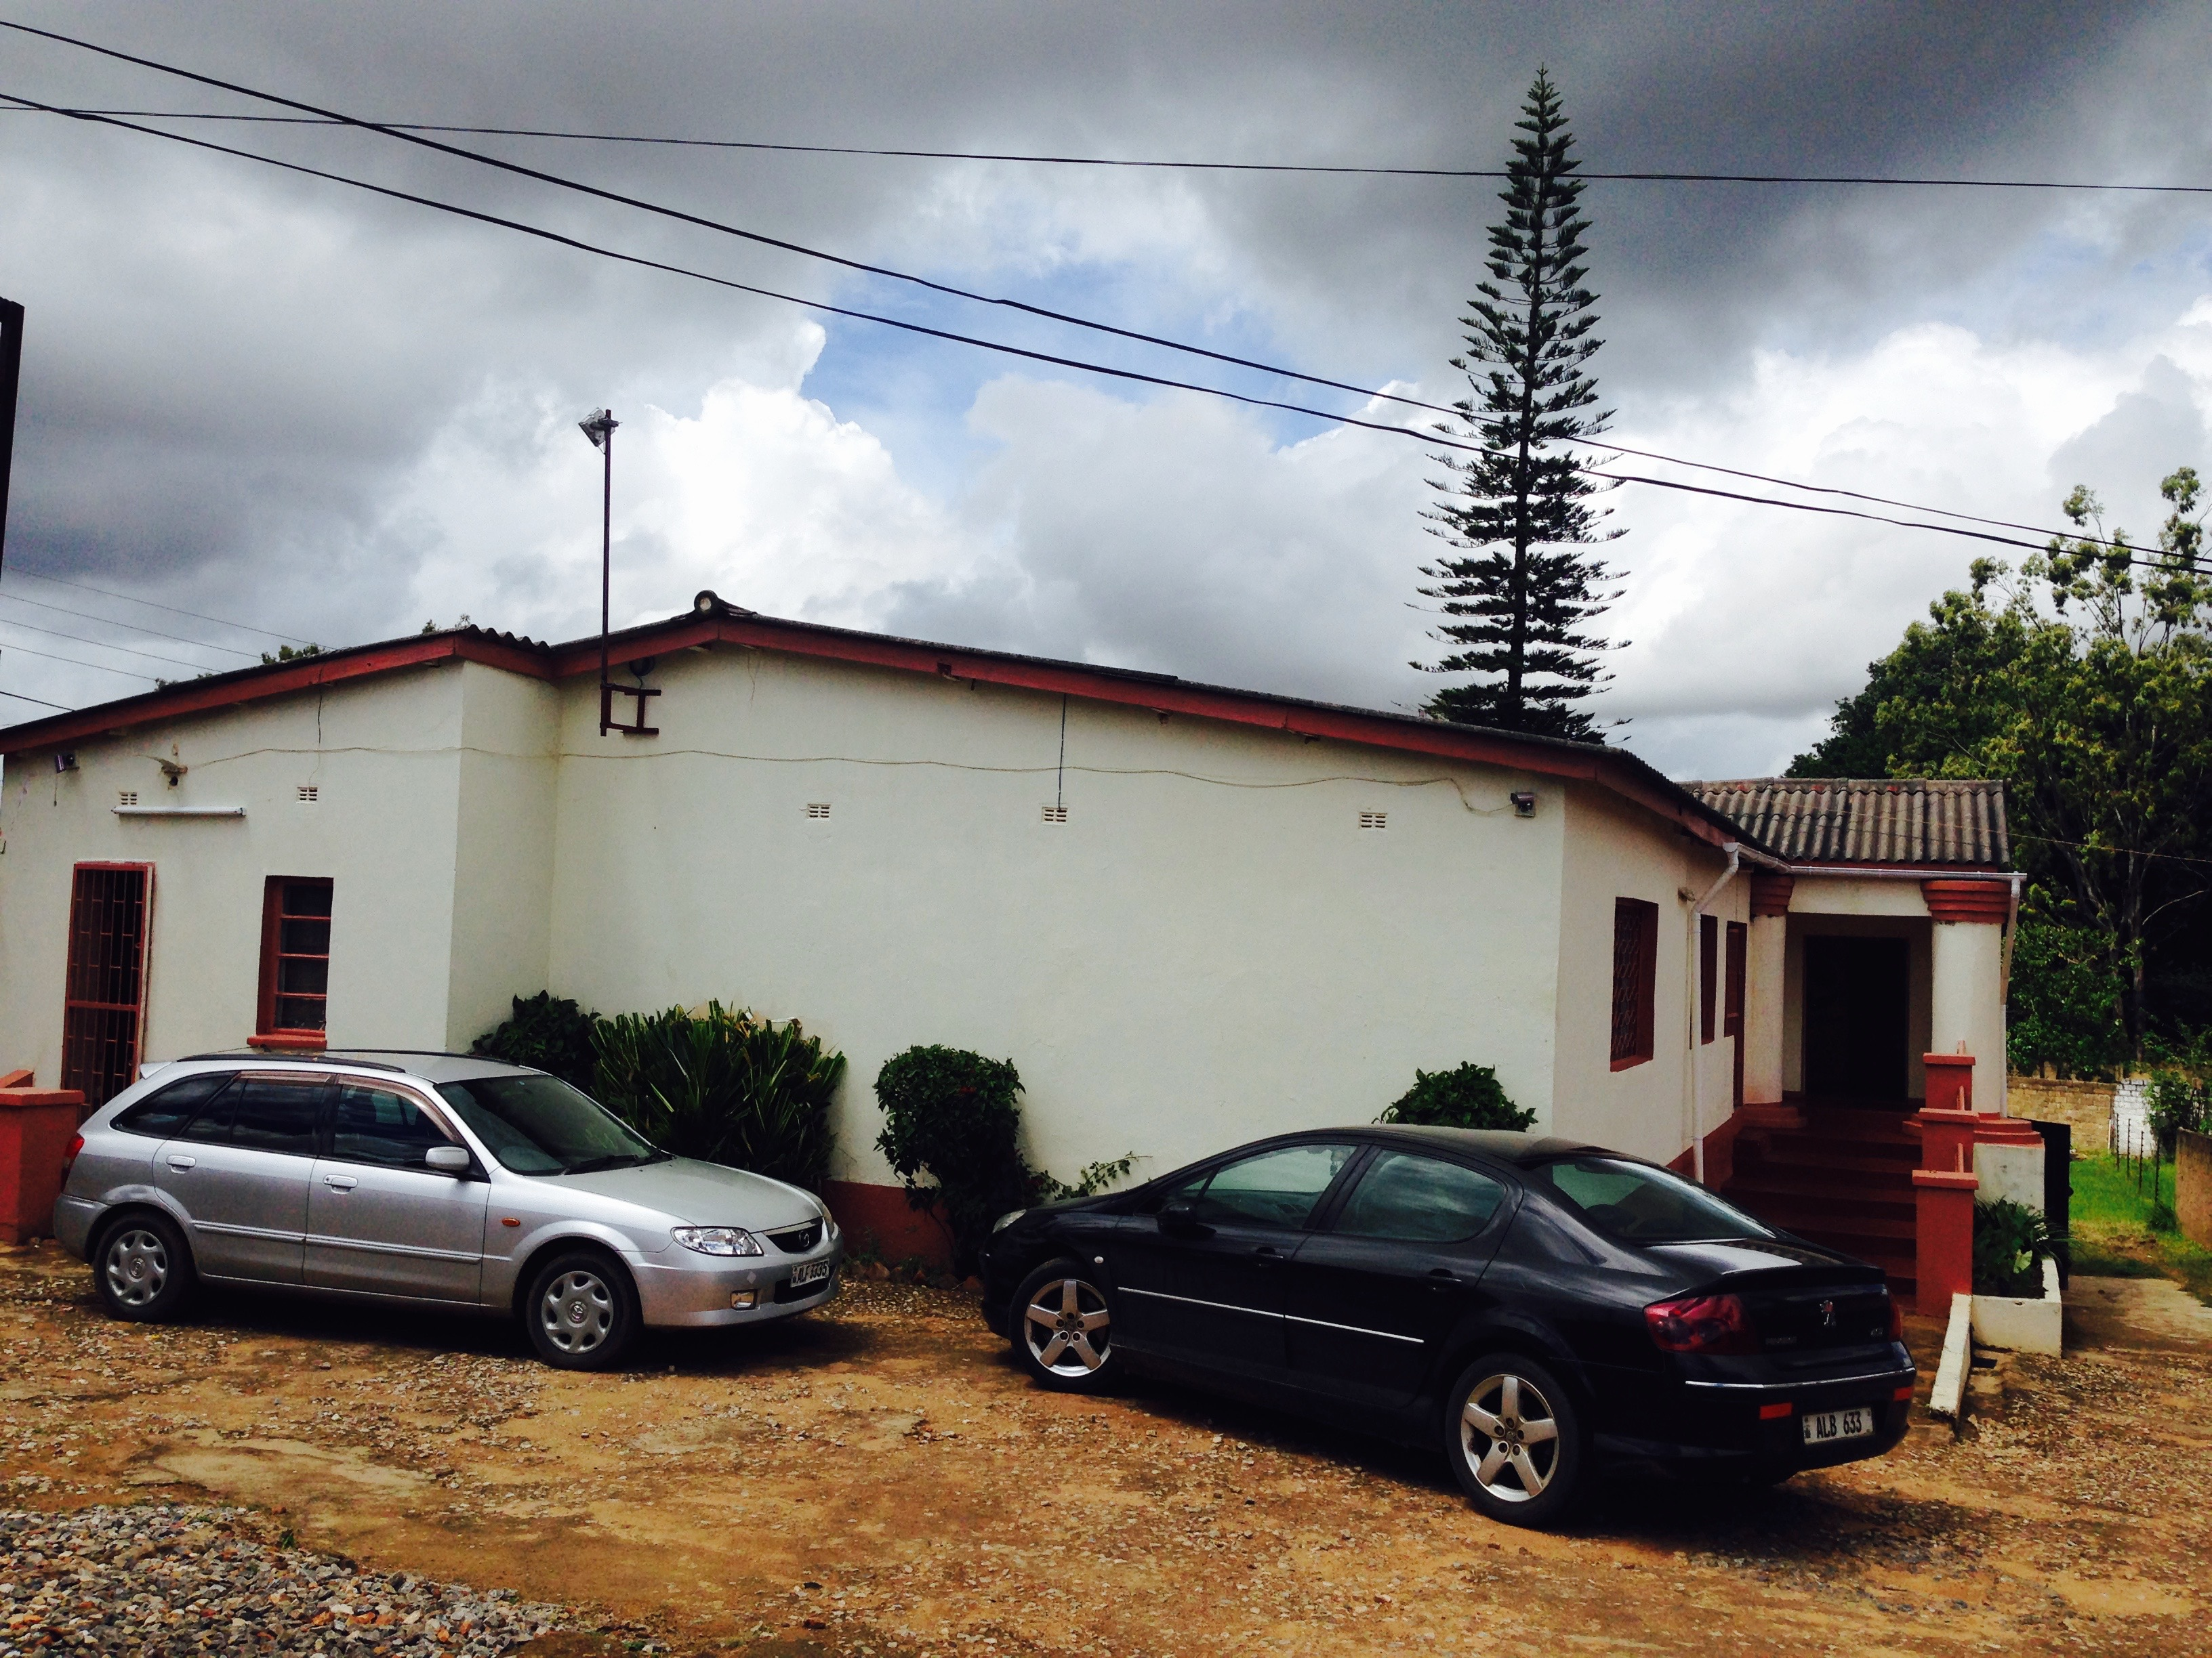
The Hub as a physical/material space

Slide 20
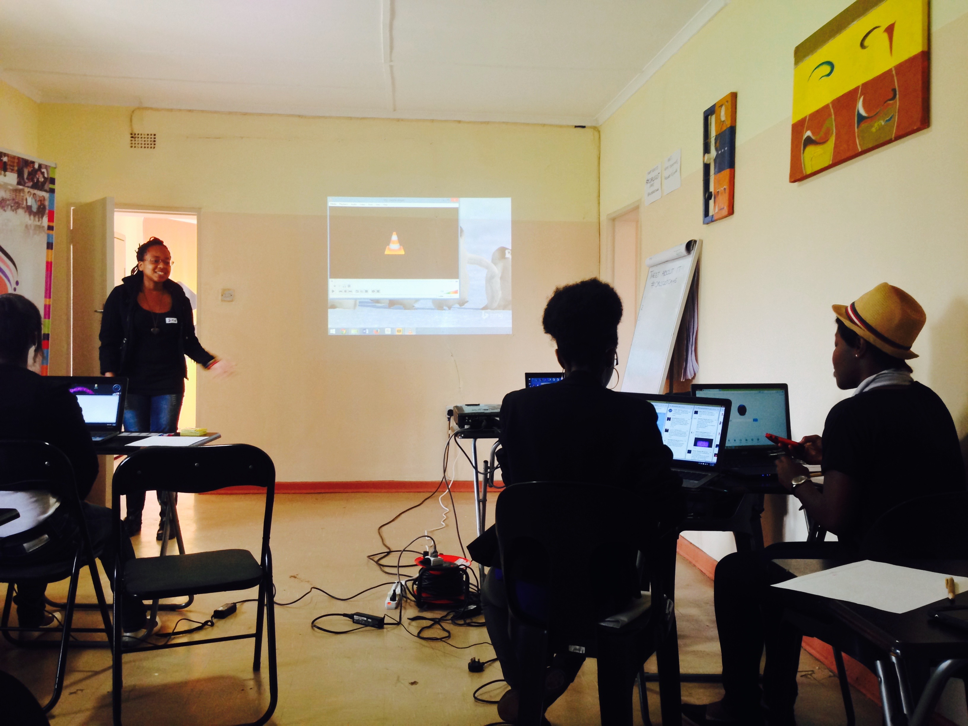
The Hub as lived experience
“When I see people going into these places [coworking places], I don't know why they bother doing it because they're just wearing headphones the whole time. There's just silence, is like a library. Whereas here is like is different, there's no barriers. Is very personal. You walk in and you're popping your head and saying hi to a bunch of people. Whereas in a co-working space you don't know all the people. They talk about the benefits of collaboration and all that stuff [in other coworking spaces], but I don’t see that happening”
“So you find people around here could really help you. If I ask him how do I go about with this because sometimes I am stuck, people come and help me. In a cafeteria I don't think I would meet such people.”

Slide 21
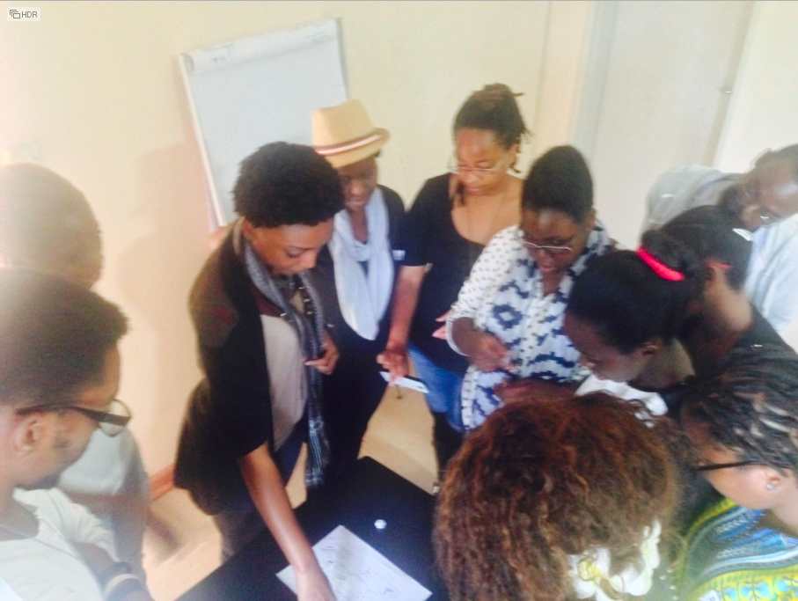
The Hub as lived experience
“ Anytime you go to an event or something, everybody already knows the organisation and its reputation. … it's pretty amazing to have such strong brand recognition when nobody knows what you do. I thought that was pretty compelling.” (Kendrick, 24).
“The great thing about [the hub] when I first came here and even now is that if you want to try something you just do it. And if that doesn't work, well it didn't work, what do we learn from that?” (Mich, 34).
“I liked the environment, how people think, we are all in the same mind set…Driven, I feel like we’re driven.” (Pippa, 30)
"I’m very passionate about Africa, and about Zambia. So I would want to know that whatever it is that I’m working on, at whichever point, should be something that is making somebody’s life better."(Ronda, 27)
Notes:
In the interviews, managers described the hub as a flexible organisation, with lots of trial and experimentation. The hub organisation here is relatively unstructured.
As such, the way the hub’s space is enacted in ways that are strongly driven the values of community and collaboration, and also reflecting a lack of formalisation of institutions and practices of entrepreneurship.
There are significantly less women in the Hub than men, partly due to the fact there are less women in the IT sector. Neverthess, a support network for women in technology use the hub as their work and training space. Some women comment that they received discriminatory attitude fromm male members of the hub, which is a reflection of gender inequality in Zambia as a socity. Nevertheless, women from ta workingclass background and those from a middle class background seem to have different experience in terms of gender equality.

Slide 22
Tech Hubs as Multiple Spatialities
“representation of space” vs “space of representations” ((Lefebvre, 1991)
Tech hobs are not blackboxes to be transferred across contexts. They need to be unpacked as heterogeneous spaces.
Embodies power geometry and embedded in the global discourse of innovation, while enacting different narratives, and performed through local social processes and situated identities.
Tech hubs are dynamic spaces that are evolving and becoming
Important to recognise the multiplicity and coexisting narratives of tech hubs as enacted spaces, and be open to heterogeneous possibilities and trajectories.
Notes:
So to illustrate what we’re trying to say here
institutional support systems shape spatial relations and practices of both hubs.
Innovation hubs need to be understood as constituted by local practices and conditioned by structural and institutional arrangements.
Government bodies and international organisations seeking to promote innovation hubs should pay closer attention to the existing institutional support in the specific environment in which a hub is embedded.
When we talk about tech hubs as spaces for change, what exactly are we talking about. We didn’t really go into the concept of innovation here, but focus on unpacking the space of tech hbs. It seems that the notion of innovation is used as a bandwageon for development. J When tech hubs use community and collaboration as branding, they are treated as instrumental for innovaiotn. It is not clear what kind of innovation are being evaluated. In a market economy, we usually measure innnovaiton in terms of marketable products and number of patents. If we are talking about innovation that bring aobut social change, the questions is then how does a hub facilitate that to happen. Are we talkinga bout social innvoations triggered by technology. s

