Slide 1
Digital Platforms Matter Globally

Slide 2
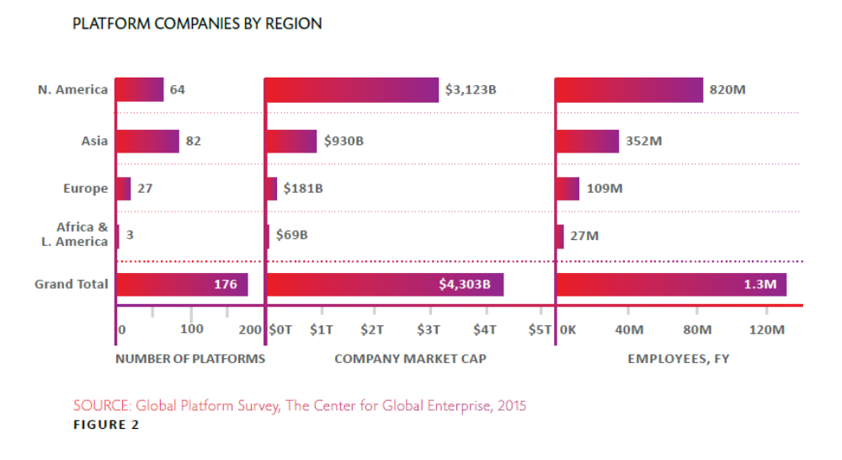

Slide 3
Is this the new business model of 21st Century?

Slide 4
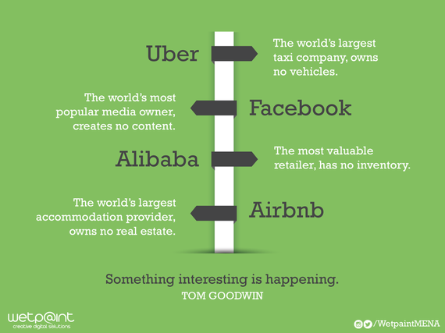

Slide 5
Developmental value and local context

Slide 6
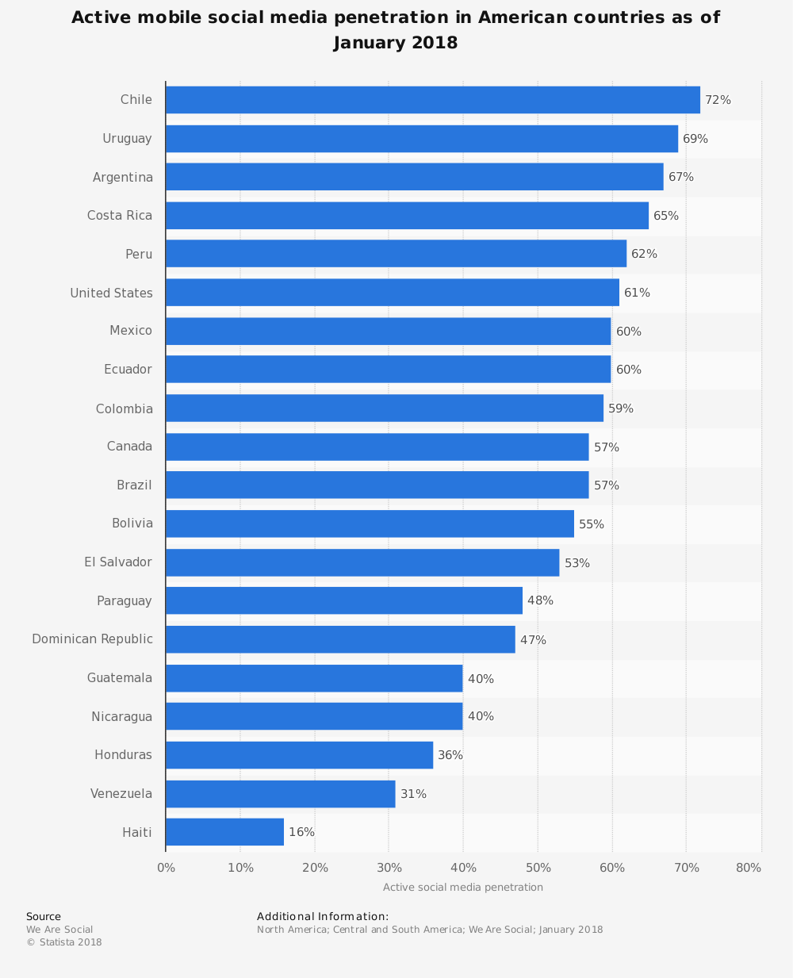
(https://www.statista.com/statistics/308282/active-social-network-usage-penetration-of-the-americas/)

