Slide 1
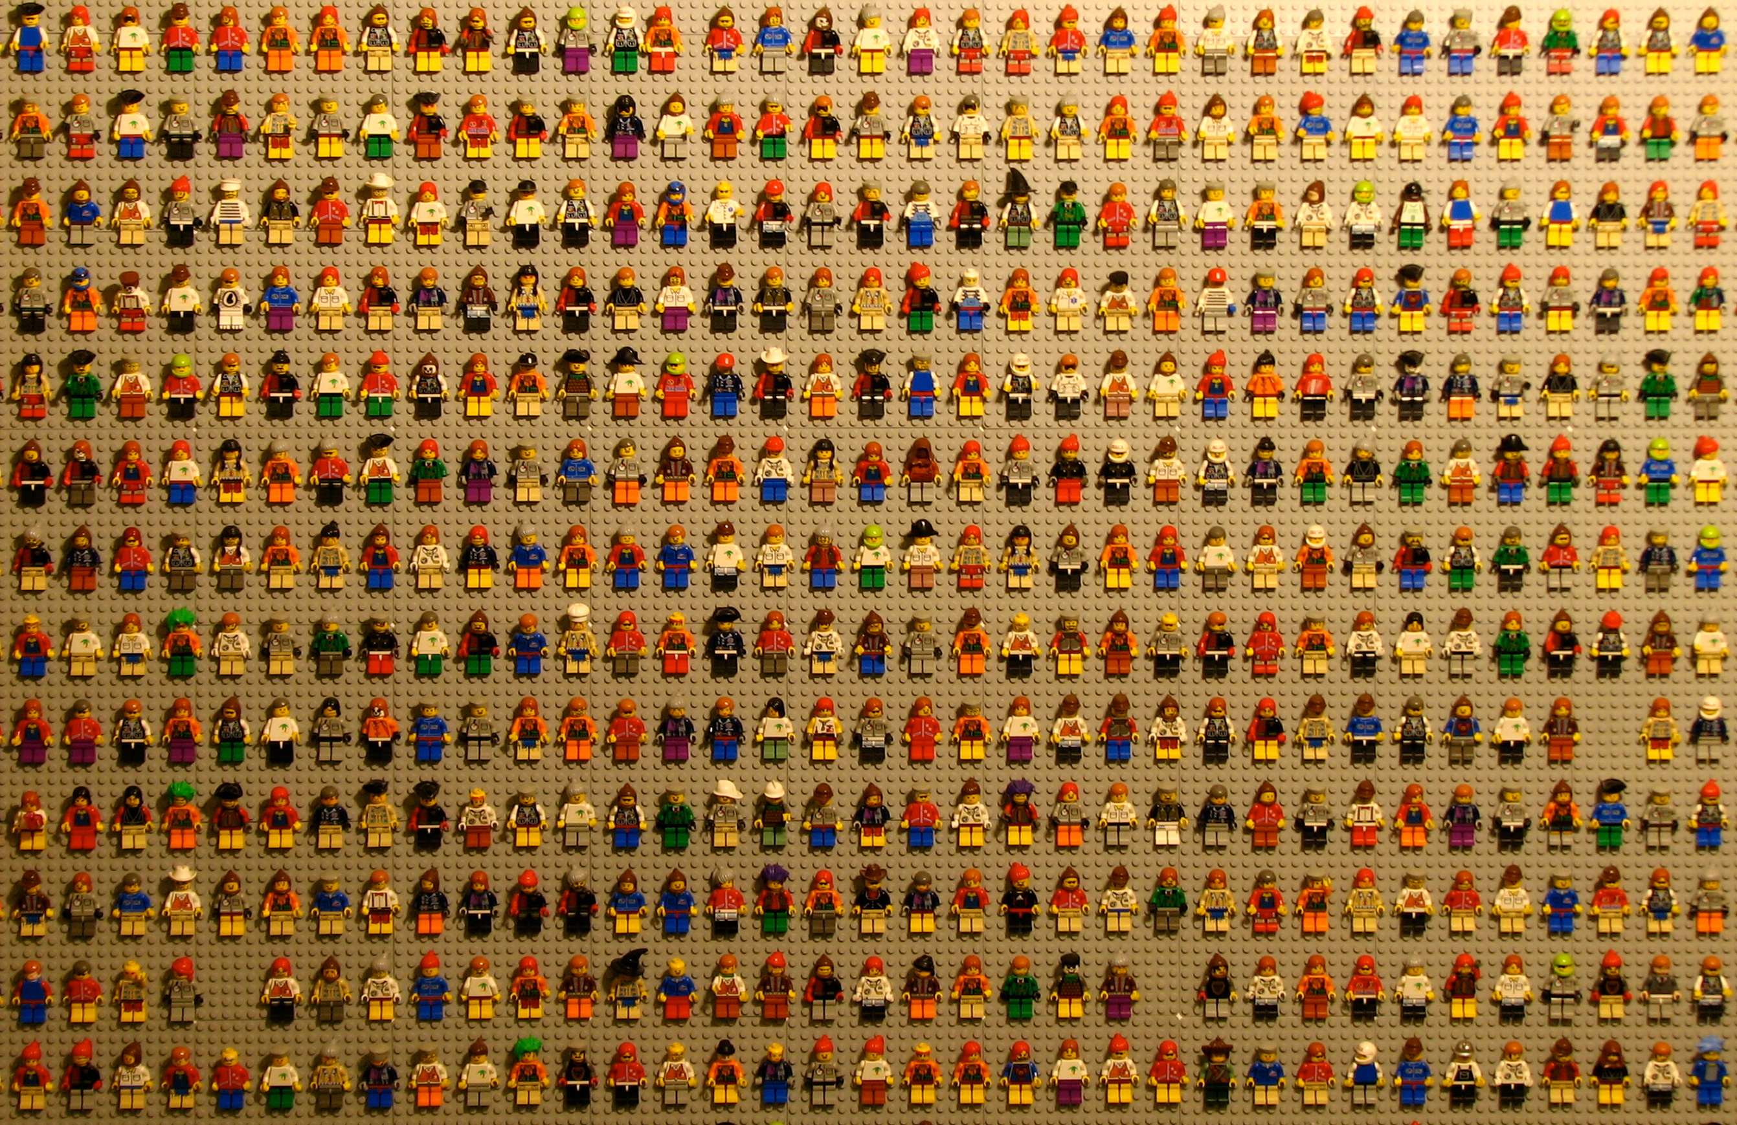
Designing the digital economy
Future research directions
Jacki O’Neill
Notes:
Since my research interest is on how we can design technology to support and enhance social impact, I am going to focus on what we need to focus on in terms of design. Of platform economy

Slide 2
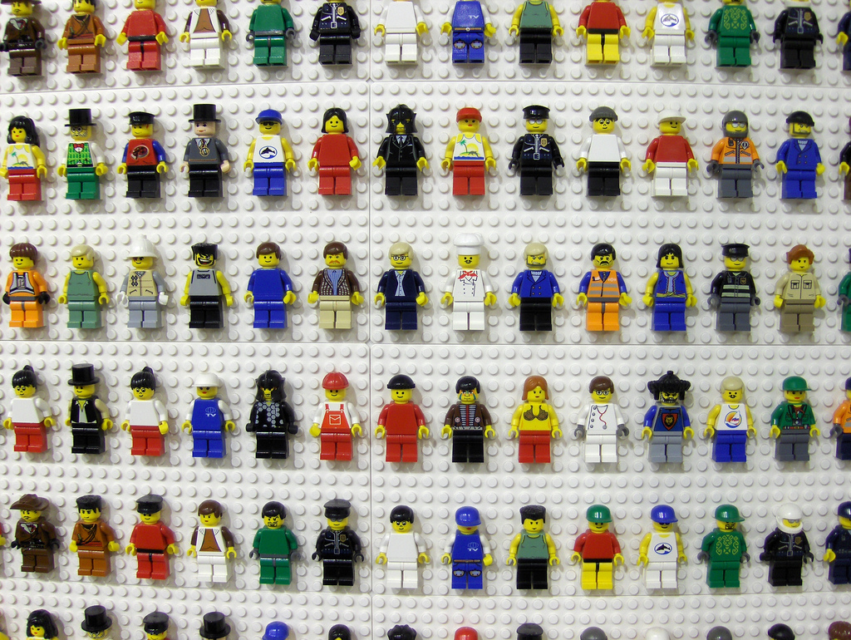
Future research priorities for platform economies
Nothing inherently exploitative in platform economy
What does it mean to create platforms which are equitable by design?
  Conceptual: What is equitable? Fair? Feminist? How do we fit such concepts with ‘market forces’?
  Practically: Designing for three perspectives (worker, platform, customer/’employer’)
Notes:
Nothing inherently exploitative: Great power in the aggregation of work that is the platform economy
Our most important research question therefore should be

Slide 3
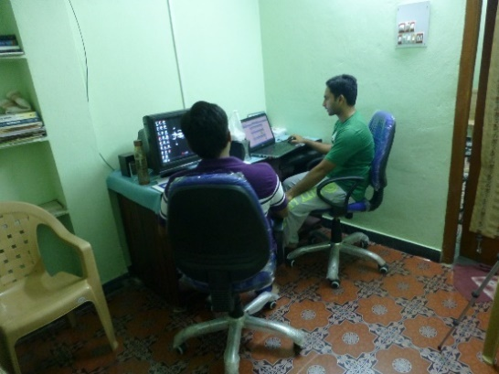
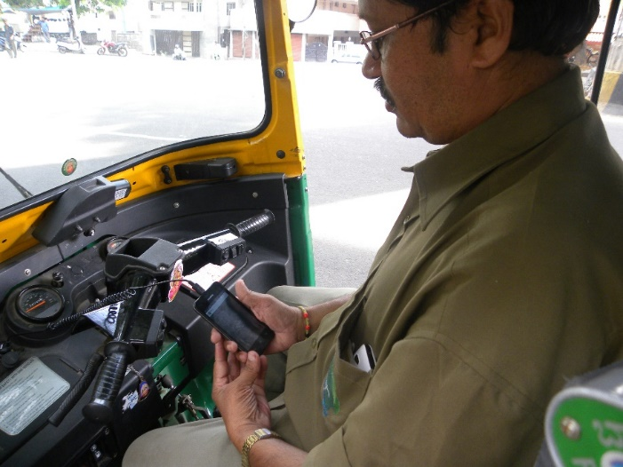
Worker perspective
So far largely (and deliberately) ignored
Workers value flexibility and independence, but current tools restrict both
Each platform is a silo and rarely enable workers to access ‘bigger picture’
How can we promote greater independence and flexibility?
  Platform agnostic tools for workers to escape the slios, understand markets they work in and career development
  Data ownership
Notes:
Designing fair algorithmic management
Take the workers perspective to do this
Bigger picture or (data intelligence) in Parminder’s terms

Slide 4
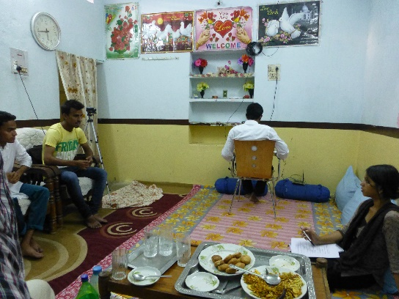
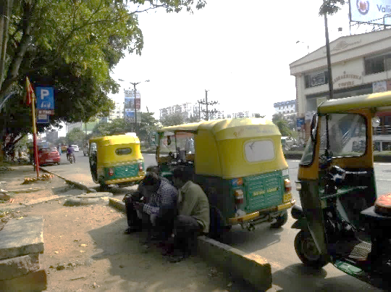
Worker perspective
So far largely (and deliberately) ignored
Understanding algorithmic management (advantages and limits)
  Designing fair algorithmic management
  Designing for worker agency and individuality
Designing for collective action
Notes:
Current algorithmic management leaves a lot to be desired
Designing fair algorithmic management
Take the workers perspective to do this

Slide 5
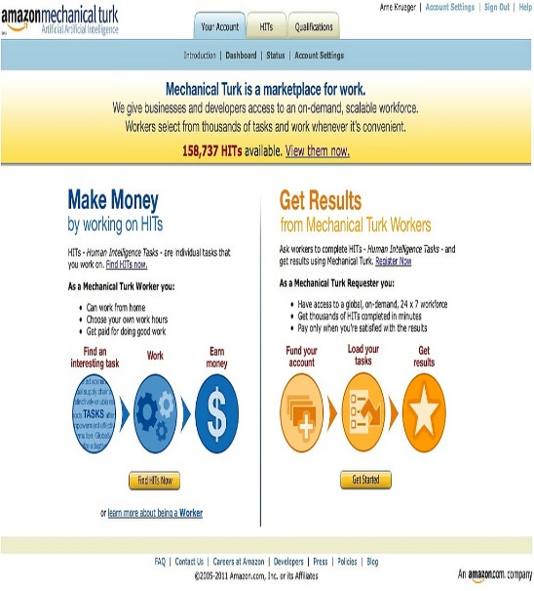

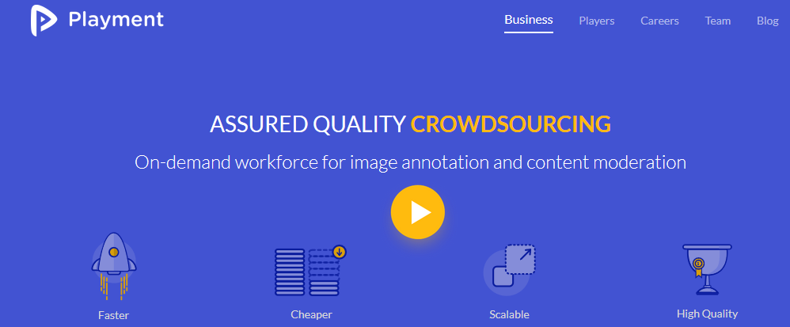



Platform perspective
How to ‘build in’ (technical and policy) responsibility
Counteract adversarial model: tech control and constrain
Notes:
Responsibility – even if your workers are contractually not your employees, platforms still have responsibility for them – for their actions and their welfare. This needs to be built in to the system, pure ‘market forces’ will not hack it
Current platform design typically uses platforms to control and constrain their workers – this sets up a costly and unpleasant adversarial model

Slide 6

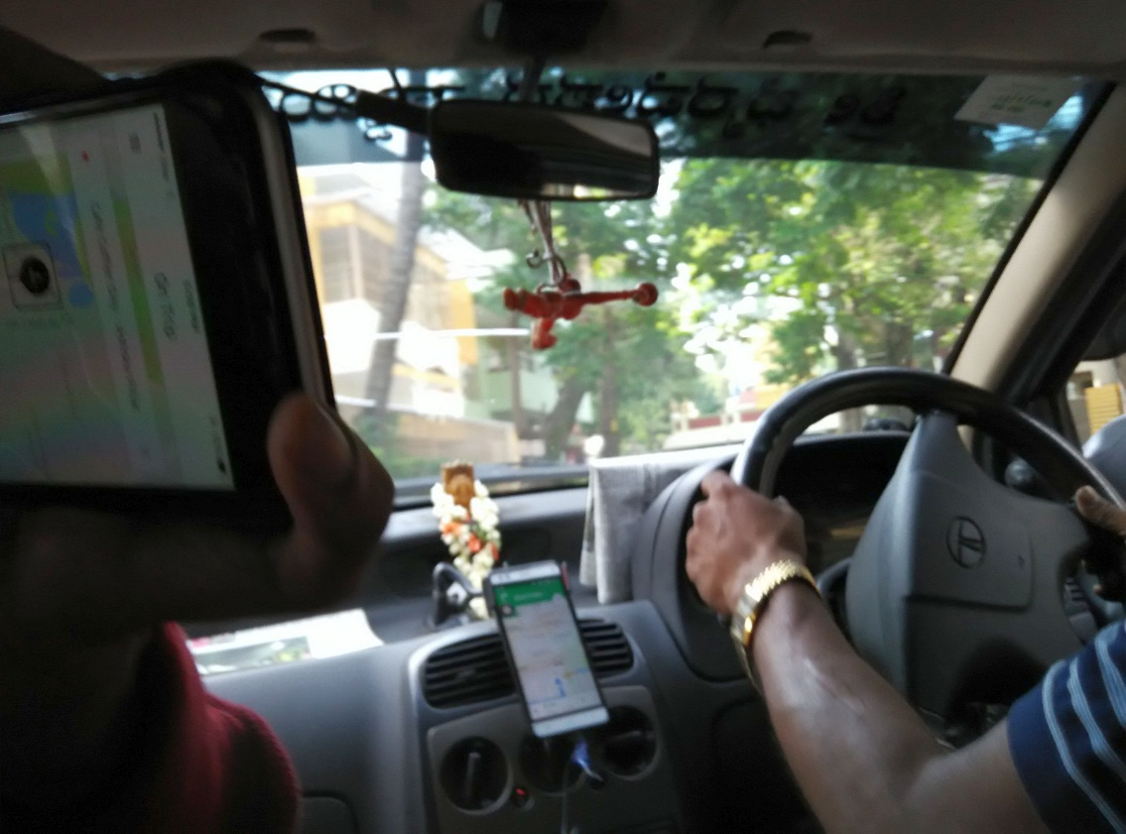
Customer/employer perspective
Supporting digital inclusion by designing platforms to benefit marginalised communities
  E.g. accessibility
Enable relationships
  Both workers and customers are individuals
  Relationship-based crowdsourcing beneficial for both worker and ‘employer’

