Slide 1
The developmental state and the platform economy
Development Implications of Digital Economies:
Findings and Next Steps
Manchester
11-12 April 2018
Balaji Parthasarathy
International Institute of Information Technology Bangalore

Slide 2
The presentation
The developmental role of the state, the developmental state, and the platform economy
A historical overview of global concerns about the impact of technology on labour
The developmental role of the state in navigating the relationship between technology and labour
The role of the “developmental state” viz-a-viz online digital gig work – illustrated through initiatives in Kenya & Nigeria

Slide 3
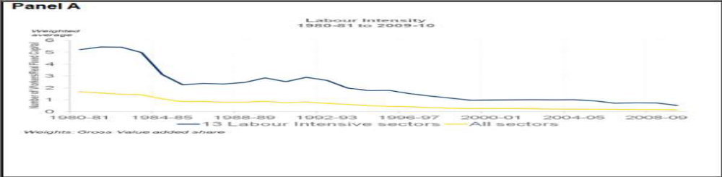
The concern: technological advancement and labour
47% of jobs in the U.S., 56% of jobs in Cambodia, Indonesia, the Philippines, Thailand and Vietnam, and 70%+ in India, Bangladesh, China, Cambodia, Nepal and Ethiopia are at high risk of being automated (ILO, 2017).

Slide 4
Automation and deskilling
The most rapidly growing mass occupations in an era of scientific technical revolution are those which have least to do with science and technology because the purpose of machinery is to decrease the number of workers attached to it” (Braverman, 1974:384)
Automation will replace “work that can be encoded in a programmable sequence” (Castells, 2010:258) and “expensive enough to be worth the investment in technology to replace them”(Castells, 2010:266).
Fragmentation of tasks leading to loss of craftsmanship, separation of conception from execution (Braverman, 1974)

Slide 5
Labour and flexible working arrangements
Improved connectivity with improvements in ICTs has, in part, enabled flexible working arrangements with the following characteristics (Castells, 2010):
- no fixed working time
- task-oriented, no job stability
- no fixed location of work
- tenuous social contract between employer and employee
Flexible work arrangements support mobility of capital viz-a-viz rigidity of labour (Castells, 2010)
Productivity and profitability increases, labour loses institutional protection leading to “individualization of labor in the labor process” (Castells. 2010:282)

Slide 6
Digital gig-work as flexible work arrangement
Digital gig work is a particular kind of flexible working arrangement
Contingent (task- or project-based) intangible work delivered digitally and done for money, organised via online outsourcing platforms that are marketplaces bringing together buyers and sellers. Eg. AMT, Freelancer, Upwork etc. (Heeks, 2017:1)
Tasks may vary from menial and monotonous parceled activities requiring some sort of judgment beyond the understanding of artificial intelligence (e.g. tagging photos, valuing emotions or the appropriateness of a site or text, completing surveys) to bigger and more meaningful works such as the creation of a logo, the development of a site or the initial project of a marketing campaign (De-Stefano, 2016:2)

Slide 7
Is the relationship between technology and labour inevitable?
Technological unemployment “due to our discovery of means of economising the use of labour outrunning the pace at which we can find new uses for labour” but this is a “temporary phase of maladjustment”(Keynes, 1933:3).
The era of mass technological unemployment is not imminent – no need for policies for a jobless economy - best strategy is not to slow technology but strive for flexibility, so that people, organizations and institutions can learn and grow their way into a healthy future (Brynjolfsson and McAfee, 2016)
What can the state as an institution do in such a situation?

Slide 8
Addressing the concerns: the role of the state
The relationship between technology and work can only be understood in complex interaction within a social system comprising management decisions, systems of industrial relations, cultural and institutional environments and government policies (Castells, 2010)
The key concern for the government is how to adapt to technological changes and ensure socially acceptable standard of living for citizens i.e. how to play a developmental role to maintain legitimacy
A developmental state sets “substantive social and economic goals” (Johnson, 1982:19), with a developmental ideology and a structure pertaining to the requisite institutions, norms and standards that can support the development process (UNESC, 2012)

Slide 9
The role of the state in advanced informational societies (G-7 countries)
Countries show variations in their employment and occupational structures amidst a long-term decline in share of manufacturing employment (Castells, 2010).
A Service Economy Model after 1970. eg. U.S.,U.K, Canada
Industrial Production Model - reduced share of manufacturing employment but still a large share of labour force.eg. Japan, Germany
These differences are due to “different government policies and firms' strategies”(Castells, 2010:246)

Slide 10
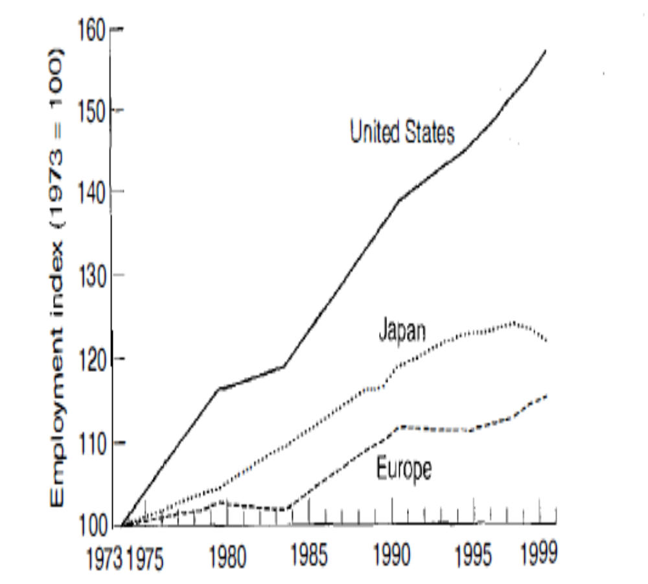
Index of employment growth, 1973-1999
High unemployment was a problem for some European countries.
Technological innovation and diffusion did not have a direct impact at the aggregate level.
Macro-economic policies and an institutional environment (including rigid labour markets) that discouraged private job creation were responsible (Castells, 2010)
Thus, employment patterns in a country are dependent on state policy
Source: (Castells, 2010 : 268)

Slide 11
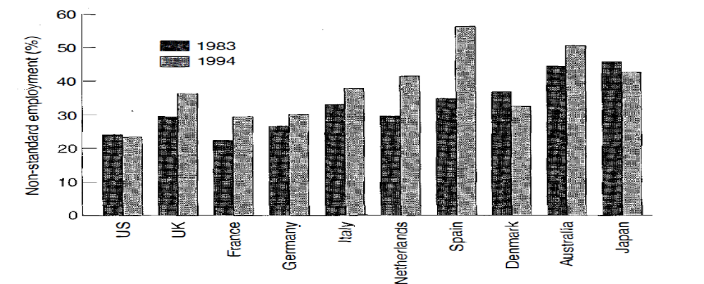
Non-standard forms of employment arise out of flexible working arrangements which vary across countries
Source : (Castells, 2010 : 288)
Non-standard forms of employment in employed labour force in OECD countries, 1983-1994

Slide 12
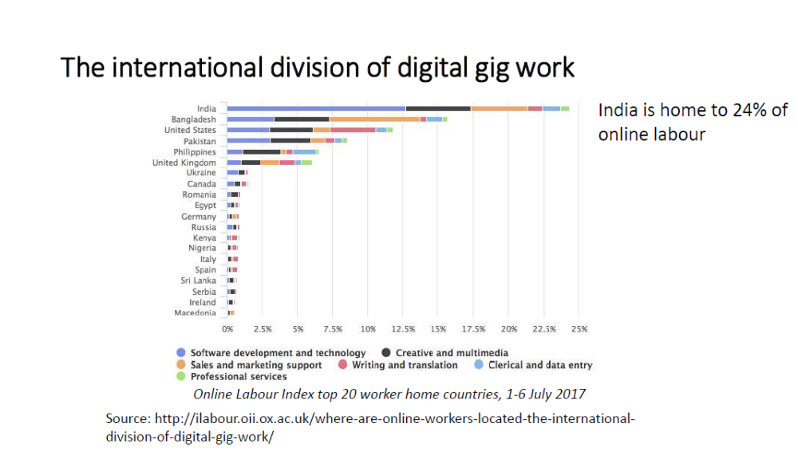

Slide 13
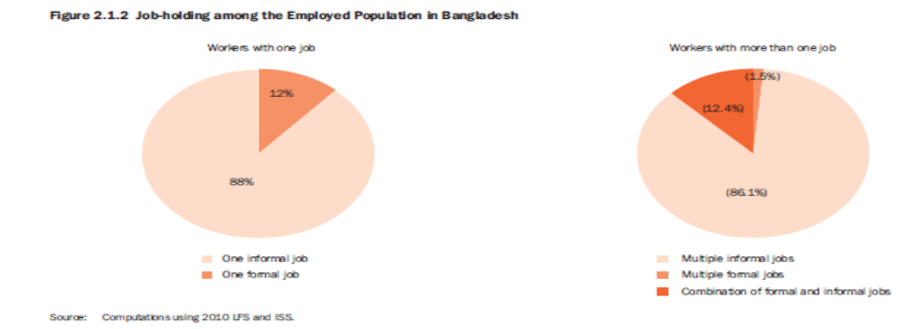
Bangladesh – high levels of informalization
Digital gig-work – part of broader trend towards informalization of labour?
Source: (Asian Development Bank & Bangladesh Bureau of Statistics, 2012:10)

Slide 14
The developmental state and digital gig work
Investment in developing skills through education and opportunities for “learning by doing” provides employment opportunities for its citizens – digital gig work being one of the options available when there is a lack of other local opportunities (UNESC,2012)
D’Cruz and Noronha (2016) suggest that, in India, Upwork provides employment and skill enhancement opportunities, specially for those in smaller cities
Rather than a problem, digital gig worker emerges as a possible solution albeit with challenges
How the solution emerges depends on the developmental model and the nature of the state: the developmental state is based on selected features, which can and need to be adapted to different conditions in time and space (UNESC, 2012)

Slide 15
Human resource capability
In an age of global shift towards services, the “comparative advantage” of a country lies in its human resources.
As Schultz proposes, investment in human capital through education and training to acquire knowledge and skills can increase human performance and earnings and thereby increase earnings, and, in turn, strengthen the economy and raise living standards (Law,2009)
The World Bank (1993) considers investment in education as one of the key factors for the East Asian Miracle
While employment is important, income security and job security are also important to ensure human development, necessitating regulation of the employment relationship

Slide 16
Regulation of the employment relationship
In digital gig work, key concerns viz-a-viz the employment relationship include:
non-recognition of the work and hence non-compliance with minimum wage laws, social security contribution, anti-discrimination regulation, sick pay and holidays (De-Stefano,2016)
- lack of accountability of the platform providers
a regulatory role of citizens on the Internet, will require information about a) who someone is (b) where they are, and (c) what they’re doing (Lessig, 2006:23)
of course, whether a part of cyberspace can be controlled depends on its code (Lessig, 2006)

Slide 17
Employment
Skilling and employment opportunities need to compliment each other to ensure that socially accepted standard of living is met
State can either provide the infrastructure or actively intervene to ensure employment opportunities through digital gig work
Ajira in Kenya and Naija Cloud in Nigeria are two active interventions undertaken by the state

Slide 18
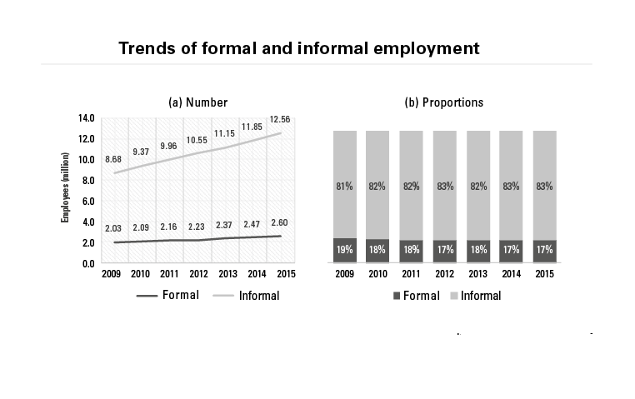
The context- Kenya
Source: https://www.africaresearchinstitute.org/newsite/publications/kenya-failing-create-decent-jobs/

Slide 19
The context - Kenya contd.
Kenya has the highest informal sector employment in Africa
In 2015, 83% of eligible workers in Kenya were employed in the informal sector, and
jobs in the informal sector were growing at a higher rate than jobs in the formal sector
According to the United Nations' Economic Commission for Africa Kenya is Africa's biggest supplier of online workers and tenth in the world, and the online work sector is fragmented and informal (https://www.businessdailyafrica.com)
Ajira Digital was launched in 2016 as an online platform to enable young people to access online jobs and provide tools, training and mentorship to work and earn an income online (https://www.iafrikan.com)
Ajira is an effort by the government to connect local skills with mainstream opportunities formalize the sector (https://www.businessdailyafrica.com)

Slide 20
The context - Nigeria
Nigeria has Africa’s largest population (approximately 174.5 million) and economy (more than $500 billion in annual GDP)
A Ministry of Communication Technology was established in 2011, an ICT Policy developed in 2012, and a National Broadband Development Plan developed in 2013
The World Bank ICT/Education team worked with Nigeria’s Ministry of Communication Technology and Federal Ministry of Education to leverage virtualized job opportunities to support job creation (http://blogs.worldbank.org)

Slide 21
The initiative – NaijaCloud - Nigeria
The Microwork for Jobs - Naijacloud initiative was launched in all 36 states of Nigeria in March, 2013 to help create awareness about job opportunities available on Microwork and e-Lancing spaces in order to address the issue of youth unemployment which according to newspaper reports was at 60%
It involved an awareness campaign carried out through a website, a Facebook page, a Twitter account and traditional media sources, a series of workshops that helped connect more than 1,000 potential workers to international microwork and freelancing organizations and workshops that helped acquaint approximately 60 local, regional and international companies and organizations with business opportunities for job creation on virtual platforms (http://blogs.worldbank.org)

Slide 22
Elance organized events that gave the company’s leadership a chance to reach out to current employees, prospective clients and potential workers (http://blogs.worldbank.org)
“Naijacloud has trained up to 2,000 potential IT professionals in Lagos and Abuja under various platforms. After three weeks, they started earning money; now, we are moving to train 800 youths in each of the states” - Mrs Omobola Johnson, Minister of Communication Technology, 17th June 2014
Thus, state policy in these emerging economies have looked at ICT as a means to provide employment and the skills required to enter the microwork and e-lancing space

Slide 23
Closing remarks
Historically policies in all states have had an impact on the nature of employment in a society
With the declining labour intensity in manufacturing emerging economies are looking at gig work as a means to enter the global value chain of services
The policies of the developmental state in East Asian countries helped them to industrialize rapidly and ‘catch-up’ with the developed countries through ‘learning by doing’
They entered the global value chain of manufacturing at a low level and gradually moved up
Digital gig work for allows for possible integration for other countries into the global value chain of services

Slide 24
Concluding remarks
Dilemmas for states
How are the rights and independence of workers to be balanced?
Will encouraging the gig economy bring workers into the formal sector?

Slide 25
References
Asian Development Bank and Bangladesh Bureau of Statistics.(2012). The Informal Sector and Informal Employment in Bangladesh. Mandaluyong City, Philippines: Asian Development Bank.
Braverman, Harry. (1974). Labour and Monopoly Capital. New York: Monthly Review Press.
Castells, Manual. (2010). The Rise of the Network Society (2nd ed.). Chichester: Blackwell Publishing Ltd
Richard Heeks (2017). Decent Work and the Digital Gig Economy: A Developing Country Perspective on Employment Impacts and Standards in Online Outsourcing, Crowdwork, etc. (Paper No. 71) Manchester: Centre for Development Informatics Global Development Institute.

Slide 26
D’Cruz, Premilla and Noronha, Ernesto (2016) Positives outweighing negatives: the experiences of Indian crowdsourced workers. Work organisation, labour & globalisation Volume 10, Number 1, Spring 2016.pp.44-63.Pluto Journals: London,UK.
De-Stefano, Valerio. (2016). The rise of the “just-in-time workforce”: On-demand work, crowdwork and labour protection in the “gig-economy”. Geneva : International Labour Office
International Labour Office.(2017). New Automation Technologies and Job Creation and Destruction Dynamics. Employment Policy Brief. Geneva : David Kucera
Johnson, Chalmers. (1982). MITI and the Japanese Miracle. California: Stanford University Press
Keynes, J.M. (1931). Economic Possibilities for our Grandchildren In Essays in Persuasion (pp. 358-373).New York: Harcourt Brace

Slide 27
Law, Wing-Wah. The Developmental State, Social Change and Education In Cowen, Robert Kazamias, Andreas M.(Eds) International Handbook of Comparative, Education.pp.257-277Institute of Education, University of London
Lessig, Lawrence.(2006).Code Version 2.0.New York: Basic Books
McAfee, Andrew, Brynjolfsson, Eric.(2016) Human Work in the Robotic Future: Policy for the Age of Automation. Foreign Affairs. 139 pp.139-150
The World Bank.(1993).The East Asian Miracle: Economic Growth and Public Policy.Oxford : Oxford University Press.
United Nations Economic and Social Council(UNESC).(2013). The Developmental State: What Options for Africa? CGPP-III, Addis Ababa, Ethiopia.

Slide 28
Electronic sources
https://www.africaresearchinstitute.org/newsite/publications/kenya-failing-create-decent-jobs/
http://blogs.worldbank.org
https://www.businessdailyafrica.com
https://www.iafrikan.com
http://ilabour.oii.ox.ac.uk/where-are-online-workers-located-the-international-division-of-digital-gig-work/

Slide 29
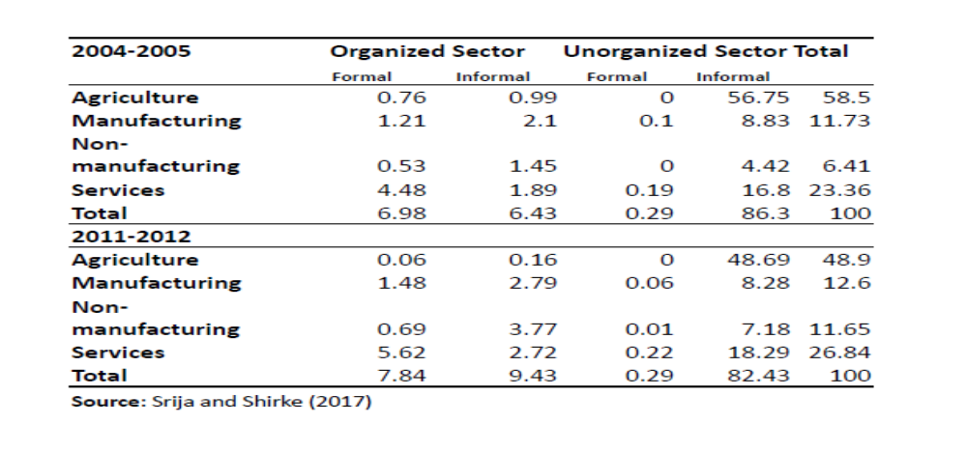
India – high levels of informalization

